Slide 1
Approximation Employed in Spontaneous Emission Theory / D.F. Walls and C.W. Gardiner (Physics Letters 41A (1972))
Roy Elkabetz

Slide 2
Outline
Motivation
Atom – Field Hamiltonian
Derivation of the Wigner - Weisskopf approximations
Comparison between the R.W.A and the Ladder approximation
Conclusions

Slide 3
Motivation
Solving Schrodinger’s equation using non – perturbative methods
Introduce the equivalence of the WW$I$ approximation to the RWA
Show the resemblance between the RWA, the Ladder approximation and the WW$I$ approximation

Slide 4
Background
Two level Atom in radiation field Hamiltonian
radiation
atom
$$H=H_{0}+H_{1}$$
$$H_{0}=\sum_{k}{ℏω_{k}{\hat{a}}_{k}^{†}{\hat{a}}_{k}+ℏω{{\hat{σ}}_{z}}^{}}$$
$\left|g> <e\right|$ atomic operator
$$H_{1}=\sum_{j}{ℏκ_{j}\left({\hat{a}}_{j}^{†}+{\hat{a}}_{j}\right)\left({\hat{σ}}^{+}+{\hat{σ}}^{−}\right) }$$
coupling
constant
creation
of photon
annihilation of photon

Slide 5
Background
Atom – Field Wavefunction
$$|ψ\left(t\right)>=\sum_{n}{c_{n}\left(t\right)e^{−i\frac{E_{n}}{ℏ}t}|n>}$$
eigenstates of $H_{0}$
Schrodinger’s equation:
$$iℏ\frac{∂}{∂t}|ψ\left(t\right)> = H|ψ\left(t\right)>$$

Slide 6
Background
Schrodinger’s Equation
$$iℏ\frac{∂}{∂t}c_{n}\left(t\right)=\sum_{s}{c_{s}\left(t\right)e^{iω_{ns}t}<s|H_{1}|n>}$$
$$ω_{ns}=:\frac{E_{n}−E_{s}}{ℏ}$$

Slide 7
Derivation of the Wigner - Weisskopf Approximations
Wigner – Weisskopf $Ι$ approximation (WW$Ι$)
$|e,0>$
excited atom, no photons
$$|g,1_{k}>$$
atom in ground state, one photon in mode $k$
$$\left|ψ\left(t\right)> =c_{0}\left(t\right)e^{−iω_{0}t}\right|e,0> +\sum_{k}{c_{k}\left(t\right)e^{−iω_{k}t}|g,1_{k} >}$$
$$ω_{0}$$
is the Bohr frequency
$$ω_{k}=ck$$

Slide 8
Derivation of the Wigner - Weisskopf Approximations
Wigner – Weisskopf $Ι$ approximation (WW$Ι$)
$$\left|ψ\left(t\right)> =c_{0}\left(t\right)e^{−iω_{0}t}\right|e,0> +\sum_{k}{c_{k}\left(t\right)e^{−iω_{k}t}|g, 1_{k}>}$$
$$iℏ\dot{c_{n}}\left(t\right)=c_{0}\left(t\right)e^{iω_{n0}t}<g,1_{n}\left|H_{1}\right|e,0>$$
$$iℏ\dot{c_{0}}\left(t\right)=\sum_{k}{c_{k}\left(t\right)e^{−iω_{k0}t}<e,0\left|H_{1}\right|g,1_{k}>}$$
$$ω_{k0}=:ω_{k}−ω_{0}$$

Slide 9
Derivation of the Wigner - Weisskopf Approximations
Wigner – Weisskopf $Ι$ approximation (WW$Ι$)
$$\left|ψ\left(t\right)> =c_{0}\left(t\right)e^{−iω_{0}t}\right|e,0> +\sum_{k}{c_{k}\left(t\right)e^{−iω_{k}t}|g,1_{k} >}$$
$$iℏ\dot{c_{n}}\left(t\right)=c_{0}\left(t\right)e^{iω_{n0}t}<g,1_{n}\left|H_{1}\right|e,0>$$
$$iℏ\dot{c_{0}}\left(t\right)=\sum_{k}{c_{k}\left(t\right)e^{−iω_{k0}t}<e,0\left|H_{1}\right|g,1_{k}>}$$
The WW$Ι$ Approximation

Slide 10
Derivation of the Wigner - Weisskopf Approximations
Solving for $c_{k}\left(t\right)$
$$\left\{\begin{aligned}c_{0}\left(t=0\right)=1 \\ c_{n}\left(t=0\right)=0\end{aligned}\right.$$
Initial conditions:
$$⇒c_{n}\left(t\right)=\frac{1}{iℏ}\int_{0}^{t}{dt^{′}c_{0}\left(t^{′}\right)e^{iω_{n0}t^{′}}<g,1_{n}\left|H_{1}\right|e,0>}$$
$$iℏ\dot{c_{0}}\left(t\right)=\sum_{k}{c_{k}\left(t\right)e^{−iω_{k0}t}<e,0\left|H_{1}\right|g,1_{k}>}$$

Slide 11
Derivation of the Wigner - Weisskopf Approximations
Solving for $c_{k}\left(t\right)$
$$iℏ\dot{c_{0}}\left(t\right)=−iω_{0}c_{0}\left(0\right)$$
$$−\frac{1}{ℏ^{2}}\sum_{n}{{\left|<g,1_{n}\left|H_{1}\right|e,0>\right|}^{2}\int_{0}^{t}{dt^{′}c_{0}\left(t^{′}\right)e^{iω_{n0}(t^{′}−t)}}}$$
Defining the next transformation:
$$\left\{\begin{aligned}α\left(t\right)=c_{0}\left(t\right)e^{iω_{0}t} \\ 𝒩\left(t\right)=\frac{1}{ℏ^{2}}\sum_{n}{{\left|<g,1_{n} \left|H_{1}\right|e,0>\right|}^{2}e^{i\left(ω_{0}−ω_{n}\right)t}}\end{aligned}\right.$$

Slide 12
Derivation of the Wigner - Weisskopf Approximations
Solving for $c_{k}\left(t\right)$
$$iℏ\dot{c_{0}}\left(t\right)=−iω_{0}c_{0}\left(0\right)$$
$$−\frac{1}{ℏ^{2}}\sum_{n}{{\left|<g,1_{n}\left|H_{1}\right|e,0>\right|}^{2}\int_{0}^{t}{dt^{′}c_{0}\left(t^{′}\right)e^{iω_{n0}(t^{′}−t)}}}$$
$$⇓$$
$$\frac{d}{dt}α\left(t\right)=−\int_{0}^{t}{dτ𝒩\left(τ\right)α(t−τ)}$$
$$τ=t−t^{′}$$

Slide 13
Derivation of the Wigner - Weisskopf Approximations
Wigner – Weisskopf $ΙΙ$ approximation (WW$ΙΙ$)
Markov Process:
A Markov process is a process where a future outcome of a system depends only on the present state of itself and not on former states from the past.
Memoryless Process

Slide 14
Derivation of the Wigner - Weisskopf Approximations
Wigner – Weisskopf $ΙΙ$ approximation (WW$ΙΙ$)
$$\frac{d}{dt}α\left(t\right)=−\int_{0}^{t}{dτ𝒩\left(τ\right)α(t−τ)}$$
Recall:
WW$ΙΙ$ approximation $\sim$ Markov process
$$⟹\frac{d}{dt}α\left(t\right)≃−α(t)\int_{0}^{∞}{dτ𝒩\left(τ\right)}$$

Slide 15
Derivation of the Wigner - Weisskopf Approximations
Wigner – Weisskopf $ΙΙ$ approximation (WW$ΙΙ$)
$$⟹c_{0}\left(t\right)=e^{−\frac{Γ_{b}}{2}t}e^{−i\left(ω_{0}+Δ_{b}\right)t}$$
The probability to stay in $|e,0>$ :
$$P\left(t\right)={\left|c_{0}\left(t\right)\right|}^{2}=e^{−Γ_{b}t}$$
Exponential Decay

Slide 16
R.W.A and Ladder Approximation
Rotating Wave approximation (RWA)
$${H_{1}}_{RWA}=ℏ\sum_{j}{κ_{j}({\hat{a}}_{j}{\hat{σ}}^{+}+{\hat{a}}_{j}^{†}{\hat{σ}}^{−})}$$
Annihilate a photon
and excite the atom
create a photon and atom in ground state
The RWA holds for weak intensity and for $ω≈ω_{0}$

Slide 17
R.W.A and Ladder Approximation
Equivalence of WW$Ι$ and RWA
$${H_{1}}_{RWA}=ℏ\sum_{j}{κ_{j}({\hat{a}}_{j}{\hat{σ}}^{+}+{\hat{a}}_{j}^{†}{\hat{σ}}^{−})}$$
$$⇓$$
$$iℏ\dot{c_{n}}\left(t\right)=c_{0}\left(t\right)e^{iω_{n0}t}<g,n\left|{H_{1}}_{RWA}\right|e,0>$$
$$iℏ\dot{c_{0}}\left(t\right)=\sum_{k}{c_{k}\left(t\right)e^{−iω_{k0}t}<e,0\left|{H_{1}}_{RWA}\right|g,k>}$$

Slide 18
R.W.A and Ladder Approximation
Equivalence of WW$Ι$ and RWA
We get the same set of equations as in the WW$Ι$ approximation
The WW$Ι$ approximation and the RWA are equivalent
$$iℏ\dot{c_{n}}\left(t\right)=c_{0}\left(t\right)e^{iω_{n0}t}<g,n\left|{H_{1}}_{RWA}\right|e,0>$$
$$iℏ\dot{c_{0}}\left(t\right)=\sum_{k}{c_{k}\left(t\right)e^{−iω_{k0}t}<e,0\left|{H_{1}}_{RWA}\right|g,k>}$$

Slide 19
R.W.A and Ladder Approximation
Ladder Approximation
$$H=H_{0}+H_{int}$$
$$H_{0}=\sum_{k}{ℏω_{k}{\hat{a}}_{k}^{†}{\hat{a}}_{k}+ℏωσ_{z}}$$
$$H_{int}=−\hat{p}∙\hat{A_{⊥}}$$
Atom basis: $|1>, |0>$
Field basis: $|0>, |1_{a}>,|2_{a}>,…,|n_{a}−1>, |n_{a}>$
Single photon approximation

Slide 20
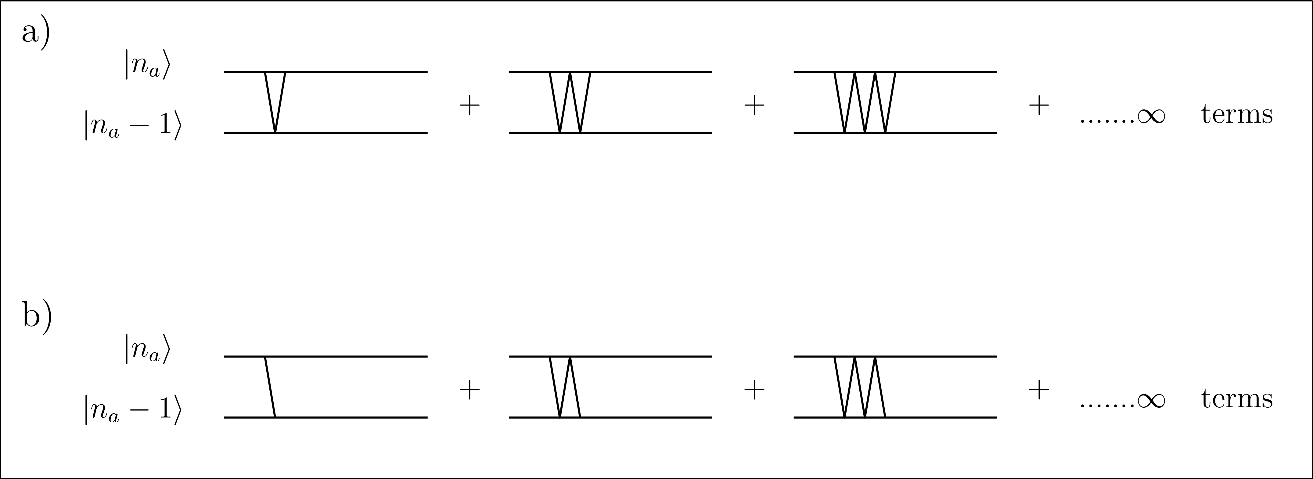
R.W.A and Ladder Approximation
Ladder Approximation: Diagrams
Single photon approximation: $|n_{a}−1>, |n_{a}>$
zero photon scattering, virtual transitions
single photon scattering + virtual transitions
Figure 1: Diagrams included in Ladder approximation

Slide 21
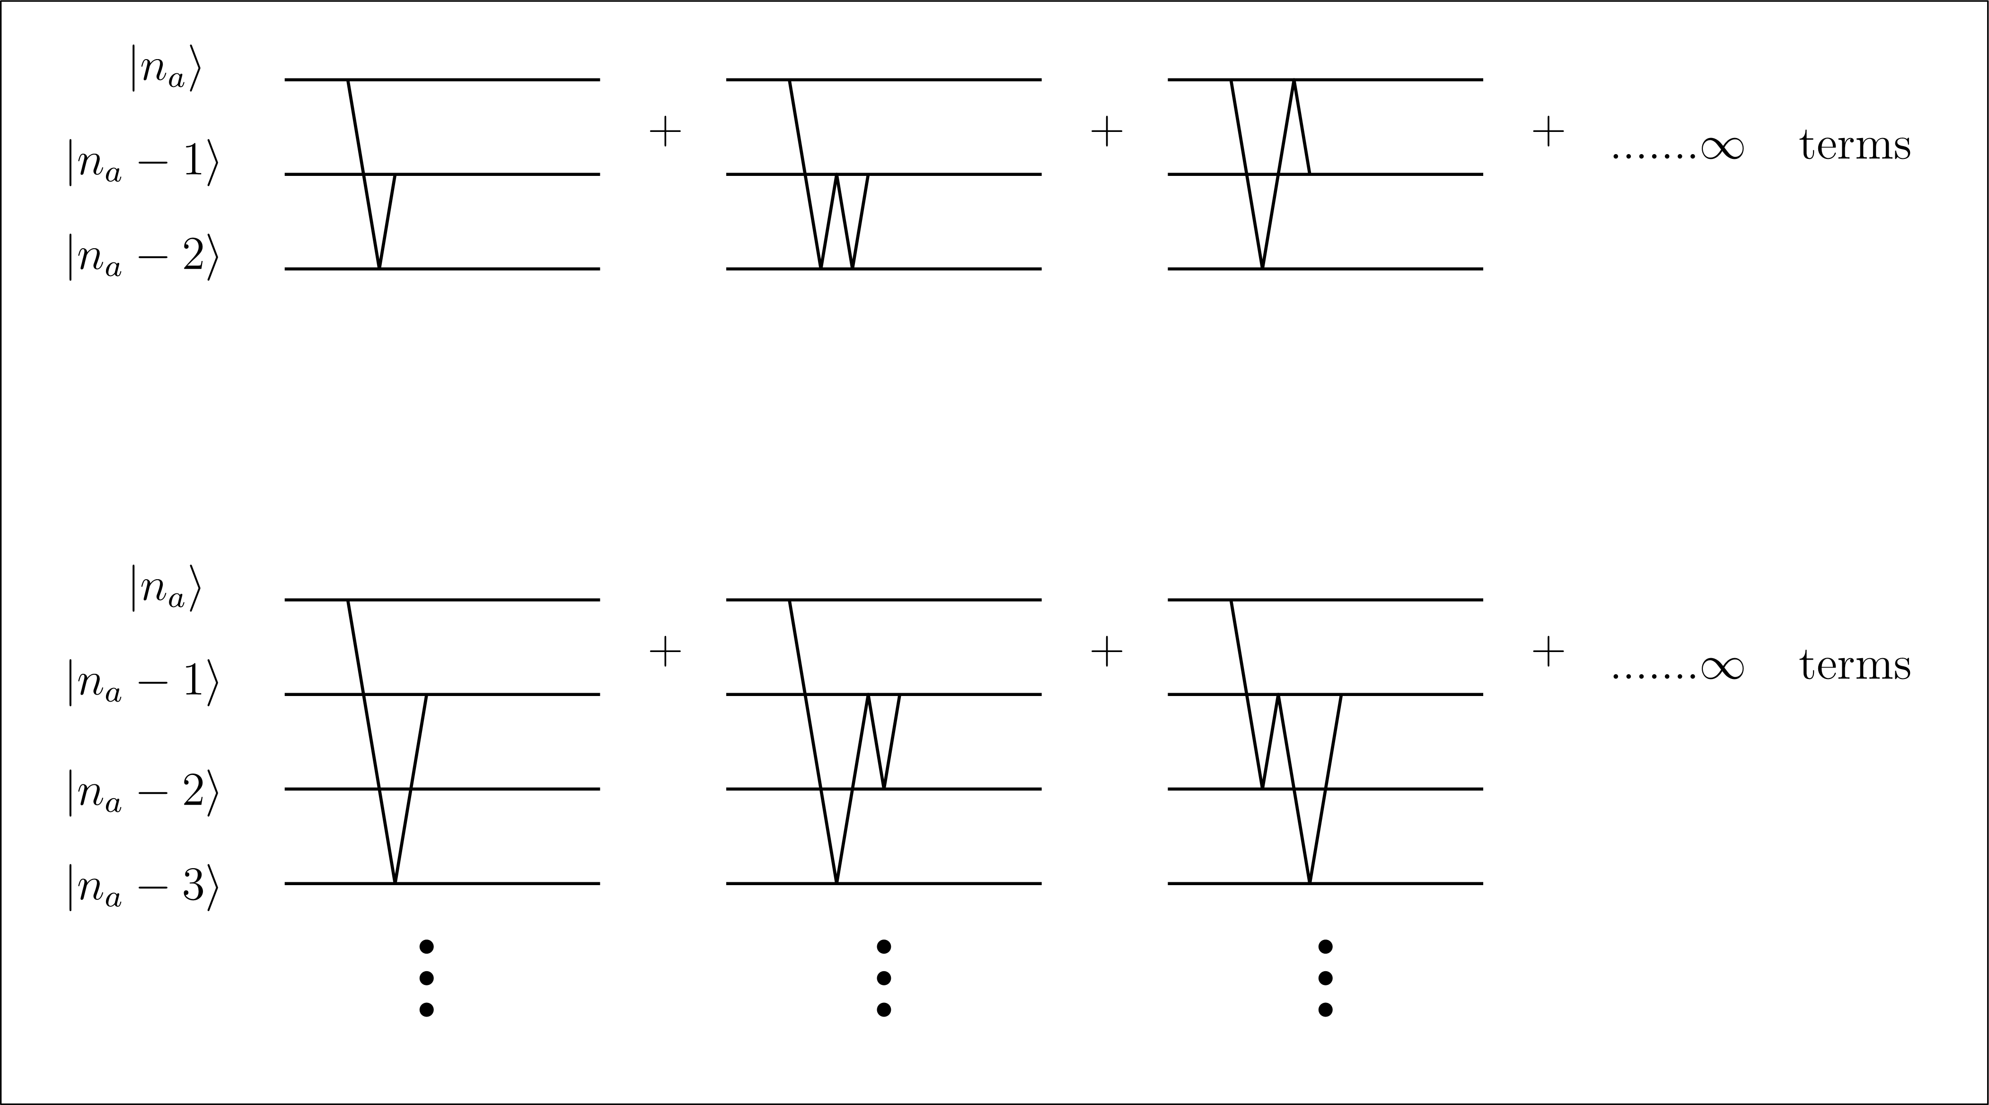
R.W.A and Ladder Approximation
Ladder Approximation: Diagrams
Figure 2: Diagrams excluded from Ladder approximation

Slide 22
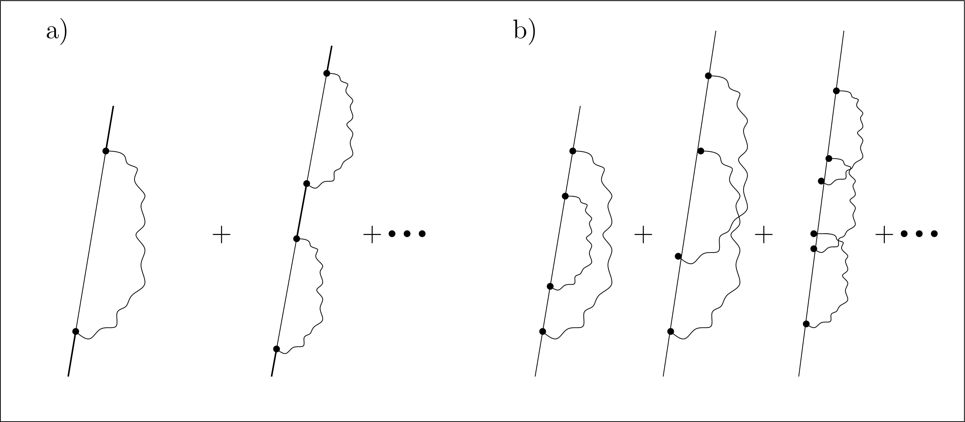
R.W.A and Ladder Approximation
Ladder Approximation: Another Diagrams
Figure 3: a) Diagrams included in Ladder approximation.
b) Diagrams excluded from Ladder approximation.

Slide 23
R.W.A and Ladder Approximation
The Ladder and the WW$I$ Approximations
We sum over infinite number of terms
Notice that $|1,n_{a}−1>, |0,n_{a}>$
$$\sim$$
$$|e,0>, |g,1_{k}>$$
Ladder basis
WW$I$ basis
$⇒$ The Ladder approximation and the WW$I$ approximation has close resemblance

Slide 24
R.W.A and Ladder Approximation
Ladder Approximation and RWA
Under the assumptions:
Single photon process
Close to resonance
$⇒$ There is a close resemblance between the RWA and the Ladder approximation

Slide 25
Conclusions
For spontaneous emission of a two level atom in radiation field
The RWA and the WW$I$ approximation are equivalent
Using the approximations above has a clear superiority over finite perturbation techniques
Under proper assumptions the RWA and the Ladder approximation are with close resemblance

Slide 26
The End
Thank You For Listening

