Slide 1
Presented by Erez Zinman & Aviram Rosochotsky

Slide 2
The structure of the presentation
A Reminder on the derivation the Planck spectral distribution function.
Detailed exposition of Ford and O’Connell’s derivation of the spectral distribution of a radiation cavity in a moving frame of reference.
Exploring the connection to the measured anisotropy of the microwave cosmic background radiation.

Slide 3
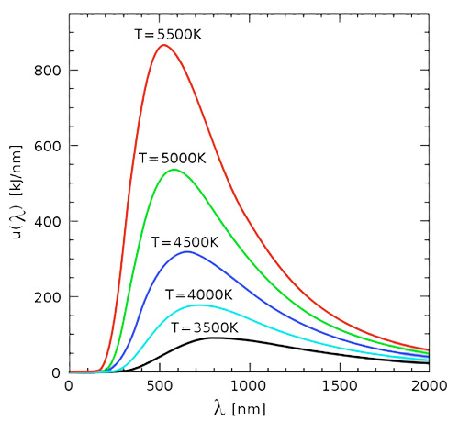
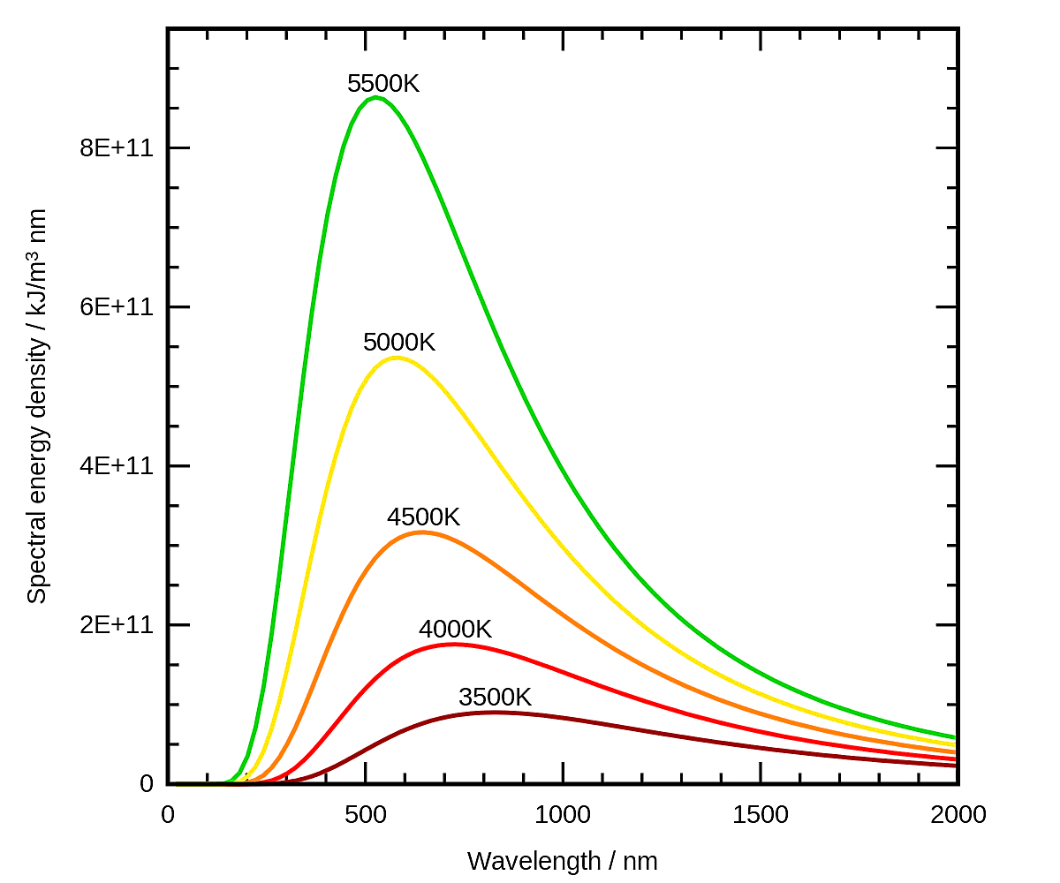
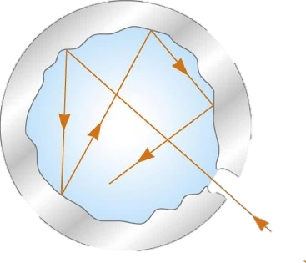
B.B.R – A Quick Reminder
Early in the course, we saw that the distribution function for energy density of modes is Planck distribution:
$$ρ\left(ω,T\right)=\frac{2ℏω^{3}}{π^{2}c^{3}}\frac{1}{e^{βℏω}−1}$$
That distribution follows from the thermalization of the EM radiation with matter.
The black body – a Cavity
$$ρ\left(λ\right) \left[\text{KJ}\text{/}{\text{m}}^{\text{3}}\right]$$
$$ρ\left(λ\right)$$
$$λ \left[\text{KJ}\text{/}{\text{m}}^{\text{3}}\right]$$

Slide 4
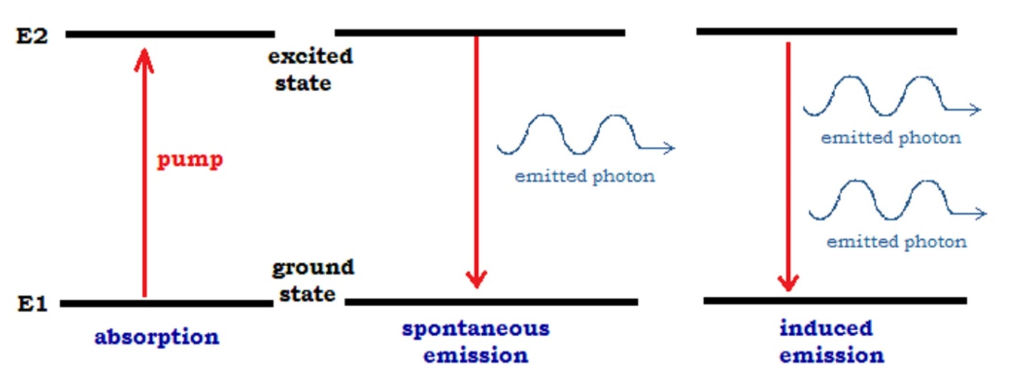
B.B.R – A Quick Reminder
Einstein’s derivation of Planck’s distribution does not require the quantization of the EM field, Only matter is “quantized” in the sense that it has discrete energy spectrum. EM radiation is treated as an ideal fluid.
In the two-level system, matter and radiation are coupled through processes of absorption, stimulated and spontaneous emission.
b
Emitted “photon”
Emitted “photon”
a
stimulating “photon”

Slide 5
BBR – Derivation using quantization of the radiation
Another way to arrive at the Planck distribution is using quantization of radiation inside the cavity:
$$\hat{A}\left(r,t\right)=\sum_{k,s }{\sqrt{\frac{2πℏ}{ωV}}}\left[{\hat{a}}_{k,s}{\hat{ε}}_{k,s}e^{i\left(k⋅r−ωt\right)}+{{\hat{a}}^{†}}_{k,s}{\hat{ε}}_{k,s}^{∗}e^{−i\left(k⋅r−ωt\right)}\right]$$
In this approach, the $k$ mode is a quantum harmonic oscillator.

Slide 6
BBR – Derivation using quantization of the radiation
The energy of the quantized EM field is given by:
$${\hat{U}}_{tot}=\frac{1}{8π}\int_{V}{\text{d}V\left({\hat{E}}^{2}+{\hat{B}}^{2}\right)}=\sum_{k,s}{{\hat{U}}_{k,s}}$$
Where
$$\hat{E}\left(r,t\right)=−∂_{t}\hat{A}\left(r,t\right), \hat{B}\left(r,t\right)=∇×\hat{A}\left(r,t\right)$$
And for a single mode:
$${\hat{U}}_{k,s}=ℏω_{k}\left({\hat{a}}_{k,s}{\hat{a}}_{k,s}^{†}+{\hat{a}}_{k,s}^{†}{\hat{a}}_{k,s}\right)=ℏω_{k}\left({\hat{N}}_{k,s}+\frac{1}{2}\right)$$

Slide 7
BBR – Derivation using quantization of the radiation
Assuming thermodynamic equilibrium with the cavity at temperature $T$, the partition function of the mode $k$ in polarization $s$ is given by:
$$𝒵_{k,s}=\sum_{n=0}^{∞}{e^{−βE_{n}\left(k,s\right)}}=e^{−\frac{βℏω_{k}}{2}}\sum_{n=0}^{∞}{e^{−βℏω_{k}n}}=\frac{\exp\left(−{\left(βℏω_{k}\right)}/2\right)}{1−\exp\left(−βℏω_{k}\right)}$$
Then the average number of photons in this mode is:
$$\left\langle {\hat{N}}_{k,s}\right\rangle =\frac{1}{\exp\left(βℏω_{k}\right)−1}$$

Slide 8
BBR – Derivation using quantization of the radiation
Using the above result:
$$\left\langle U_{k,s}\right\rangle ∝\left\langle {\hat{a}}_{k,s}{\hat{a}}_{k,s}^{†}+{\hat{a}}_{k,s}^{†}{\hat{a}}_{k,s}\right\rangle =\left\langle 2{\hat{N}}_{k,s}+1\right\rangle =\coth\left(\frac{ℏω_{k}}{{2k}_{B}T}\right)$$
Since $\left[{\hat{a}}_{k,s},{\hat{a}}_{k^{′},s^{′}}^{†}\right]=δ_{k,k^{′}}δ_{s,s^{′}}$, then:
$$\left\langle {\hat{a}}_{α}{\hat{a}}_{β}^{†}\right\rangle ∝\sum_{n_{α},m_{β}}{e^{−βE\left(n_{α},m_{β}\right)}}\left\langle n_{α},m_{β} | {\hat{a}}_{α}{\hat{a}}_{β}^{†} | n_{α},m_{β}\right\rangle ∝δ_{α,β}$$
And so:
$$\left\langle {\hat{a}}_{k,s}{\hat{a}}_{k^{′},s^{′}}^{†}+{\hat{a}}_{k,s}^{†}{\hat{a}}_{k^{′},s^{′}}\right\rangle =\coth\left(\frac{ℏω_{k}}{{2k}_{B}T}\right)δ_{k,k^{′}}δ_{s,s^{′}}$$

Slide 9
BBR – Derivation using Quantization of the Radiation
Now that we have the average number of photons in each mode, we can calculate the energy density:
$$\left\langle {\hat{U}}_{tot}\right\rangle =\frac{1}{8π}\int_{V}{\text{d}V\left({⟨E}^{2}⟩ +\left\langle B^{2}\right\rangle \right)}≡\int_{V}{W\left(r,t\right)\text{d}V}$$
Where
$$W\left(r,t\right)=\frac{1}{8π}\left({⟨E}^{2}⟩ +\left\langle B^{2}\right\rangle \right)$$

Slide 10
BBR – Derivation using Quantization of the Radiation
By taking $\hat{E}\left(r,t\right)=−∂_{t}\hat{A}\left(r,t\right)$, we find that:
$$\left.\begin{aligned}\left\langle E_{j}\left(r,t\right)E_{m}\left(0,0\right)\right\rangle =\sum_{k,s,k^{′},s^{′}}{ }\frac{2πℏ\sqrt{ωω^{′}}}{V}×&\left(e^{i\left(k⋅r−ωt\right)}{\hat{ε}}_{s,j}{\hat{ε}}_{s^{′},m}^{∗}\left\langle {\hat{a}}_{k,s}{\hat{a}}_{k^{′},s^{′}}^{†}\right\rangle \right. \\ & +\left.e^{−i\left(k⋅r−ωt\right)}{\hat{ε}}_{s,j}^{∗}{\hat{ε}}_{s^{′},m}\left\langle {\hat{a}}_{k,s}^{†}{\hat{a}}_{k^{′},s^{′}}\right\rangle \right)\end{aligned}\right.$$
( We remember that $\left\langle {\hat{a}}_{k,s}^{†}{\hat{a}}_{k^{′},s^{′}}\right\rangle ∝δ_{k,k^{′}}δ_{s,s^{′}}$ and set $k=k^{′},s=s′$. )

Slide 11
Recalling the expression for energy density:
$$W=\frac{1}{16π^{3}}\int{{\text{d}}^{3}k}ℏω\left(δ_{jm}−{\hat{k}}_{j}{\hat{k}}_{m}\right)\cos\left(k⋅r−ωt\right)\coth\left(\frac{ℏω_{k}}{{2k}_{B}T}\right)$$
We use the following change of variables:
$$\int{{\text{d}}^{3}k}=\int{\text{d}Ω}\int_{0}^{∞}{{\left|k\right|}^{2}\text{d}\left|k\right|}=\frac{1}{c^{3}}\int{\text{d}Ω}\int_{0}^{∞}{ω^{2}\text{d}ω}$$
Since $ω=c\left|k\right|$. We arrive at the expression:
$$\begin{aligned}W=\int{\text{d}Ω}\int_{0}^{∞}{ \text{d}ω}\underbrace{\left[\frac{1}{{\left(2πc\right)}^{3}}ℏω^{3}\coth\left(\frac{ℏω}{{2k}_{B}T}\right)\right]} \\ ≡ρ\left(ω,θ,φ \right)\end{aligned}$$
$ρ\left(ω,\hat{k}\right)$ is the spectral
density function!

Slide 12
$$ρ\left(ω,\hat{k}\right)=\frac{1}{{\left(2πc\right)}^{3}}ℏω^{3}\coth\left(\frac{ℏω}{{2k}_{B}T}\right)$$
We note the following:
Obviously, there’s an independence of the energy density upon the direction of the EM wave ($\hat{ k}$), as to be expected.
Without the inclusion of the zero-point energy ($E_{0}=\frac{1}{2}ℏω$), the density becomes:
$$ρ\left(ω,\hat{k}\right)=\frac{2}{{\left(2πc\right)}^{3}}ℏω^{3}\frac{1}{e^{βℏω}−1}=\frac{1}{4π}\left(\frac{2}{π^{2}c^{3}}ℏω^{3}\frac{1}{e^{βℏω}−1}\right)$$ Which means that $ρ\left(ω,\hat{k}\right)=\frac{1}{4π}ρ\left(ω\right)$ that we’ve seen in class.

Slide 13
We now repeat this calculation for a moving observer!
We begin by Lorentz-transforming the fields and variables from $S$ to $S^{′}$.

Slide 14
The Physical System
$$S=\left(t,r\right)$$
An observer at a frame $S^{′}$ that moves at a velocity $v$ relative to the cavity’s rest frame $S$.
$$v=βc\hat{v}$$
$$S^{′}=\left(t^{′},r^{′}\right)$$
A black body at a frame $S$ and temperature $T$, has the energy density $ρ\left(ω,T\right)$ of the EM field mode with frequency $ω$.
At the frame $S$, the energy density is isotropic.

Slide 15
Lorentz Transformation
$$ct^{′}=γ\left(ct−β\left(r⋅\hat{v}\right)\right)$$
$$r^{′}=r+\left(γ−1\right)\left(r⋅\hat{v}\right)\hat{v}−γ\left(ct\right)β\hat{v}$$
$$E^{′}\left(r^{′},t^{′}\right)=γ\left[E\left(r,t\right)+β\hat{v}×B\left(r,t\right)\right]−\left(γ−1\right)\left[E\left(r,t\right)⋅\hat{v}\right]\hat{v}$$
$$B^{′}\left(r^{′},t^{′}\right)=γ\left[B\left(r,t\right)−β\hat{v}×B\left(r,t\right)\right]−\left(γ−1\right)\left[B\left(r,t\right)⋅\hat{v}\right]\hat{v}$$
( $v=βc\hat{v}$ is the velocity of $S^{′}$ )

Slide 16
the energy density At $S^{′}$
For the moving observer at $S^{′}$, the energy density transforms as:
$$W^{′}\left(r,t\right)=\frac{1}{8π}\left(\left\langle E^{′2}\right\rangle +\left\langle B^{′2}\right\rangle \right) \\ =\frac{1}{4π}\left(γ^{2}\left(1+β^{2}\right)\left\langle E_{i}E_{i}\right\rangle −2γ^{2}β^{2}{\hat{v}}_{i}{\hat{v}}_{j}\left\langle E_{i}E_{j}\right\rangle +2βγ^{2}{\hat{v}}_{i}ε_{ijk}\left\langle E_{j}B_{k}\right\rangle \right) \\ =… \\ =\int{\text{d}Ω}\int_{0}^{∞}{\text{d}ω}\coth\left(\frac{ℏω}{2k_{B}T}\right)γ^{2}\frac{ℏω^{3}}{{\left(2πc\right)}^{3}}{\left(1−β\hat{v}⋅\hat{k}\right)}^{2}$$

Slide 17
the energy density At $S^{′}$
Identifying the expression for the spectral density $ρ\left(ω,\hat{k}\right)$ at the rest frame $S$, and defining the spectral density $ρ^{′}\left(ω^{′},{\hat{k}}^{′}\right)$ in the frame $S^{′}$:
$$W^{′}\left(r,t\right)=\int{\text{d}Ω}\int_{0}^{∞}{\text{d}ω}γ^{2}{\left(1−β\hat{v}⋅\hat{k}\right)}^{2}ρ\left(ω,\hat{k}\right)≡\int{\text{d}Ω^{′}}\int_{0}^{∞}{\text{d}ω^{′}}ρ^{′}\left(ω^{′},{\hat{k}}^{′}\right)$$
$$ρ^{′}\left(ω^{′},{\hat{k}}^{′}\right)=γ^{2}{\left(1−β\hat{v}⋅\hat{k}\right)}^{2}\frac{\text{d}ω}{\text{d}ω^{′}}\frac{\text{d}Ω}{\text{d}Ω^{′}}ρ\left(ω,\hat{k}\right)$$
To proceed, we need to introduce the Lorentz-transformation of angles ($\hat{v}⋅\hat{k}$) and of frequencies $ω$.

Slide 18
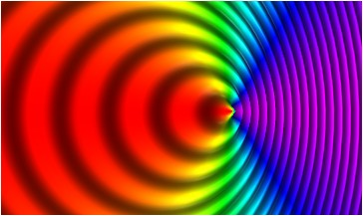
Lorentz-Transformation – Reminder
The set $\left(ω,ck\right)$ transforms like $\left(ct,r\right)$:
$$ω^{′}=γ\left(ω−β\left(ck⋅\hat{v}\right)\right) \\ ck^{′}=ck+\left(γ−1\right)\left(ck⋅\hat{v}\right)\hat{v}−γωβ\hat{v}$$
Hence, the Doppler shift, and aberration formulae are:
$ω^{′}=$ $γ\left(1−β\hat{v}⋅\hat{k}\right)ω$
$${\hat{k}}^{′}⋅\hat{v}=\frac{\hat{k}⋅\hat{v}−β}{1−β\hat{v}⋅\hat{k}}$$
$$θ^{′}$$
$$θ$$
$$x^{′}$$
$$x$$

Slide 19
Back to transforming the B.B.R
Since $\hat{k}⋅\hat{v}=\cos\left(θ\right)$, $\text{d}Ω=−\text{d}\left(\cos\left(θ\right)\right)\text{d}φ$, and similarly in the $S^{′}$ frame:
$$\frac{\text{d}Ω}{\text{d}Ω^{′}}=\frac{\text{d}\left(\cos\left(θ\right)\right)}{\text{d}\left(\cos\left(θ^{′}\right)\right)}=\frac{\text{d}\left(\hat{k}⋅\hat{v}\right)}{\text{d}\left({\hat{k}}^{′}⋅\hat{v}\right)}$$
By applying the inverse transformation, we also get to:
$$\frac{\text{d}ω}{\text{d}ω^{′}}=γ\left(1+β\hat{v}⋅{\hat{k}}^{′}\right)$$
$$\hat{v}$$
$$r$$
$$r^{′}$$
$$θ^{′}≠θ$$
$$φ^{′}=φ$$

Slide 20
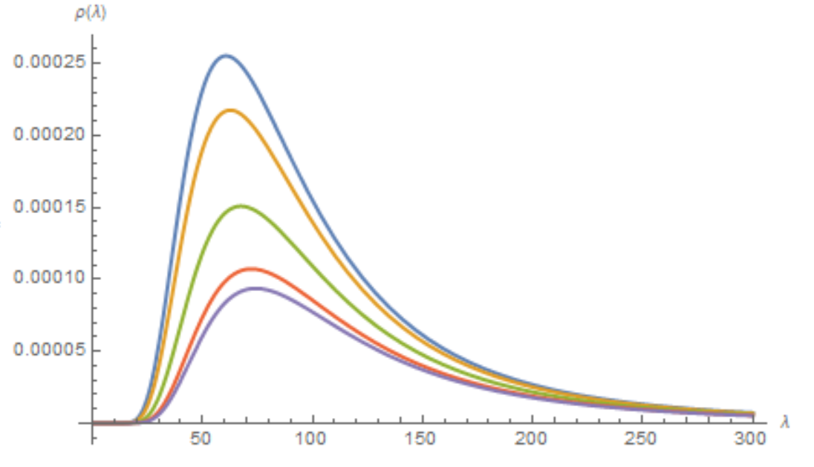
Finally, we get the spectral density as seen by the moving observer:
$$ρ^{′}\left(ω^{′},{\hat{k}}^{′}\right)=\frac{ℏω^{′3}}{{\left(2πc\right)}^{3}}\coth\left(γ\left(1+β\hat{v}⋅{\hat{k}}^{′}\right)\frac{ℏω^{′}}{{2k}_{B}T}\right)$$
(Black Body)
Some remarks about this result:
It is no longer isotropic.
The parameter $T$ is defined to be the temperature at the rest frame $S$. It need not Lorentz-transform.
This result was obtained in 1968 by Peebles and Wilkinson by assuming that photon-number is Lorentz-invariant.
$$k^{′}$$
$$θ^{′}$$
$$\hat{v}⋅{\hat{k}}^{′}=cos\left(θ^{′}\right)$$
$$v$$
For $β=0.3$
$$θ^{′}=0$$
$$θ^{′}=π/4$$
$$ρ^{′}\left(λ^{′}\right)$$
$$θ^{′}=π/2$$
$$θ^{′}={3π}/4$$
$$θ^{′}=π$$
$$λ^{′}$$

Slide 21
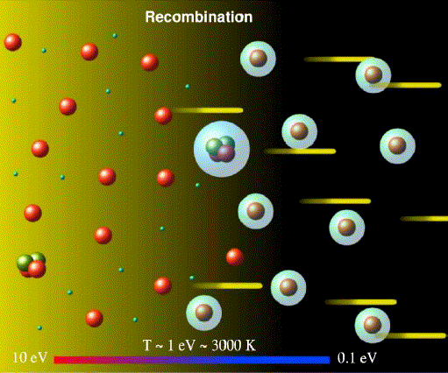
An application – The Cosmic Microwave Background (CMB)
The CMB radiation is the remnant blackbody radiation field of the plasma of the primordial universe.
The CMB radiation is a picture the equilibrium (Planck) distribution from before recombination and is therefore a BBR to a great accuracy.
Different satellites orbiting the earth measure this radiation in different directions of the sky.
( This discussion follows Heer and Kohl (1968) and Peebles and Wilkinson (1968). )

Slide 22
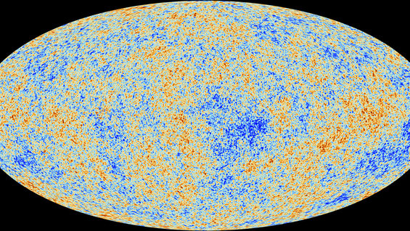
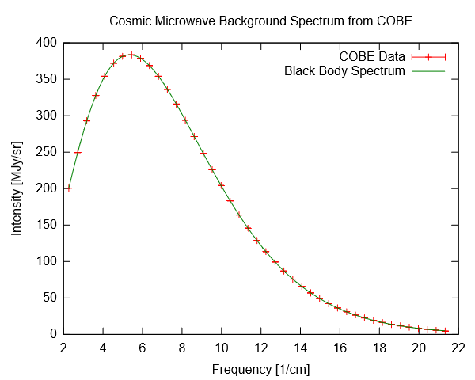
The results are maps depicting the temperature fluctuation of this radiation field.
CMB is highly isotropic and homogeneous, with only slight intrinsic variations from BBR resulting from high-energy physics of the early (hot) universe.
The spectral density of the CMB is best realization of Planck blackbody distribution yet.

Slide 23
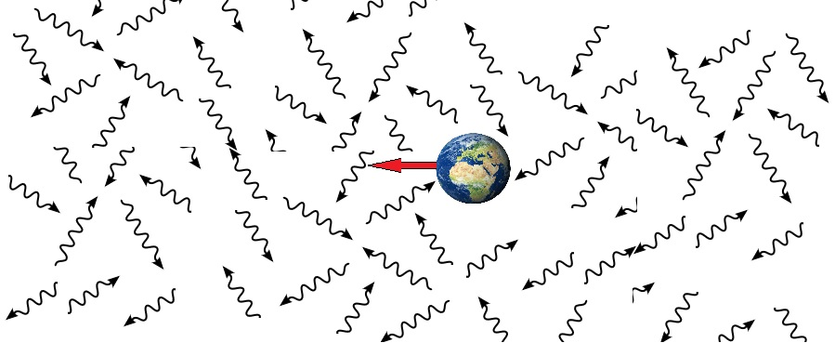
The dipole anisotropy of CMB.
However there is another feature of CMB which we will focus on – a dipole anisotropy that is caused by the motion of the earth with respect to the frame in which CMB is isotropic.
An observer moving trough the CMB would detect a redshift in the direction opposite to it’s direction of motion, and a blueshift in that direction.

Slide 24
Detecting the CMB Anisotropy
By allowing an antenna with a response frequency $ω$ to come to equilibrium with the CMB, it follows from the distribution function that was obtained previously, that antenna would be exposed to the transformed spectral function:
$$ρ\left(ω,k\right)=\frac{ℏω^{3}}{{\left(2πc\right)}^{3}}\coth\left(\frac{ℏω}{2k_{B}T_{\text{ant}}\left(\hat{k}\right)}\right)=\frac{ℏω^{3}}{{\left(2πc\right)}^{3}}\coth\left(γ\left(1+β\hat{v}⋅\hat{k}\right)\frac{ℏω}{{2k}_{B}T}\right)$$
So it will attain the temperature:
$$T_{\text{ant}}=T\frac{1}{γ\left(1+β\hat{k}∙\hat{v}\right)}=T\frac{1}{γ\left(1+β\cos\left(θ\right)\right)}$$
(Here, all variables are in the moving observer frame.)

Slide 25
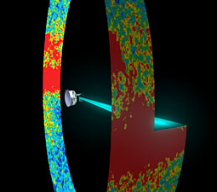
By placing two antennas at opposite angles with respect to each other, the following expression may be measured,
$$\frac{T\left(θ+π\right)−T\left(θ\right)}{T\left(θ+π\right)+T\left(θ\right)}=β\cos\left(θ\right)$$
from this expression it is possible to determine both $θ$ and the velocity of the.
$$θ$$

Slide 26
By decomposing the temperature map into multipoles it is possible to obtain the dipole anisotropy.
The motion of the earth in CMB results in an increase of the dipole term in the harmonic decomposition. Hence:
$${\left(\frac{∆T}{T}\right)}_{l=1}≃{10}^{−3}, {\left(\frac{∆T}{T}\right)}_{l>1}≃{10}^{−5}$$
$$v$$
$$l=1$$
$$\frac{∆T}{T}=\sum_{l.m}{a_{lm}}Y_{lm}^{∗}\left(\hat{n}\right)$$
$$l=16$$

Slide 27
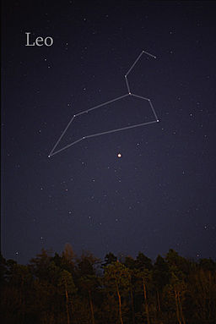
Modern measurements
Average temperature of CMB radiation: $\sim 2.7°\text{K}.$
Temperature variance due to the earth’s motion: $\sim \text{0.0034}°\text{K}$
These results are equivalent to a peculiar motion of roughly $600 \text{Km}\text{/}\text{hr}$ in the direction of the constellation Leo.

Slide 28
Implications on the principle of relativity.
According to the principle of relativity one should not be able to perform a local experiment that would reveal one’s velocity with respect to a preferred frame.
However, as was shown, any observer can determine his velocity with respect to CMB by measuring the CMB dipole anisotropy!

Slide 29
Is this a violation of the principle of relativity?
No!
The POR requires that the laws of physics be Lorentz invariant but it does not exclude something like “spontaneous symmetry breaking”.
The CMBR “spontaneously selects“ a specific (“preferred”) inertial reference frame which is the only one where the spectral distribution is isotropic.

Slide 30
From Ford and O’Connell’s result, for $T=0$ the spectral distribution becomes invariant of frame:
$$ρ\left(ω′,k′\right)=ℏ{\left(\frac{ω′}{2πc}\right)}^{3}\coth\left(\frac{γ\left(1+β{\hat{k}}^{′}∙\hat{v}\right)ℏω′}{2k_{B}T}\right)\underset{T→0}{⟶}ℏ{\left(\frac{ω′}{2πc}\right)}^{3}$$
$$ρ\left(ω,\hat{k}\right)=ℏ{\left(\frac{ω}{2πc}\right)}^{3}\coth\left(\frac{ℏω}{2k_{B}T}\right)\underset{T→0}{⟶}ℏ{\left(\frac{ω}{2πc}\right)}^{3}$$
This is consistent with QED having a Lorentz-invariant ground state, and the CMB are an “excited states” of the physical theory.

Slide 31
Is this a violation of the principle of relativity?
“ Lorentz invariance is clearly broken on large scales by cosmology, which does provide us with a preferred frame, namely the frame in which the Cosmic Microwave Background Radiation (CMBR) is spatially isotropic, and to a good 1st approximation, Hubble friction provides a dynamical explanation for why all observers come to rest in this frame. But we normally don't think of the CMBR or other cosmological fluids as “spontaneously breaking” Lorentz invariance – we instead think of them as excited states of a theory with a Lorentz invariant ground state. Indeed, the expanding universe redshifts away the CMBR, till in the deep future the universe is empty and Lorentz invariance (or de Sitter invariance) is recovered. Also, Lorentz invariance is certainly a good symmetry locally on scales much smaller than the cosmological horizon. ”
- Arkani-Hamed, Cheng, Luty and Thaler (2005)

Slide 32
To Sum-up…
Black-body radiation – Classical and quantum derivations yield similar expressions (up to the zero-point energy).
Movement with respect to the black-body results in different spectral energy.
Applying the above results to the cosmic microwave background radiation will give us the CMB’s rest frame.
The existence of such rest frame could challenge the validity of special relativity.

Slide 33
Bibliography
Ford, G. W., & O'Connell, R. F. (2013). Lorentz transformation of blackbody radiation. PHYSICAL REVIEW E.
Arkani-Hamed, N., Cheng, H.-C., Luty, M., & Thaler, J. (2005). Universal dynamics of spontaneous Lorentz violation and a new spin-dependent inverse-square law force. Journal of High Energy Physics.
Heer, C. V., & Kohl, R. H. (1968). Theory for the Measurement of the Earth's Velocity through the 3°K Cosmic Radiation. Physical Review, 1611-1614.
Knight, C. C., & Knight, P. L. (2005). Introductory Quantum Optics. Cambridge: Cambridge University Press.
Peebles, P. J., & Wilkinson, D. T. (1968). Comment on the Anisotropy of the Primeval Fireball. Physical Review, 2168.

