Slide 1
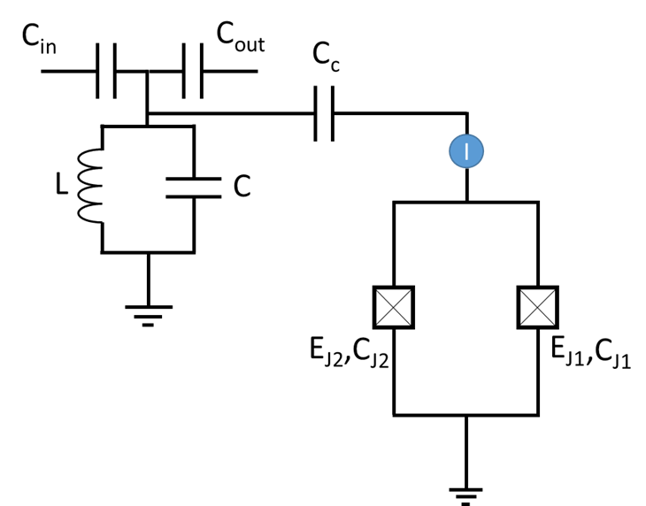
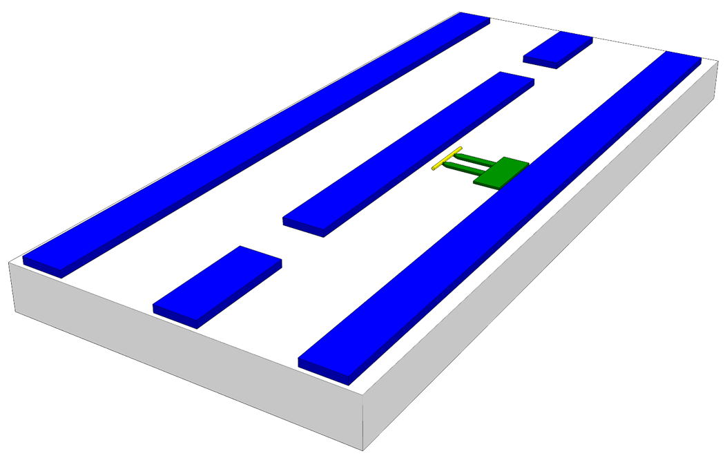
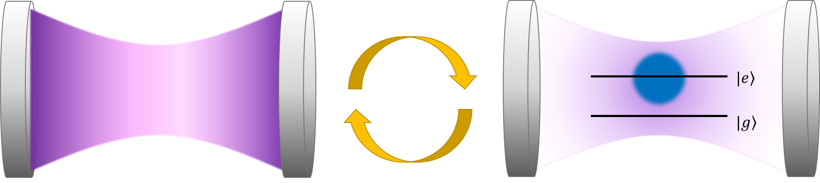
Cavity Quantum Electrodynamics for Superconducting Electrical Circuits
Alexandre Blais, Ren-Shou Huang, Andreas Wallraff, S.M. Girvin and R.J. Schoelkopf
PRA 69, 062320 (2004)
Dima Panna
Shlomi Bouscher

Slide 2
Outline
Cavity Quantum Electrodynamics - review
Circuit Implementation of CQED
Superconducting 1D cavity
Artificial Atom- Cooper Pair Box
Charging Effect
Cooper Pair Box Physics
Combined System

Slide 3
Motivation
Macroscopic analog of atomic physics experiments
Strong light matter coupling on chip
Spontaneous emission inhibition
Quantum computing and control

Slide 4
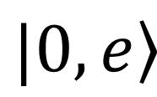
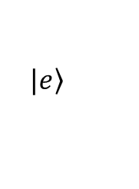
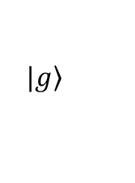
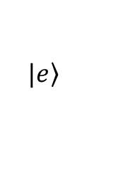
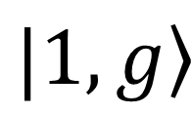
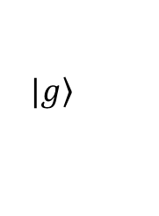
Cavity Quantum Electrodynamics (CQED)
$$|e〉$$
$$|e〉$$
$$|g〉$$
$$|g〉$$
$$|0,e〉$$
$$|1,g〉$$

Slide 5
Circuit Implementation of Cavity QED
Superconducting “Mirror”
Superconducting Cavity
Artificial Atom
-
Cooper Pair Box
Silicon Substrate
Superconducting “Mirror”

Slide 6
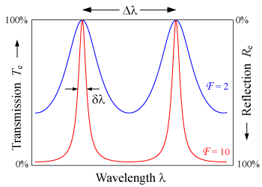

Circuit Implementation of CQED
Niobium
Silicon Substrate
L
C

Slide 7
Cooper Pair Box as an Artificial Atom – Josephson Junction
Cooper Pair
Superconducting condensate composed of Cooper-pairs
Condensate is non-dissipative and has some defined global phase
e
e
Josephson Junction – SIS junction – 2 weakly linked SC condensates
Josephson Junction
S
I
S

Slide 8
Cooper Pair Box as an Artificial Atom – Josephson Junction
Cooper Pair
Junction dynamics described through two key relations:
The First Josephson Relation
The Second Josephson Relation
e
e
Josephson Junction
Josephson Energy:
S
I
S
Physical meaning: Kinetic energy of charge carriers
Moving through the junction
C_{J}
E_{J}

Slide 9
Cooper Pair Box as an Artificial Atom – DC SQUID
S
Fine tuning $E_{J}$ through magnetic flux Φ (DC-SQUID):
S
S
Superconducting Island
Josephson Junctions
Source Electrode
DC SQUID

Slide 10
Island and Charging Effect
-
-
-
-
-
-
-
-
-
-
-
-
Island
-
-
-
-
-
-
-
-
-
-
-
-
-

Slide 11
Island and Charging Effect
Island
C
C_{g}
GATE
-q₁
q₁
-q₂
q₂
-
-
-
-
-
SOURCE
Island
-
-
Vg
-
-
-
-
-
-
-
Vg
L | C (4π*L) | Ec | T
10um | 1.1fF | 70ueV | 0.84K (³He)
1um | 0.11fF | 0.7meV | 8.4K (LHe)
0.1um | 0.011fF | 7meV | 84K (LN₂)
0.01um | 1.1aF | 70meV | 840K (spa)

Slide 12
Charge quantization on the island
N=-3
N=-2
N=-1
N=0
N=1
N=2
N=3

Slide 13
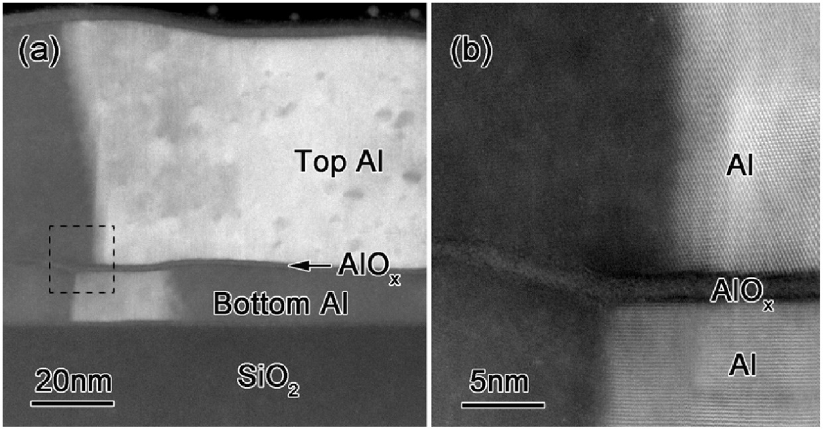
Island Insulation
Affecting charge while keeping it localized – Conflicting demands
R
SOURCE
Island
C
L J Zeng et.al., Journal of Physics D: Applied Physics, Volume 48, Number 39
Aluminum native oxide 1.5nm

Slide 14
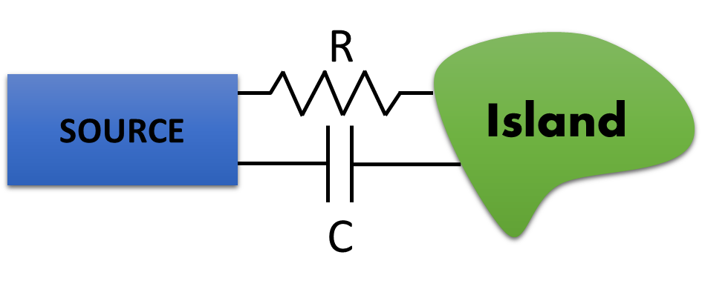
Cooper Pair Box
Combine Josephson junction with island structure
e
e
Superconductor
C_{J}
N=-4
N=-2
N=0
N=2
N=4
E_{J}
E_{J}
,C_{J}

Slide 15
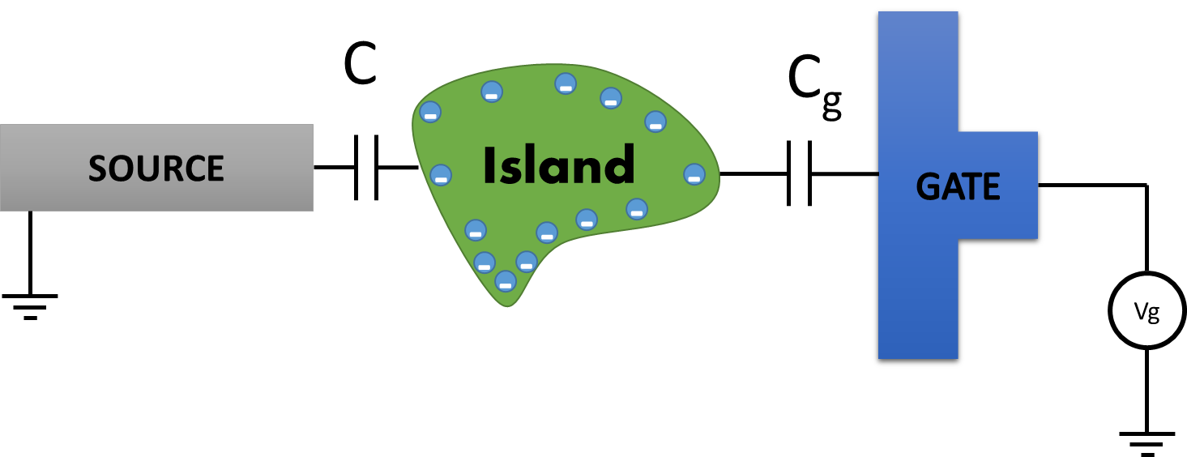
Charge Qubit
Classical Equation of Motion
Classical Lagrangian
E_{J1}
,C_{J1}
C_{g}
I
E_{J2}
,C_{J2}
Vg

Slide 16
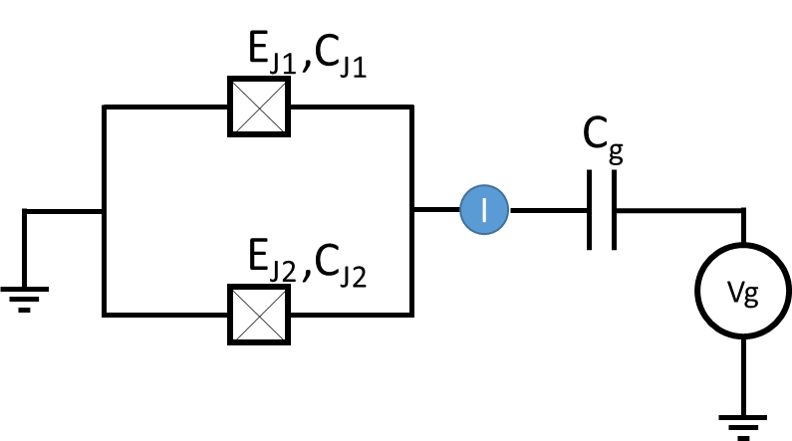
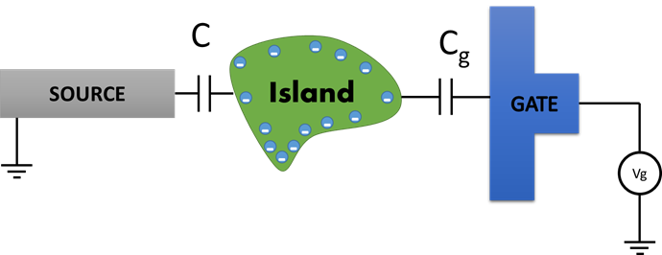
Charge Qubit
Express Hamiltonian in the N basis
State with a certain charge N is a “plane wave” in phase representation
Final Hamiltonian
Charging Energy
Josephson Energy

Slide 17
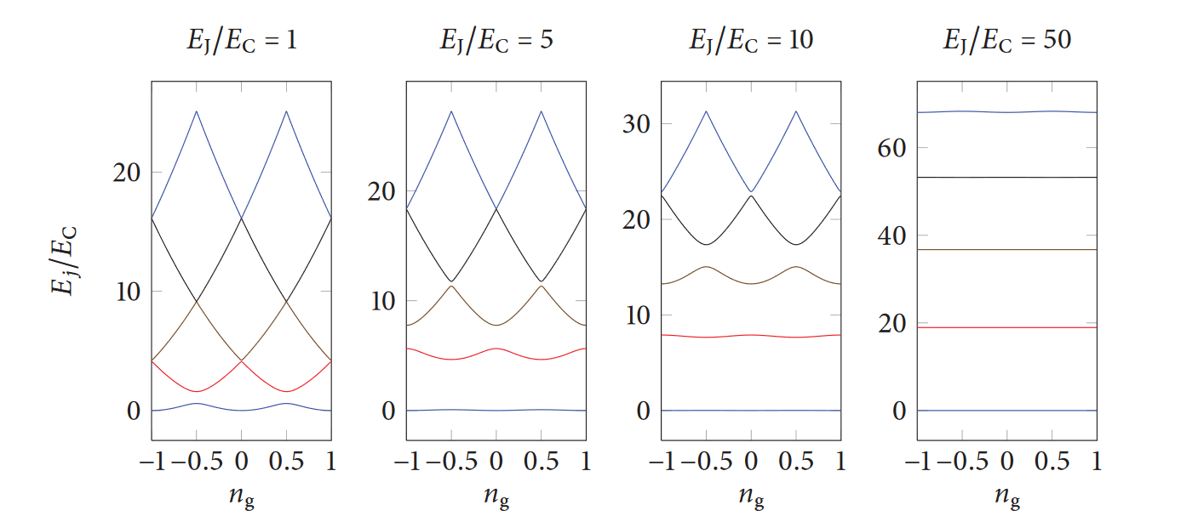
Charge Qubit
1
10
0
50
Joesphson Energy lifts degeneracy

Slide 18
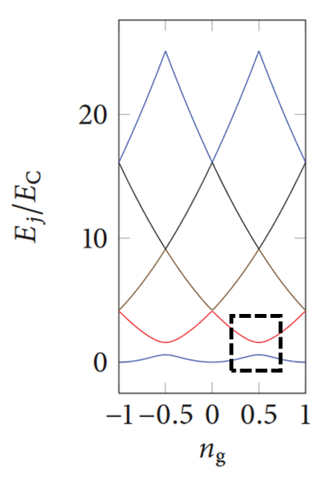
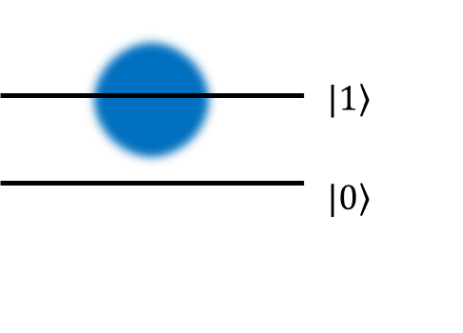
Two level system
Island
Island
Cooper Pair box mapped to a pseudospin -1/2 particle description
e
e
E_{J1}
,C_{J1}
C_{g}
I
E_{J2}
,C_{J2}
Vg

Slide 19

Combined System

Slide 20
Combined System

Slide 21
Conclusion and Remarks
Conventional QED system mapped to macroscopic QED system
1D Cavity offers strong dipole interaction due to field confinement
Overall structure (relatively) simple to fabricate and scale up (multiple cavities and qubits)
Multiple qubits can be placed in same cavity and addressed via different modes

Slide 22
Questions?

