Slide 1
Presented by
Gilad Laredo
Atom-photons interactions 118137
Spring 2017

Slide 2
Introduction
$$2bcosωt$$
System evolves according to Schrödinger eq.
Notes:
2 level system with oscillating interaction:

Slide 3
But how do we solve this?
Difficult…
?
By the RWA:
Easy…
RWA = rotating wave approximation

Slide 4
Paper goal
Present methods and results obtained while solving the transition probability for:
Without the rotating wave approximation
time independent Hamiltonian Infinite matrix representation
Time periodic Hamiltonian
Floquet theorem

Slide 5
time independent Hamiltonian Infinite matrix representation
Time periodic Hamiltonian
Floquet theorem
Generalize the problem:
: Constant diagonal matrix
Generalize the problem:
Step 1 – determine general form of solution (Floquet):
: Matrix of periodic functions
Step 2 – equivalence to (infinite) eigenvalue problem.
Step 3 – express time-evolution operator:

Slide 6
Eigenvalue equation for
“Floquet Hamiltonian”
Greek letters – atomic states
Roman letters – Fourier components

Slide 7
- Floquet Hamiltonian
An example

Slide 8
“Floquet state”

Slide 9
Time evolution operator
Using:
the periodic structure of
The unitarity of
Is a complete set
Some calculations…
Time evolution operator of
Transition amplitude in Floquet space

Slide 10
Relation to Quantized Field Theory
Time evolution operator of
Transition amplitude in Floquet space
The transition amplitudes in Floquet space is the Fourier series coefficients of the time evolution operator(!)
the resolvant operator is the Fourier transform of

Slide 11
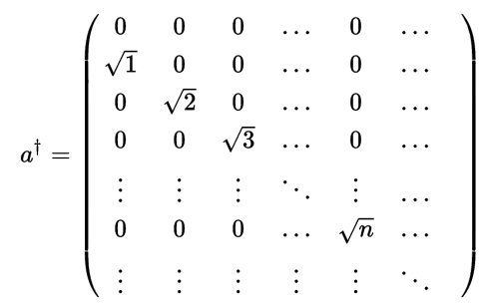
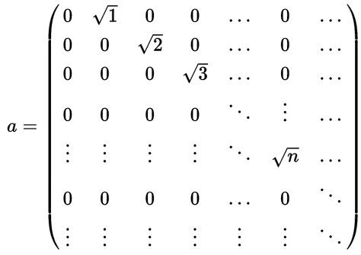
But is in Floquet space (not Hilbert-Fock quantum space…)
Two differences between and :
start form n=0 while at
off-diagonal elements depend on ‘n’.

Slide 13
and are similar but NOT the same!
Main differences between and :
off-diagonal elements depend on ‘n’.
start form n=0 while at
But, our writer didn’t give up.
Jon H. Shirley solution :
“consider in the vicinity of some very large photon number N”
why?
In the matrix region, the off-diagonal terms change slowly.
if is an eigenvalue of then is also eigenvalue.

Slide 14
Therefore:
Authors claim :
The quantum state is approximately isomorphic to the Floquet state for .
Floquet states can be interpret as “quantum states” containing a definite though very large number of photons.

Slide 16
Could we reconstruct from
the semiclassical amplitude ?
Using coherent states.
Assuming large number of photons.
peaked at and extremely small elsewhere
Using the periodicity properties of to get rid of N.
Quantum-Floquet theory:
Equivalent to semiclassical theory.
Admits interpretation in terms of quantized field.

Slide 17
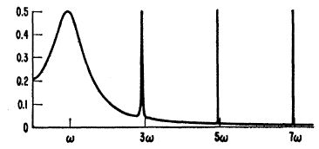
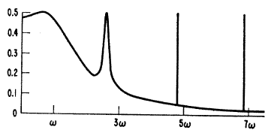
More AMAZING things with
Rabi formula + correction:
Valid for large times
No averaging over a continuum (Fermi’s golden rule)
Bloch-Siegert shift:
easier derivation
Simple derivation of higher orders
Transition probability for multiple quantum transitions (non-directly connected states)
Applied to more than 2 level quantum state.

Slide 18
All of this because -
Thank you.

