Slide 1
Comparison of the Hanbury Brown–Twiss effect for bosons and fermions
Guy Shafir & Yang Cao

Slide 2
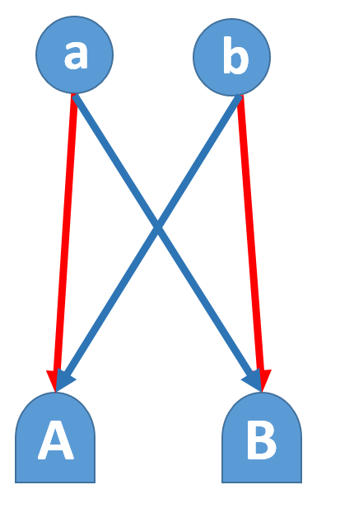
Hanbury Brown–Twiss effect
Measure the correlation function of two photoionizations, HB&T is interference between two processes.
i
j
Structure of
κ
λ
For A=B:
For A≠B:
For two far detectors:

Slide 3
2nd order correlation - Bosons
Applying Wick’s theorem:
Where the normal algebra of annihilation and creation operators where used:

Slide 4
2nd order correlation - Fermions
Applying the anti-commutator relations for fermions
We get:

Slide 5
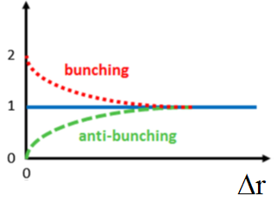
Bunching and anti-bunching
Take the limit: we get
Bunching of Bosons:
Anti-bunching of fermions:

Slide 6
Correlation lengths
Photons:
L is the distance between source and detector
s is the source size
λ is the wavelength
Particles: replace the wavelength with De-Broglie wavelength:

Slide 7
Measuring HB&T for a particle beam (1)
A cloud of ultra-cold metastable helium atoms is released at the switch-off of a magnetic trap. The cloud expands and falls under the effect of gravity onto a time-resolved and position-sensitive detector (microchannel plate and delay-line anode) that detects single atoms.
³He: Fermions
⁴He: Bosons
Δy
Δx

Slide 8
Measuring HB&T for a particle beam (2)
The chosen states of both isotopes had nearly the same magnetic moments.
Allowed to achieve the same spot size and the same temperature
The atoms are free-falling at the time of the trap turn-off, generating identical flight time to the detector.
Interaction between particles on the same ensemble is negligible.

Slide 9
Main result
⁴He
³He

Slide 10
Correlation length
Falling time and spot size are the same for both atoms.
Expected ratio in correlation length is mass ratio: 1.3333
Measured correlation length ratio: 1.3±0.2
Correlation length is also in good agreement with the formula above.

Slide 11
Contrast
Theoretical contrast is 100% (0 for fermions, 2 for bosons)
Measured contrast was very low
~1.03 for bosons
~0.94 for fermions
Reason: finite resolution of the detector
Difference between bosons and fermions are claimed from two reasons:
Finite time of the magnetic field shutdown which may influence bosons different than fermions
Systematic errors in the estimate of the resolution function

Slide 12
Effect of temperature
Higher temperature increases the source size, Therefor reducing the correlation length and the contrast:

Slide 13
Summary
The authors showed the Hanbury Brown and Twiss effect for both bosons and fermions with the two isotopes of Helium:
Bunching effect was observed for bosons
Anti-bunching effect was observed for fermions.
Careful steps were taken during the experiment to achieve almost identical conditions for the two isotopes, enabling to understand the effect as a purely quantum effect associated with the exchange symmetries of the wave-functions of indistinguishable particles.

