Slide 1
Inhibited Spontaneous Emission
Eran Gazit & Ayal Beck
Daniel Kleppner
Phys. Rev. Lett. 47, 233 – Published 27 July 1981

Slide 2
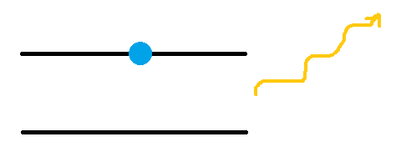
Spontaneous Emission
$$ℏω$$
$$|e>$$
$$|g>$$
$$Γ=\frac{1}{ℏ^{2}}\left|<e\right|H_{int}|g>{\left.​\right|}^{2}ρ(ν)$$
$$ν=\frac{k}{2π}=\frac{1}{λ}$$
Fermi Golden Rule
Probability to find excited atom
$$P_{e}\left(t\right)=e^{−Γt}$$
Notes:
האם לדבר על מה זה הגודל של H אינטרקציה? מוזכר במאמר השני.

Slide 3
Density of modes in free space
$$⇒$$
$$E=hν$$
$$ν^{2}=ν_{x}^{2}+ν_{y}^{2}+ν_{z}^{2}$$
$$N=2\frac{\frac{4}{3}πk^{3}}{\frac{{\left(2π\right)}^{3}}{V}}$$
$$ρ_{vac}\left(ν\right)=\frac{1}{V}\frac{∂N}{∂ν}=\frac{8πν^{2}}{c^{3}}$$

Slide 4
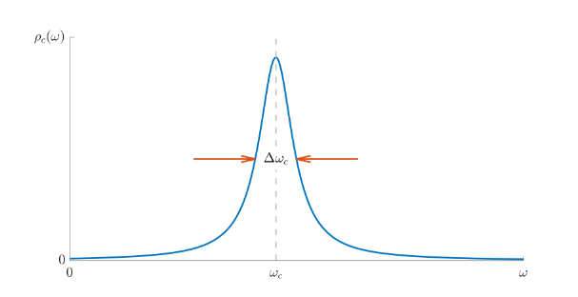
Density of states in a cavity
For a cavity tuned around 𝜈 with a very high quality factor of Q=$\frac{ν}{Δν}$ the d.o.s is approximately: $\frac{1 mode}{Vol∗Δν}$
If we take, without loss of generality, Vol=${(\frac{c}{2ν})}^{3}$ we get: $ρ_{cavity}$=$\frac{8ν^{2}}{c^{3}}Q≈ρ_{vac}Q$
The Purcell effect: Whenever a cavity satisfies the properties mentioned before, we get an enhanced spontaneous emission rate: $Γ_{c}=Γ_{0}Q$
*Graph in courtesy of Slava

Slide 5
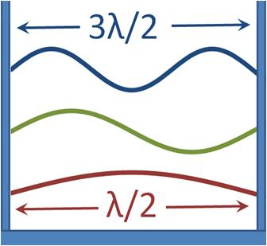
Inhibited spontaneous emission
It is also possible to suppress spontaneous emission
For λ>2d (with d being the cavity length) we will get no spontaneous emission!

Slide 6
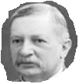
Setting an inhibited spontaneous emission experiment
Due to technical reasons, we resolve to using waveguides
$$τ=\frac{1}{Γ}$$
$$v$$
Detector
$$L=vτ$$
We will use Rydberg atoms for this experiment

Slide 7
Waveguide
d
$$x$$
TE Modes
$$E_{y}$$
$$β$$
Transverse Electric
$$z$$
$$H$$
0
d
$$x$$
$$H_{y}$$
TM Modes
$$β$$
Transverse Magnetic
$$z$$
$$E$$
0

Slide 8
Waveguide
TE Modes
TM Modes

Slide 9
Cutoff Frequency
$$β should be real$$
$$⇒$$
$$λ<2d$$
$$β_{1}=\sqrt{{\left(\frac{2π}{λ}\right)}^{2} −{\left(\frac{π}{d}\right)}^{2} }$$
$$TE Cutoff wavelength$$
$$β_{0}=k=\frac{2π}{λ}$$
$$⇒$$
$$TM does not have cutoff$$

Slide 10
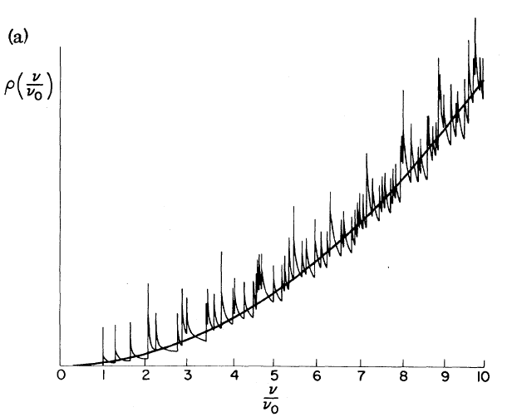
Density Of Modes In A Waveguide
$$ρ_{1}(ν) ∝\frac{ν}{\sqrt{ν^{2}−ν_{1}^{2}}}$$
$$ρ(ν)∝\sum_{j}{\frac{ν}{\sqrt{ν^{2}−ν_{j}^{2}}}}$$
Inhibited Spontaneous Emission - Daniel Kleppner
Phys. Rev. Lett. 47, 233 – Published 27 July 1981
Notes:
זה למעשה לגלבו גלילי. אולי כדאי להזכיר את זה למרות שזה מבלבל.
מה אומרים הקווים המודגשים והלא מודגשים?

Slide 11
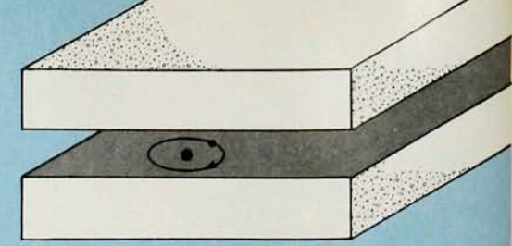
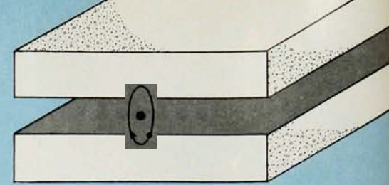
TE and TM Emission
$$\vec{d}$$
$$\vec{d}$$
$$TE$$
$$TM$$
$$σ polarization$$
$$π polarization$$
Cavity Quantum Electrodynamics - Serge Haroche, Daniel Kleppner
Physics Today 42, 1, 24 (1989)
Notes:
למה זה יוצר TE וזה יוצר TM? ומה הקשר למסלול ול"מסלולי רידברג". כנראה יש מצבים שבאופן קלאסי מתאימים לסיבוב כזה וסיבוב הפוך.

Slide 12
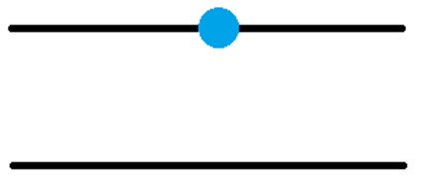
Experiment 1
Detector
Waveguide
$$0.2 mm$$
$$20 cm$$
$$|e>$$
$$λ=0.4mm±Δλ$$
$$|g>$$

Slide 13
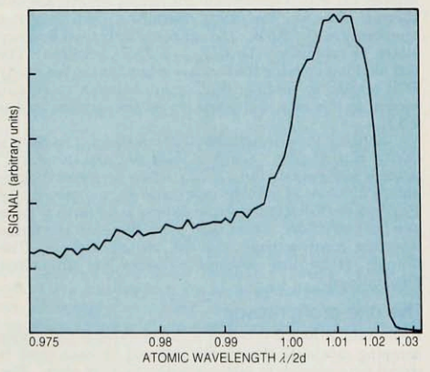
Results
$$Number of$$
$$still excited$$
$$atoms$$
Wavelength
Cavity Quantum Electrodynamics - Serge Haroche, Daniel Kleppner
Physics Today 42, 1, 24 (1989)

Slide 14
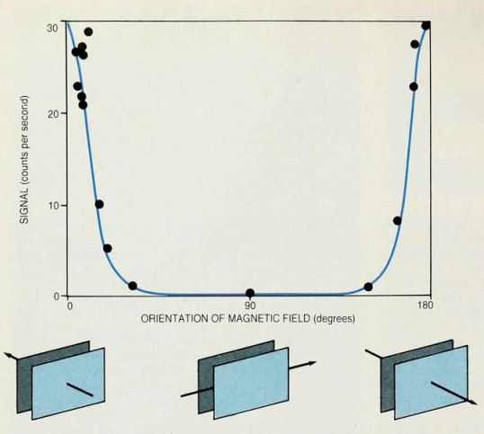
Experiment 2
Cavity Quantum Electrodynamics – Serge Haroche, Daniel Kleppner
Physics Today 42, 1, 24 (1989)

Slide 15
Conclusions
Spontaneous emission can be inhibited under the right conditions
We showed the possibility of inhibited spontaneous emission through classical arguments

Slide 16
Thanks for listening!

