Slide 1
Strong Coupling of a Spin Ensemble to a Superconducting Resonator
Y. Kubo et al., Physical Review Letters 105.14 (2010): 140502
Nir Alfasi
Viterby Faculty of Electrical Engineering
Atom-Photons Interactions
Spring 2017

Slide 2
Introduction
Motivation – quantum circuits with long coherence times and rapid quantum state manipulation.
“Hybrid” quantum system combining:
Natural quantum system – atoms, photons, spins. Natural decoupling from environmental noise → long coherence times.
Artificial quantum system – superconducting qubits. Strong coupling to EM fields, fast quantum gating, short coherence times.

Slide 3
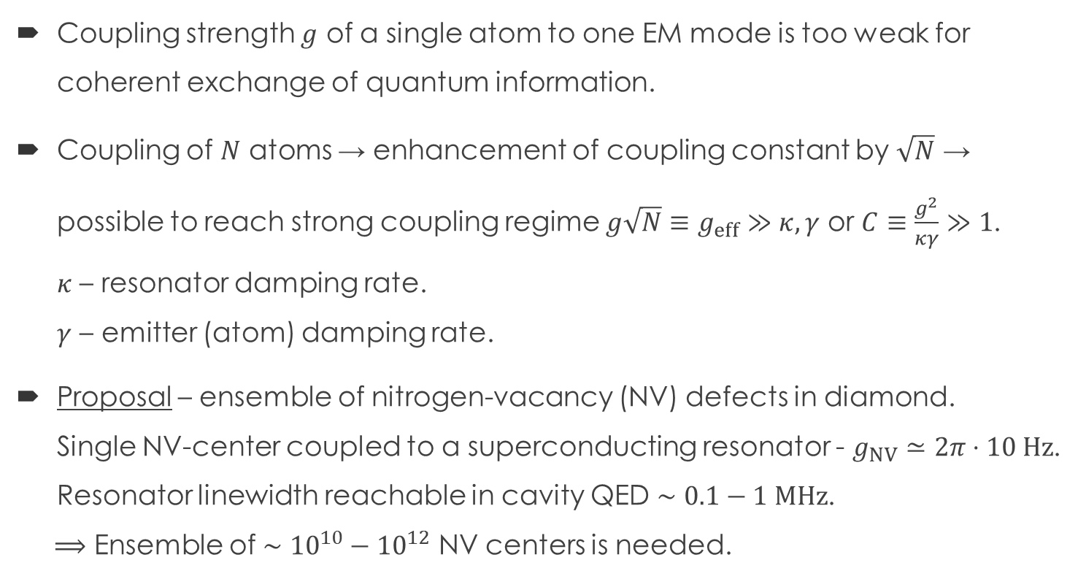
Introduction
Coupling strength $g$ of a single atom to one EM mode is too weak for coherent exchange of quantum information.
Coupling of $N$ atoms → enhancement of coupling constant by $\sqrt{N}$ → possible to reach strong coupling regime $g\sqrt{N}≡g_{eff}≫κ,γ$ or $C≡\frac{g^{2}}{κγ}≫1$.
$κ$ – resonator damping rate.
$γ$ – emitter (atom) damping rate.
Proposal – ensemble of nitrogen-vacancy (NV) defects in diamond.
Single NV-center coupled to a superconducting resonator - $g_{NV}≃2π⋅10 Hz$.
Resonator linewidth reachable in cavity QED $∼0.1−1 MHz$.
$⟹$ Ensemble of $∼{10}^{10}−{10}^{12}$ NV centers is needed.

Slide 4
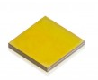
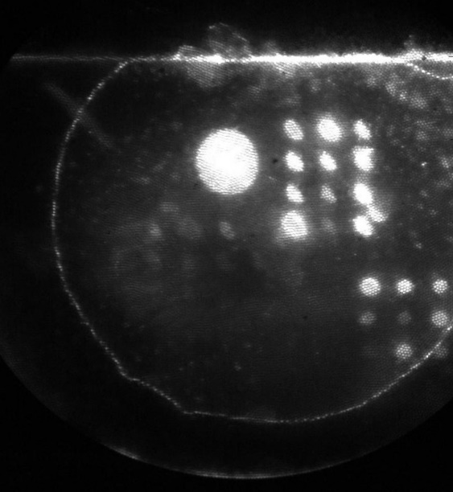
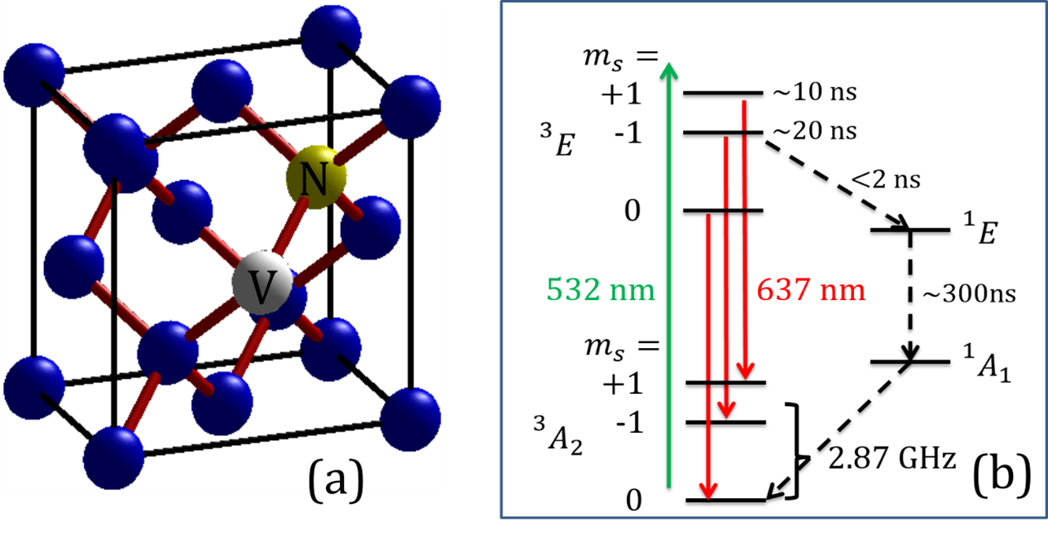
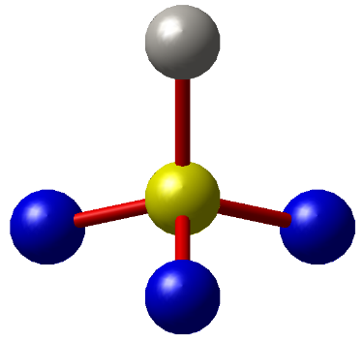
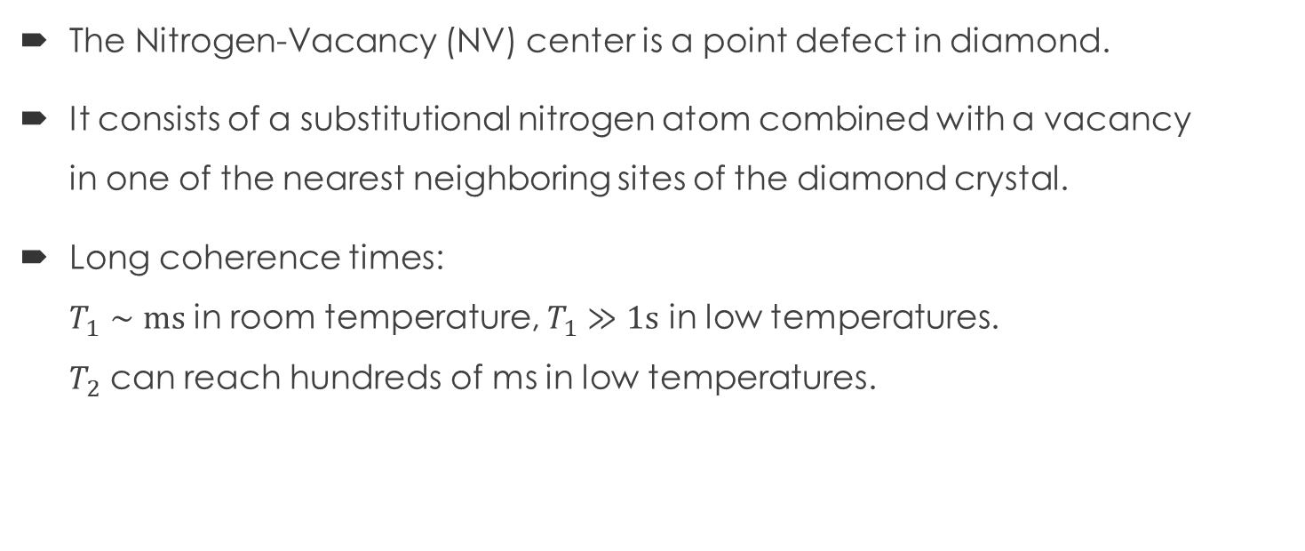
Introduction - NV center
The Nitrogen-Vacancy (NV) center is a point defect in diamond.
It consists of a substitutional nitrogen atom combined with a vacancy
in one of the nearest neighboring sites of the diamond crystal.
Long coherence times:
$T_{1}∼ms$ in room temperature, $T_{1}≫1s$ in low temperatures.
$T_{2}$ can reach hundreds of ms in low temperatures.
V
N

Slide 5
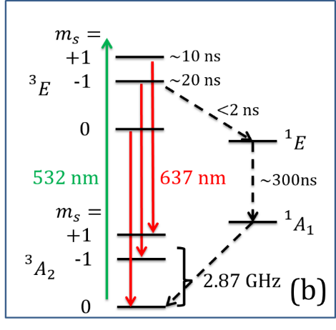
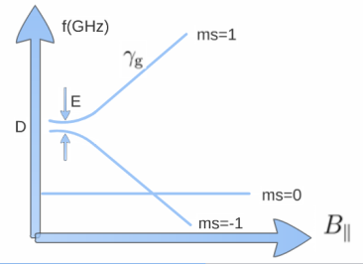

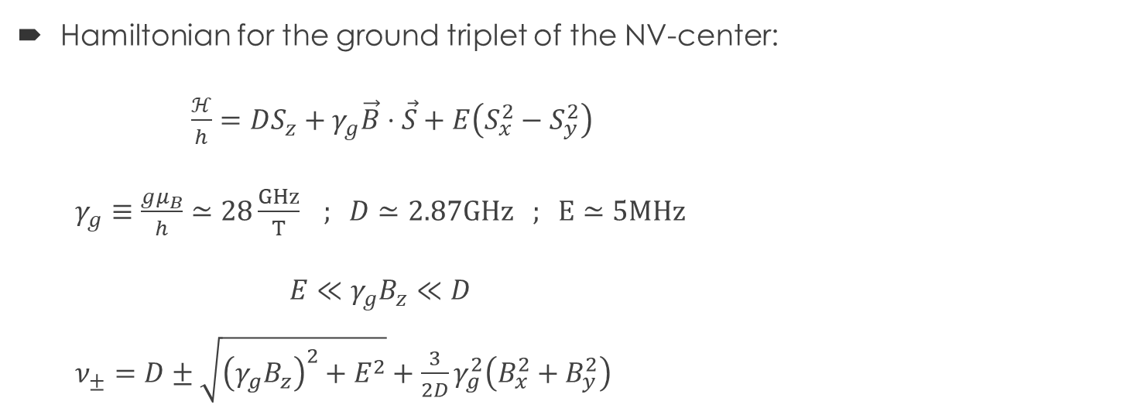



Introduction - NV center
Hamiltonian for the ground triplet of the NV-center:
$\frac{ℋ}{h}=DS_{z}+γ_{g}\vec{B}⋅\vec{S}+E\left(S_{x}^{2}−S_{y}^{2}\right)$
$γ_{g}≡\frac{gμ_{B}}{h}≃28\frac{GHz}{T} ; D≃2.87GHz ; E≃5MHz$
$E≪γ_{g}B_{z}≪D$
$ν_{±}=D±\sqrt{{\left(γ_{g}B_{z}\right)}^{2}+E^{2}}+\frac{3}{2D}γ_{g}^{2}\left(B_{x}^{2}+B_{y}^{2}\right)$
$$⇓$$
$B_{z}≳200 mT$ ,
$B_{⊥}≪100 mT$ $⟹$
$$ν_{±}≃D±γ_{g}B_{z}$$

Slide 6
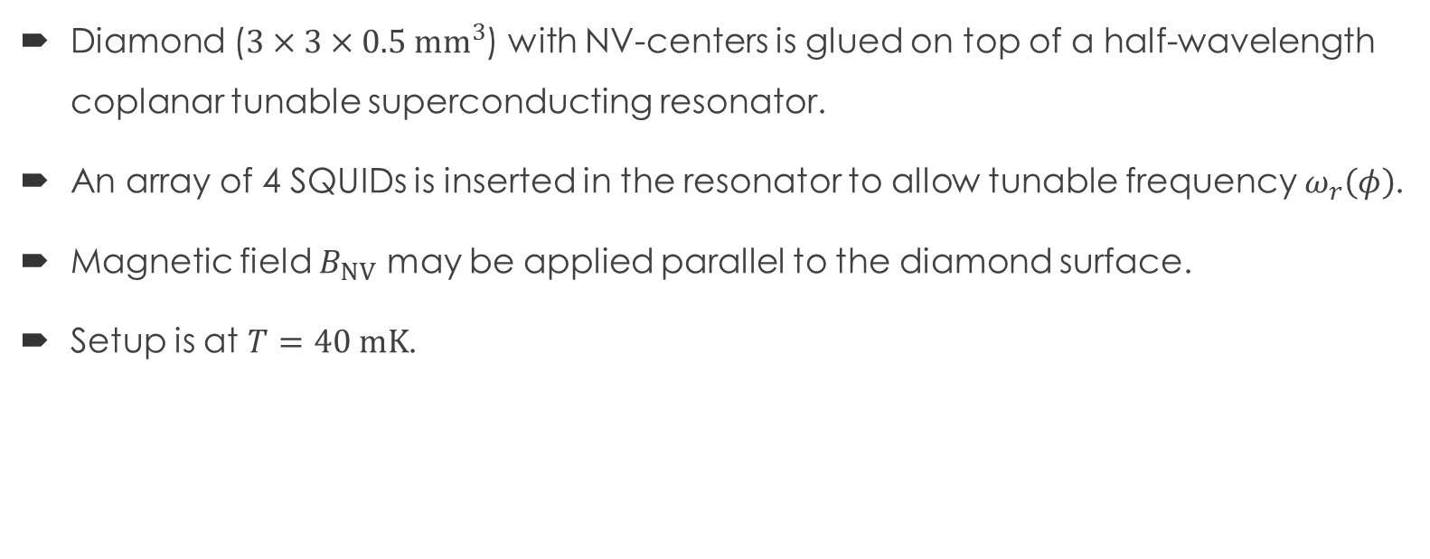
Experimental setup
Diamond ($3×3×0.5 {mm}^{3}$) with NV-centers is glued on top of a half-wavelength coplanar tunable superconducting resonator.
An array of 4 SQUIDs is inserted in the resonator to allow tunable frequency $ω_{r}\left(φ\right)$.
Magnetic field $B_{NV}$ may be applied parallel to the diamond surface.
Setup is at $T=40 mK$.

Slide 7
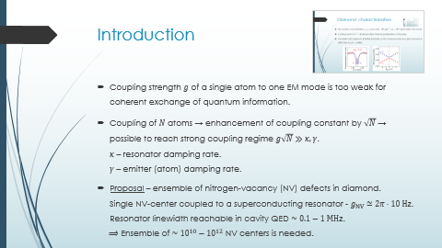
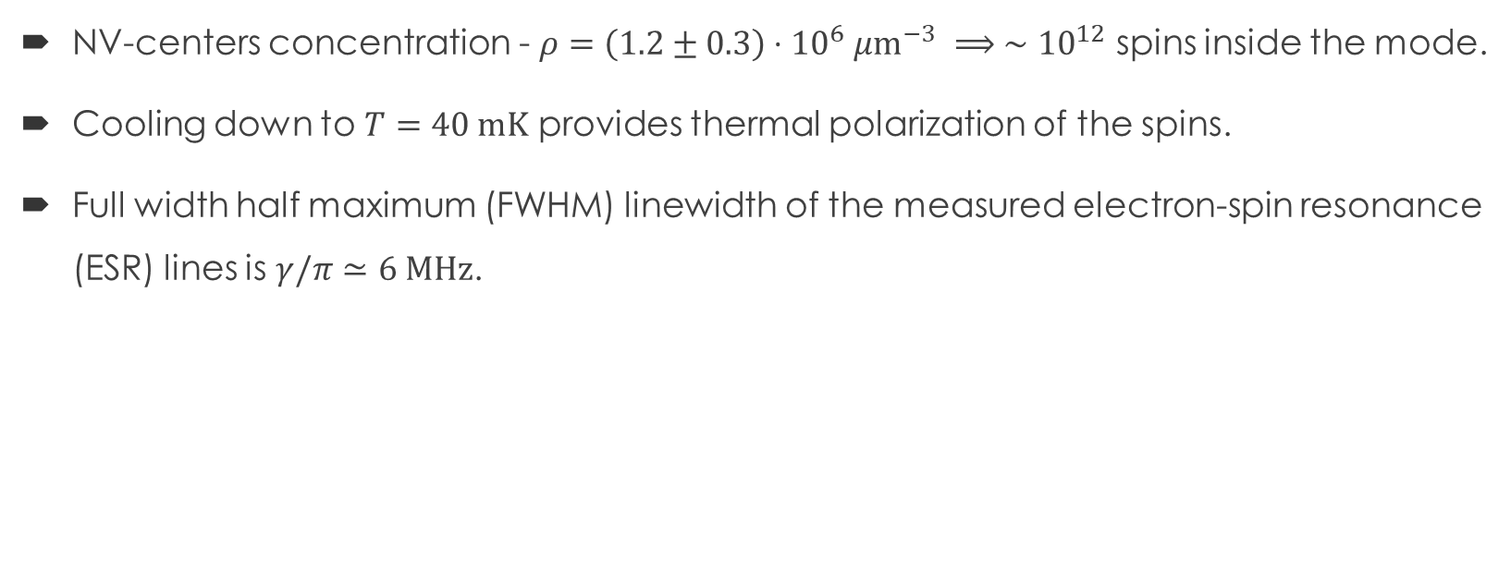

Diamond characterization
NV-centers concentration - $ρ=\left(1.2±0.3\right)⋅{10}^{6} μm^{−3} ⟹ ∼{10}^{12}$ spins inside the mode.
Cooling down to $T=40 mK$ provides thermal polarization of the spins.
Full width half maximum (FWHM) linewidth of the measured electron-spin resonance (ESR) lines is $γ/π≃6 MHz$.

Slide 8
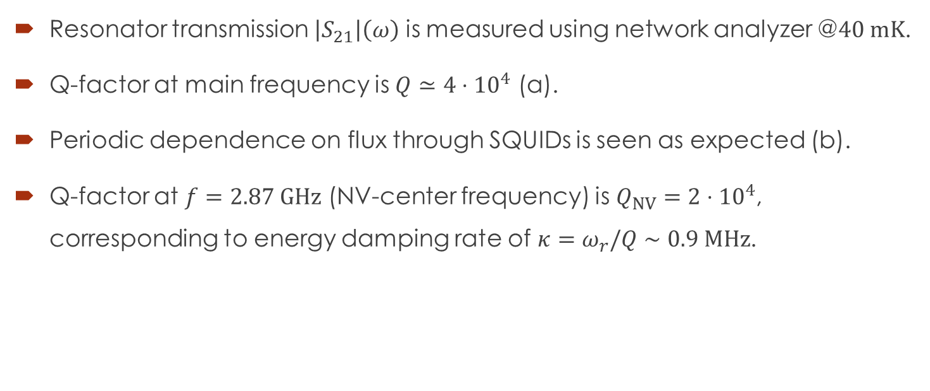
Resonator characterization
Resonator transmission $\left|S_{21}\right|\left(ω\right)$ is measured using network analyzer @$40 mK$.
Q-factor at main frequency is $Q≃4⋅{10}^{4}$ (a).
Periodic dependence on flux through SQUIDs is seen as expected (b).
Q-factor at $f=2.87 GHz$ (NV-center frequency) is $Q_{NV}=2⋅{10}^{4}$, corresponding to energy damping rate of $κ=ω_{r}/Q∼0.9 MHz$.

Slide 9
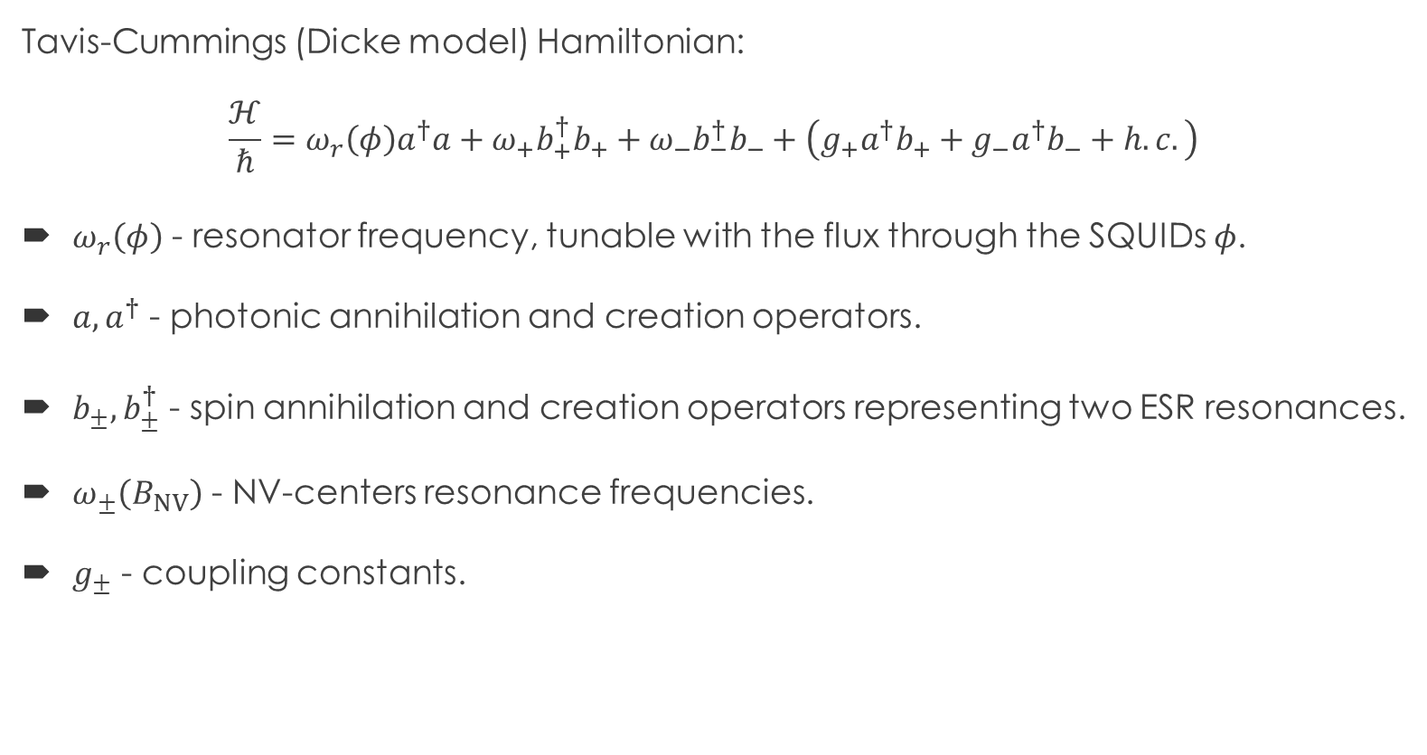
Diamond-resonator – the model
Tavis-Cummings (Dicke model) Hamiltonian:
$$\frac{ℋ}{ℏ}=ω_{r}\left(φ\right)a^{†}a+ω_{+}b_{+}^{†}b_{+}+ω_{−}b_{−}^{†}b_{−}+\left(g_{+}a^{†}b_{+}+g_{−}a^{†}b_{−}+h.c.\right)$$
$ω_{r}\left(φ\right)$ - resonator frequency, tunable with the flux through the SQUIDs $φ$.
$a,a^{†}$ - photonic annihilation and creation operators.
$b_{±},b_{±}^{†}$ - spin annihilation and creation operators representing two ESR resonances.
$ω_{±}\left(B_{NV}\right)$ - NV-centers resonance frequencies.
$g_{±}$ - coupling constants.

Slide 10
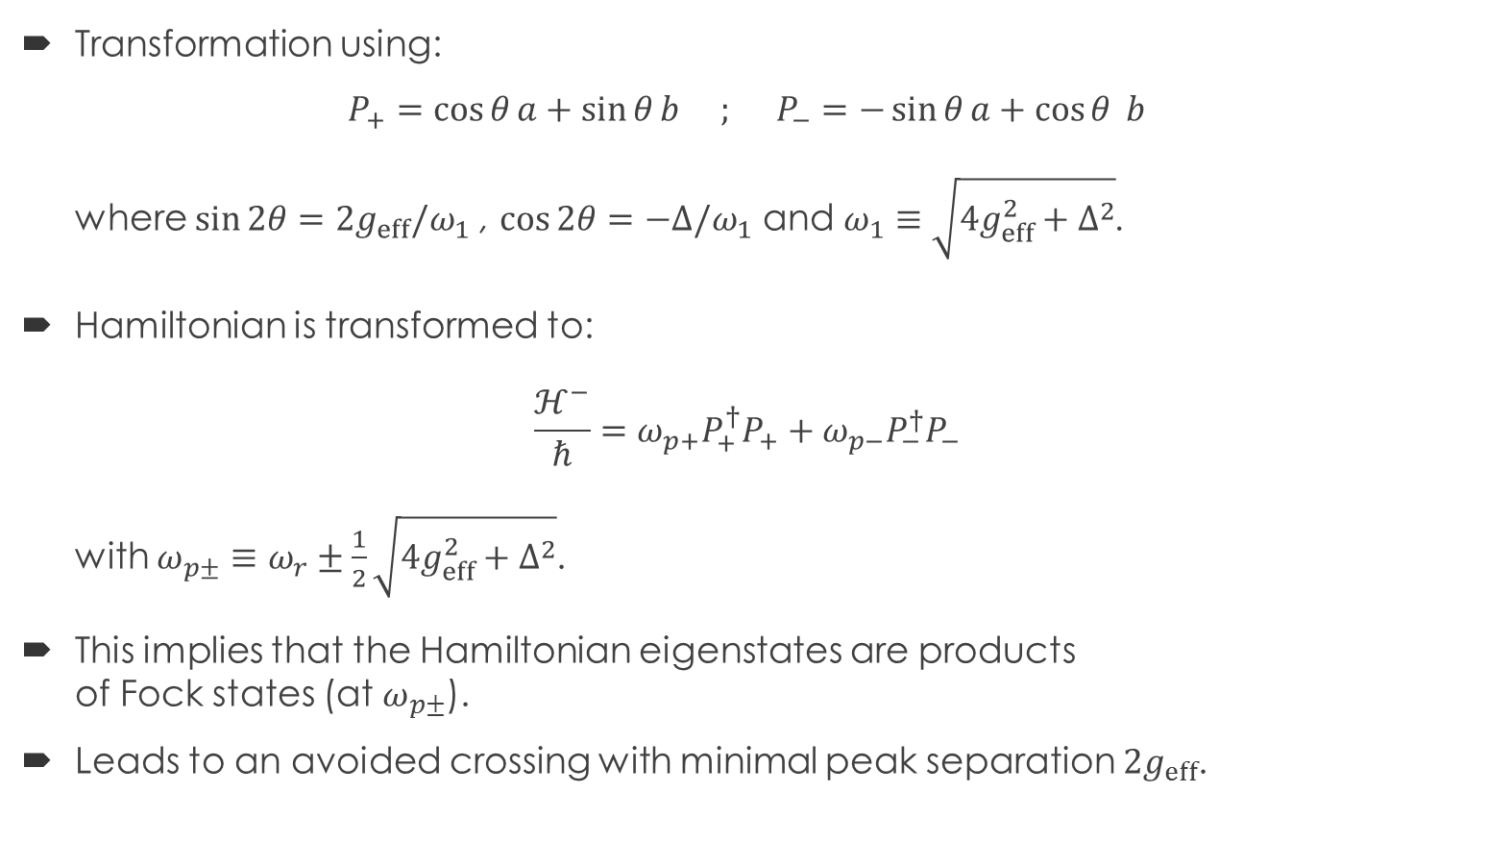
Diamond-resonator – the model
Transformation using:
$P_{+}=\cos{θ}a+\sin{θ}b ; P_{−}=−\sin{θ}a+\cos{θ }b$
where $\sin{2θ}=2g_{eff}/ω_{1}$ , $\cos{2θ}=−Δ/ω_{1}$ and $ω_{1}≡\sqrt{4g_{eff}^{2}+Δ^{2}}$.
Hamiltonian is transformed to:
$\frac{ℋ^{−}}{ℏ}=ω_{p+}P_{+}^{†}P_{+}+ω_{p−}P_{−}^{†}P_{−}$
with $ω_{p±}≡ω_{r}±\frac{1}{2}\sqrt{4g_{eff}^{2}+Δ^{2}}$.
This implies that the Hamiltonian eigenstates are products
of Fock states (at $ω_{p±}$).
Leads to an avoided crossing with minimal peak separation $2g_{eff}$.

Slide 11
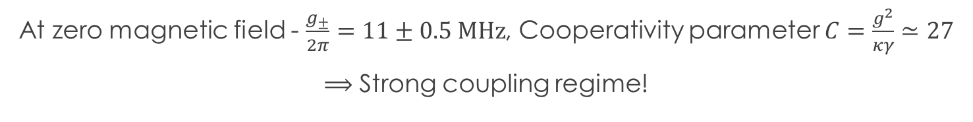
Diamond-resonator – measurements
At zero magnetic field - $\frac{g_{±}}{2π}=11±0.5 MHz$, Cooperativity parameter $C=\frac{g^{2}}{κγ}≃27$
$⟹$ Strong coupling regime!

Slide 12
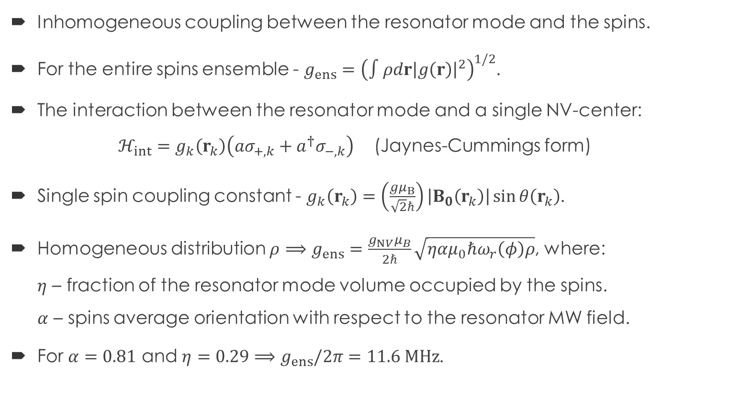
Coupling constant estimation
Inhomogeneous coupling between the resonator mode and the spins.
For the entire spins ensemble - $g_{ens}={\left(∫ρdr{\left|g\left(r\right)\right|}^{2}\right)}^{1/2}$.
The interaction between the resonator mode and a single NV-center:
$ℋ_{int}=g_{k}\left(r_{k}\right)\left(aσ_{+,k}+a^{†}σ_{−,k}\right)$ (Jaynes-Cummings form)
Single spin coupling constant - $g_{k}\left(r_{k}\right)=\left(\frac{gμ_{B}}{\sqrt{2}ℏ}\right)\left|B_{0}\left(r_{k}\right)\right|\sin{θ\left(r_{k}\right)}$.
Homogeneous distribution $ρ$ $⟹g_{ens}=\frac{g_{NV}μ_{B}}{2ℏ}\sqrt{ηαμ_{0}ℏω_{r}\left(φ\right)ρ}$, where:
$η$ – fraction of the resonator mode volume occupied by the spins.
$α$ – spins average orientation with respect to the resonator MW field.
For $α=0.81$ and $η=0.29$ $⟹g_{ens}/2π=11.6 MHz$.

Slide 13
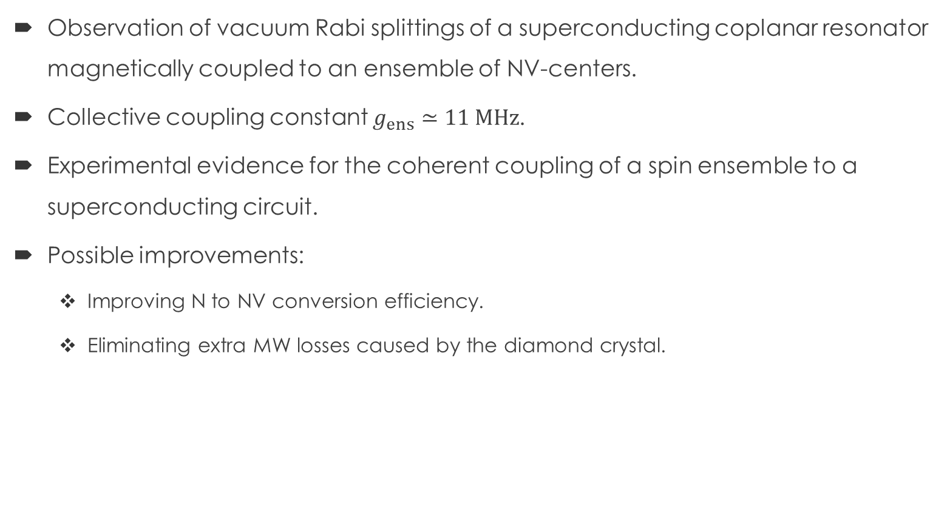
Summary
Observation of vacuum Rabi splittings of a superconducting coplanar resonator magnetically coupled to an ensemble of NV-centers.
Collective coupling constant $g_{ens}≃11 MHz$.
Experimental evidence for the coherent coupling of a spin ensemble to a superconducting circuit.
Possible improvements:
  Improving N to NV conversion efficiency.
  Eliminating extra MW losses caused by the diamond crystal.

Slide 14
THANK YOU!
Questions?

Slide 15
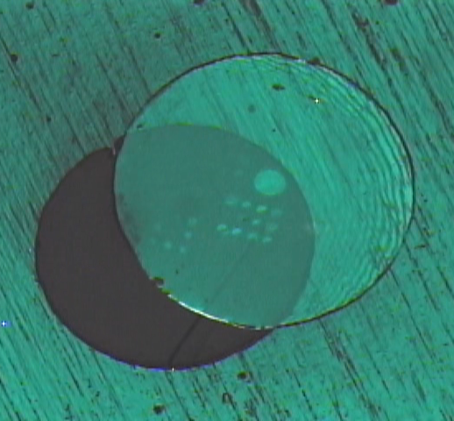
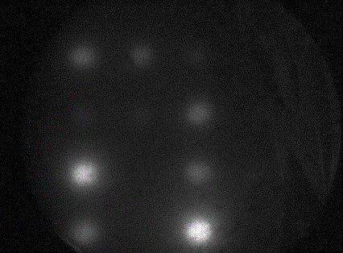
Nitrogen-Vacancy defect
Several ways to create NV-centers in a diamond crystal:
  CVD growth
  Ion implantation
  Ion irradiation
  Electron irradiation
We use electron irradiation in TEM followed by annealing and acids cleaning.

Slide 16
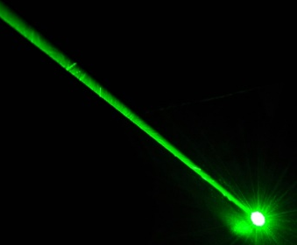


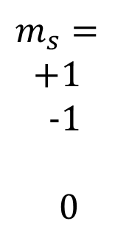

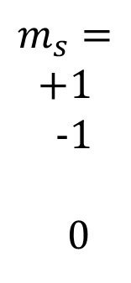







Electronic structure
1.
$$m_{s}=$$
$$+1$$
-1
0
10 ns
Triplet excited state
$${}^{3}E$$
<2 ns
$${}^{1}E$$
$${}^{1}E$$
532 nm
637 nm
$$1.945eV$$
$$1.190eV$$
Intermediate singlet states
$$(1041nm)$$
300ns
$$(637nm)$$
$$m_{s}=$$
$$+1$$
-1
0
$${}^{1}A_{1}$$
$${}^{1}A_{1}$$
Triplet ground state
$${}^{3}A_{2}$$
2.87 GHz

Slide 17

1.
$$m_{s}=$$
$$+1$$
-1
0
10 ns
$${}^{3}E$$
<2 ns
2.
$${}^{1}E$$
532 nm
637 nm
300ns
$$m_{s}=$$
$$+1$$
-1
0
$${}^{1}A_{1}$$
$${}^{3}A_{2}$$
2.87 GHz
Maximum photoluminescence - polarization

Slide 18
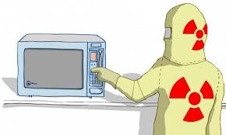

1.
$$m_{s}=$$
$$+1$$
-1
0
$${}^{3}E$$
2.
$${}^{1}E$$
$$m_{s}=$$
$$+1$$
-1
0
$${}^{1}A_{1}$$
3.
$${}^{3}A_{2}$$
$$f_{MW}≃2.87GHz$$
2.87 GHz

Slide 19
1.
$$m_{s}=$$
$$+1$$
-1
0
10 ns
$${}^{3}E$$
<2 ns
2.
$${}^{1}E$$
532 nm
637 nm
300ns
$$m_{s}=$$
$$+1$$
-1
0
$${}^{1}A_{1}$$
3.
$${}^{3}A_{2}$$
2.87 GHz
Decrease in photoluminescence

Slide 20
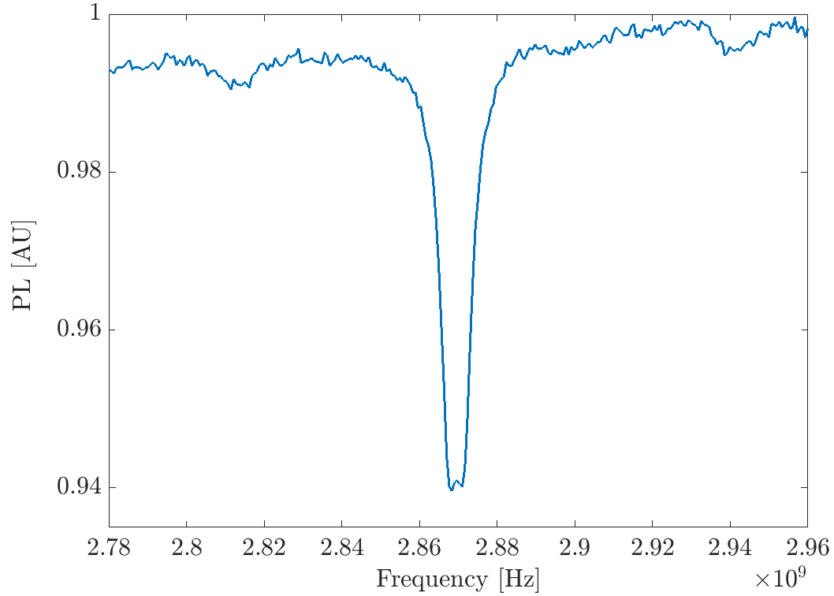
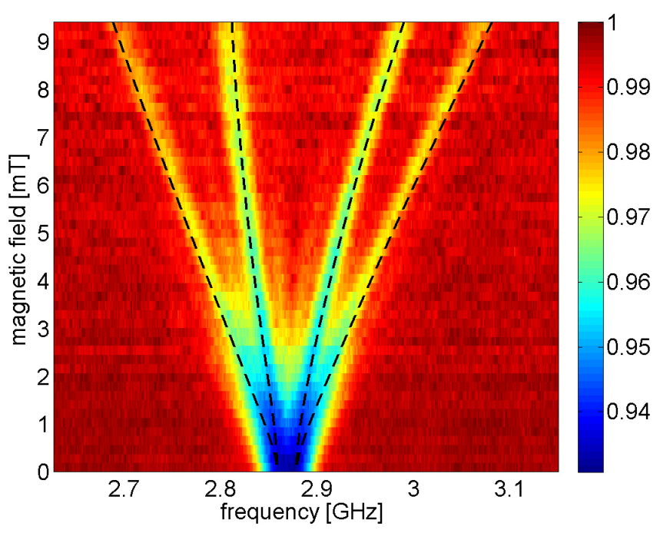
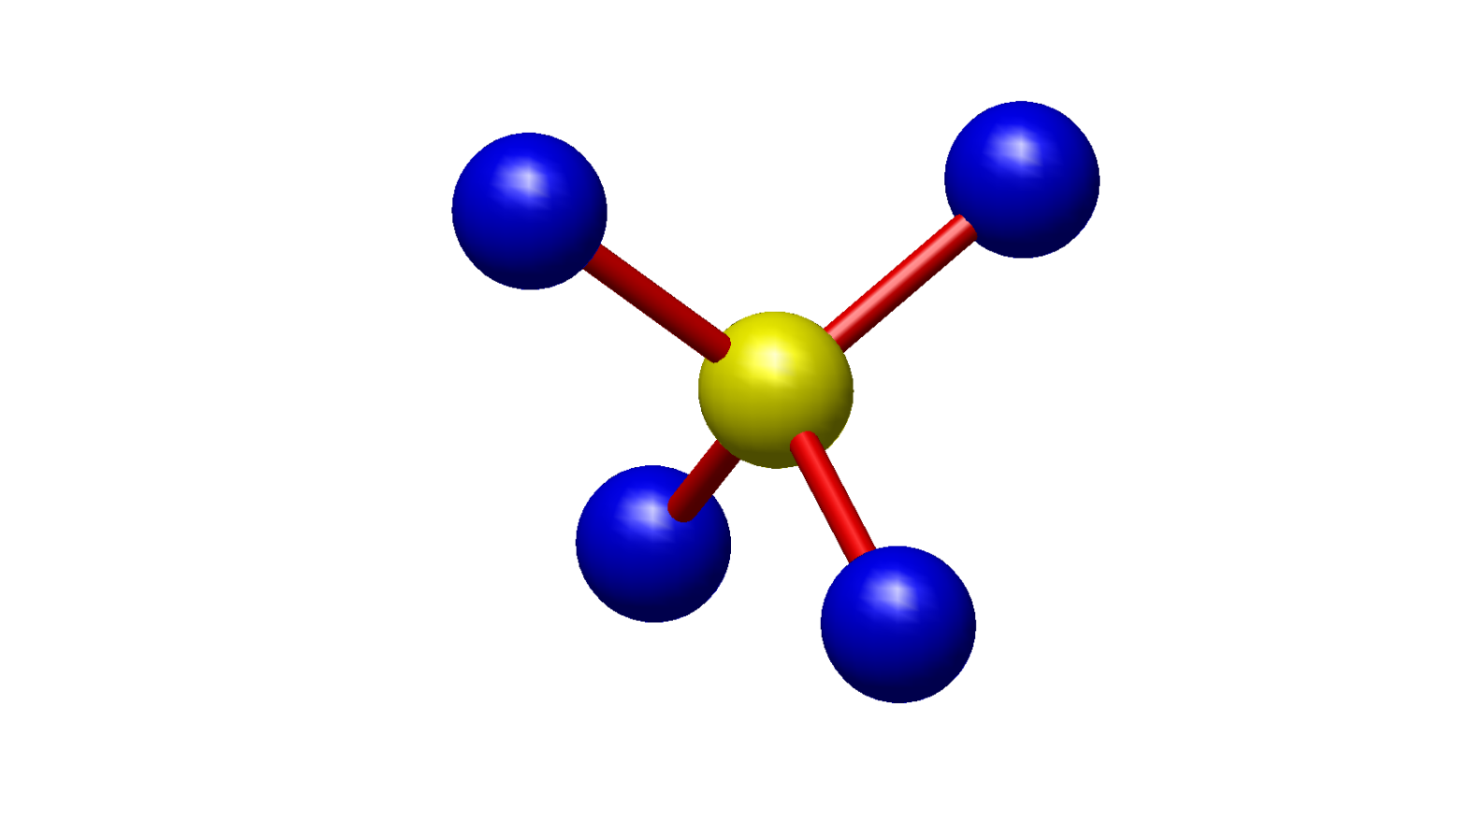


Introduction - NV center
B on
$$θ={21}^{∘}$$
Optically detected magnetic resonance (ODMR)
C
N
V
C
C
$$\vec{B}=(\cos{θ},\sin{θ},0)$$

Slide 21
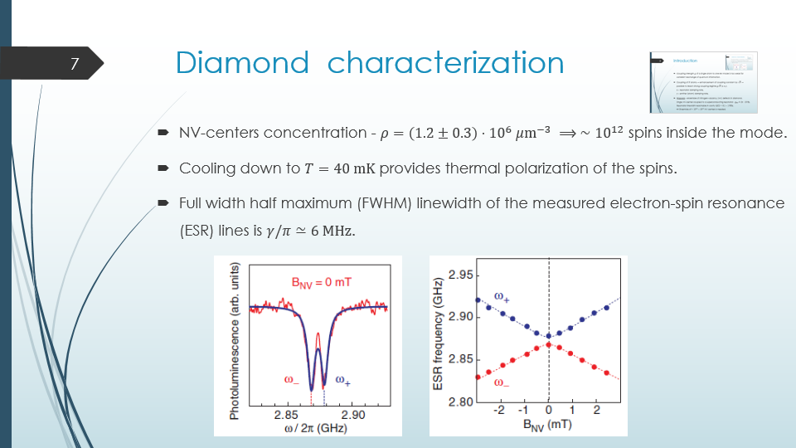
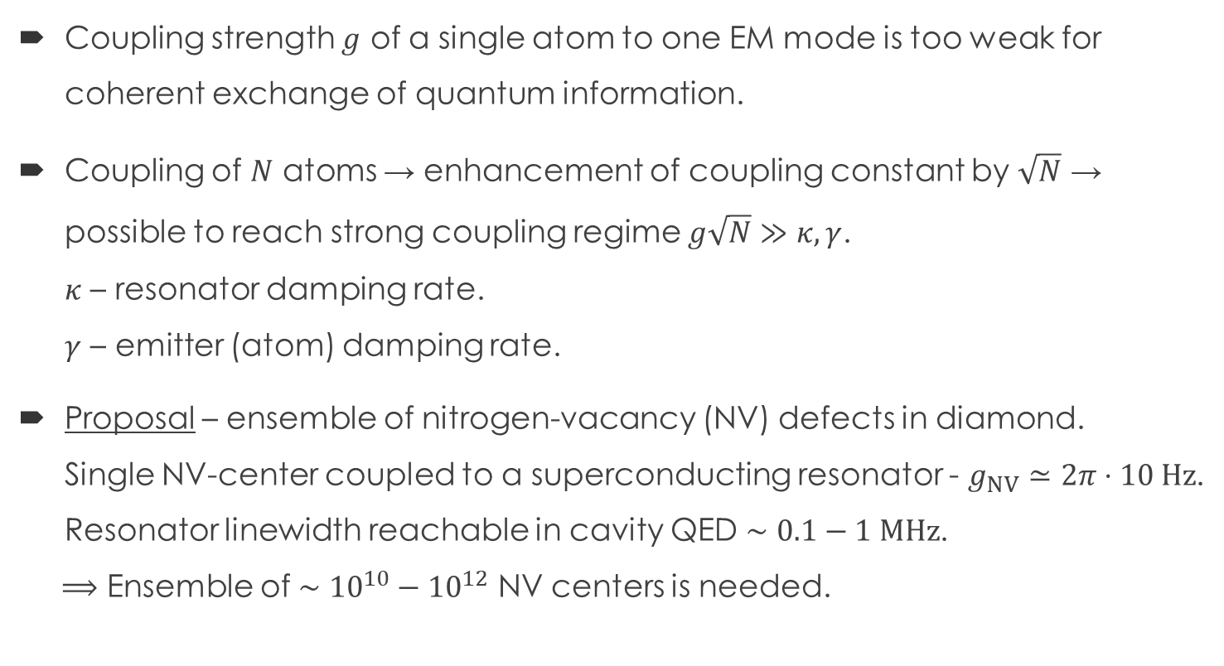

Introduction
Coupling strength $g$ of a single atom to one EM mode is too weak for coherent exchange of quantum information.
Coupling of $N$ atoms → enhancement of coupling constant by $\sqrt{N}$ → possible to reach strong coupling regime $g\sqrt{N}≫κ,γ$.
$κ$ – resonator damping rate.
$γ$ – emitter (atom) damping rate.
Proposal – ensemble of nitrogen-vacancy (NV) defects in diamond.
Single NV-center coupled to a superconducting resonator - $g_{NV}≃2π⋅10 Hz$.
Resonator linewidth reachable in cavity QED $∼0.1−1 MHz$.
$⟹$ Ensemble of $∼{10}^{10}−{10}^{12}$ NV centers is needed.

