Slide 1
Paper presentation: Indistinguishable photons from a single photon device
Authors: C. Santori et al, nature, 419, 10 oct 2002
Atom Photon Interactions, spring 2017
Presented by: Idan Yokev
Notes:
More focus on why “semiconducturs”

Slide 2
Introduction
In the paper, Santori et al. demonstrate the production of indistinguishable photons from semiconductor quantum dots using a Hong-Ou-Mandel (HOM) type experiment.
Why is this important?
What are Quantum Dots?
Why the experiment is cool, scientifically speaking

Slide 3
Background
The 3 q’s: Quantum computing, quantum dots & quantum beam splitters

Slide 4
Motivation
Any Two Level System is a good source
Main practical application is quantum information
Quantum computing circuits will require sources that can be fabricated and integrated
Quantum computing is enabled by the HOM effect
Notes:
Quantum computing relies on entangled states, which are produced through interactions of single photons

Slide 5
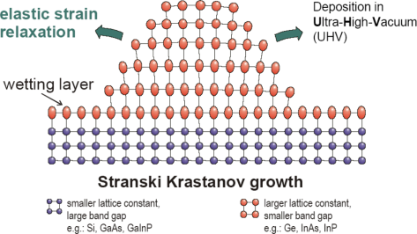
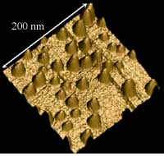
Quantum Dots & microcavities
Nano-scale structures with low band gap embedded in a high band gap layer
The 3D confinement creates a potential well with discrete energy levels
Fabricated
Self assembly
Microcavity improves coupling efficiency
Notes:
Semiconductor QD are nano-scale structures with low band gap embedded in a high band gap layer
The 3D confinement creates a potential well with discrete energy levels
Since grown in fabrication can be a part of a semiconductor quantum computing circuit
The fabrication method is based on self assembly and highly random
Microcavity improves coupling efficiency

Slide 6
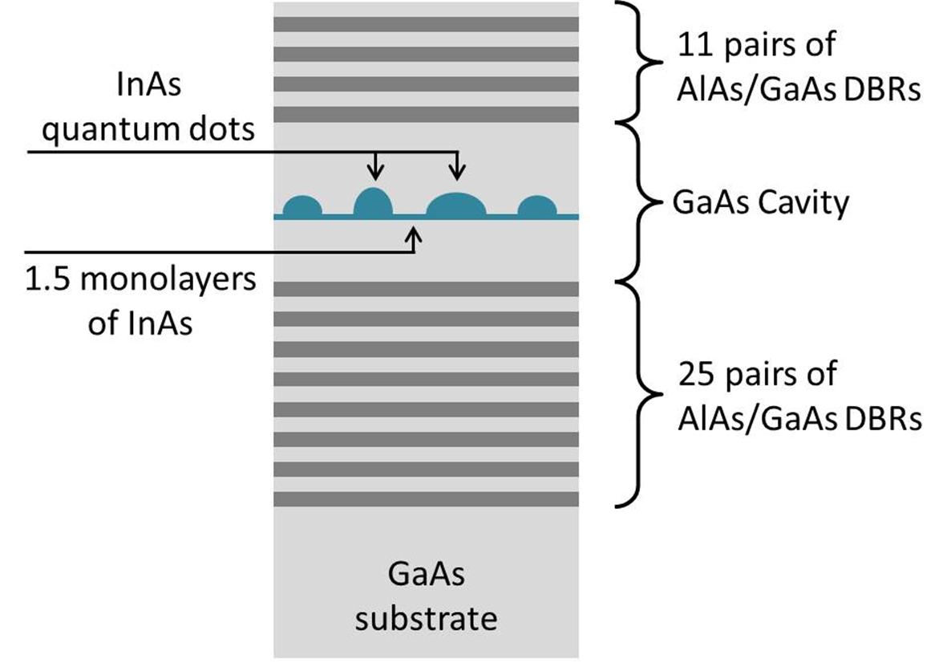
Quantum Dots & microcavities
Indistinguishability means same state
Discrete energy levels control wavelength
Microcavity selects mode
Q factor and Purcell enhancement
Single photon emission require single QD / cavity matching
An SEM image of a typical device, showing the tapered etch and contrasting AlAs and GaAs DBR layers
Solomon, G. S., M. Pelton, and Y. Yamamoto. "Single-mode spontaneous emission from a single quantum dot in a three-dimensional microcavity." Physical Review Letters 86.17 (2001): 3903.
Notes:
For photons to be indistinguishable they need to have the same polarization, frequency and spatial mode (k vector)
While any Two Level System can ideally be a single photon source one still needs to control the mode of the photon
As we’ve seen in the cource, decreasing the mode volume is necessary to achieve high coupling efficiency
The QD is sandwiched in the cavity between DBR mirrors to select resonance

Slide 7
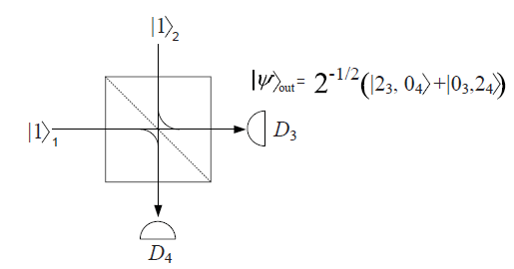
Theory for Hong-Ou-Mandel
BS with photons occupying both input ports
Sum of amplitudes
Phase shift between options 2 & 3
Destructive interference
$${\left.|ψ\right\rangle }_{out}=\sqrt{2}\left(\left.|2_{3},0_{4}\right\rangle +\left.|0_{3},2_{4}\right\rangle \right)$$
Quantum Electronics Course, TAU
CC BY-SA 3.0, https://en.wikipedia.org/w/index.php?curid=18378806
Notes:
R=T
True ONLY for number state

Slide 8
Theory for Hong-Ou-Mandel
In classical and coherent interference, we know: $\frac{g^{\left(2\right)}\left(τ=0\right)}{g^{\left(2\right)}\left(τ→∞\right)}=2$
$g^{\left(2\right)}<\frac{1}{2}$ can only be explained by quantum interference
Notes:
Coherent refers to a quantum field in a coherent state – displacement operator
True ONLY for number state

Slide 9
Experiment Details and Results
In 3 acts

Slide 10
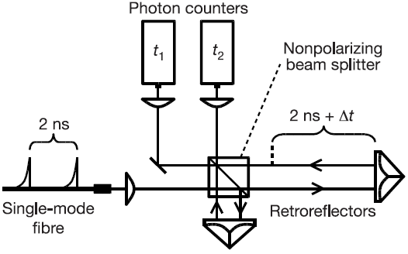
Experimental setup
HBT to test single photon emission
HOM to test Degree Of Indistinguishability (DOI)
Correlation is defined as delay between detectors: $τ=t_{2}−t_{1}$
$g^{\left(2\right)}$ as a figure of merit, histogram of $τ$
Histogram is symmetric
Very low combined efficiency: $η^{\left(2\right)}\sim 2.3⋅{10}^{−6}$
13 ns
$t≪$13 ns
. . .
Notes:
HBT – removing arm reduces efficiency by 1/2
Single photon / Single spontaneous emission is a limiting condition for HOM
Correlation calculated as histogram of delay between binary detections – 53 ps resolution
HOM event occurs only when first photon goes in long arm and second photon goes in short arm
Hong-Ou-Mandel

Slide 11
Act I – Single photon source, HBT
13 ns
$t≪$13 ns
. . .
13 ns
The probability for more than 1 photon emission is calculated by dividing the area of the central (non) peak by the area of adjacent side peaks
$g$ is the normalized probability the either of 2 consecutive pulses $2_{\left[ns\right]}$ to generate 2 photons
Notes:
Figure 1 The single-photon source. a, Pillar microcavity structures containing InAs
quantum dots in a one-wavelength-thick GaAs spacer, sandwiched between distributed-
Bragg-reflector (DBR) mirrors, grown by molecular-beam epitaxy. The DBR mirrors were
constructed by stacking quarter-wavelength-thick GaAs and AlAs layers on top of each
other. There are 12 DBR pairs above, and 30 DBR pairs below, the spacer. Pillars with
diameters ranging from 0.3 to 5 mm and heights of 5 mm were fabricated in a random
distribution by chemically assisted ion beam etching (CAIBE) with Arþ ions and Cl2 gas,
using sapphire dust particles as etch masks. Owing to the irregular shapes of the pillars,
the fundamental mode is typically polarization-nondegenerate. b, Photon correlation
histogram of emission from quantum dot 2 under pulsed, resonant excitation, obtained
using a Hanbury Brown and Twiss-type set-up. The emission was split into two paths by a
beam splitter, each path leading to a photon counter. A histogram was generated of the
relative delay t ¼ t 2 2 t 1 between a photon detection at one counter (t 1) and the other
(t 2). The vanishing central peak is the signature of suppressed two-photon emission. The
parameter g described in the text was obtained by dividing the area of the central peak at
t ¼ 0 by that of the nearest side peaks. The decrease of the side peaks away from t ¼ 0
indicates blinking with a timescale of 85 ns, an effect that we usually see with resonant
excitation8. For this measurement, the set-up shown in Fig. 3a was used, with one arm
blocked.

Slide 12
Act 2 – two photon interference, HOM

Slide 13
Act 2 – two photon interference, HOM
Pulse 1 fires at $t=0$
Pulse 2 fires at $t=2_{\left[ns\right]}$
The long arm is $2_{\left[ns\right]}$ longer than the short arm
Assuming equal probabilities we expect 5 peaks with ratio of: $1:2:2:2:1$
Pulse 1 | Pulse 2 | Detector 1 | Detector 2 | $$τ\left[ns\right]$$
Long arm | Short arm | Start | Stop | 0
Long arm | Short arm | Stop | Start | 0
Short arm | Short arm | Start | Stop | 2
Short arm | Short arm | Stop | Start | -2
Long arm | Long arm | Start | Stop | 2
Long arm | Long arm | Stop | Start | -2
Short arm | Long arm | Start | Stop | 4
Short arm | Long arm | Stop | Start | -4
Gantz, L. "Quantum bits utilizing the quantum dot confined bright and dark excitons" Research Thesis, Technion

Slide 14
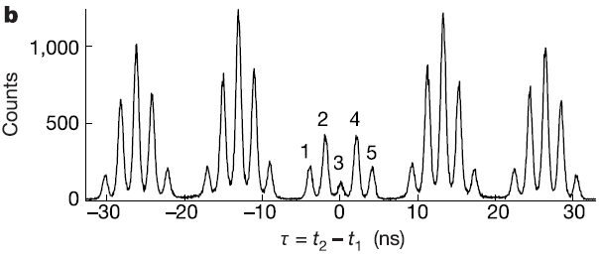
Act 2 – two photon interference, HOM
$τ$ at peaks numbered 1-5 is: -4,-2,0,2,4 ns respectively

Slide 15
Act 3 – qualifying the source
Relative mean areas of the peaks can be calculated: $A_{1}=R^{3}T , A_{2}= [R^{3}T\left(1+2g\right)+RT^{3}]$ $A_{3}=\left[\left(R^{3}T+RT^{3}\right)\left(1+2g\right)−2{\left(1−ε\right)}^{2}R^{2}T^{2}V\left(Δt\right)\right]$ $A_{4}=\left[R^{3}T+RT^{3}\left(1+2g\right)\right] , A_{5}=RT^{3}$
$R,T$ are the BS coefficients ,$g$ was defined above, $\left(1−ε\right)$ is the visibility of the interferometer itself
$V\left(Δt\right)$ is the mean overlap between wave packets
This is the DOI

Slide 16
Act 3 – qualifying the source
A dephasing measure is defined $M\left(Δt\right)={A_{3}}/{A_{2}+A_{4}}$
The experiment was repeated at varying $Δt$
Finding a fit for $M$ allows estimating $V\left(0\right)$
After considering setup imperfections overlap was estimated at $V\left(0\right)=0.81$ for the best QD

Slide 17
Conclusions & further studies
The authors demonstrated the first case of a semiconductor based single photon source with high DOI
The authors also demonstrate an elegant setup to compare quality of single photon sources
The dephasing factor was fitted empirically and doesn’t provide any physical insight
Future works have developed a more comprehensive model to explain dephasing as effects within the quantum source
Entire work was done in close to absolute zero
Efficiency must be greatly increased

Slide 18
Backup

Slide 19
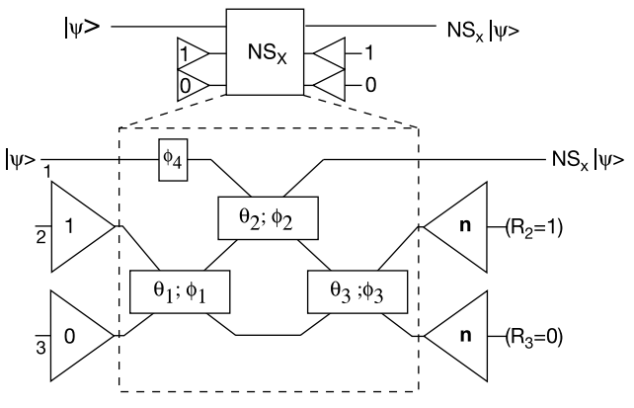
Motivation - LOQC
LOQC can use photon polarization as the two level system that defines a qubit
LOQC has 2 basic components to create a quantum gate
Phase shifters apply a linear single qubit operation
Beam splitters for 2 qubits operation
Under these condition, for the beam splitter to utilize the quantum aspects of the photons, the photons must be indistinguishable
Nonlinear phase shifts on one mode
Duan, Lu-Ming, et al. "Long-distance quantum communication with atomic ensembles and linear optics." arXiv preprint quant-ph/0105105 (2001).
Conditional flip sign c-z: $\left.|a\right\rangle \left.|b\right\rangle →{\left(−1\right)}^{ab}\left.|a\right\rangle \left.|b\right\rangle$

Slide 20
Quantum Mach-Zehnder Interferometer
For classical fields, assuming $E_{2}=0$ the output will be proportional to the phase difference between the paths
Ideally oscillating between full constructive interference and full destructive interference in each port
In the quantum picture as well the probability to find a photon at each port is related to path difference
The joint transfer matrix for the quantum analysis is the same as in the classical case
In both pictures the visibility is lost as the absolute path length exceeds coherence time
Notes:
For classical fields, assuming $E_{2}=0$ the output will be proportional to the phase difference between the paths
Ideally oscillating between full constructive interference and full destructive interference in each port
In the quantum picture as well the probability to find a photon at each port is related to path difference
The joint transfer matrix for the quantum analysis is the same as in the classical case
In both pictures the visibility is lost as the absolute path length exceeds coherence time

Slide 21
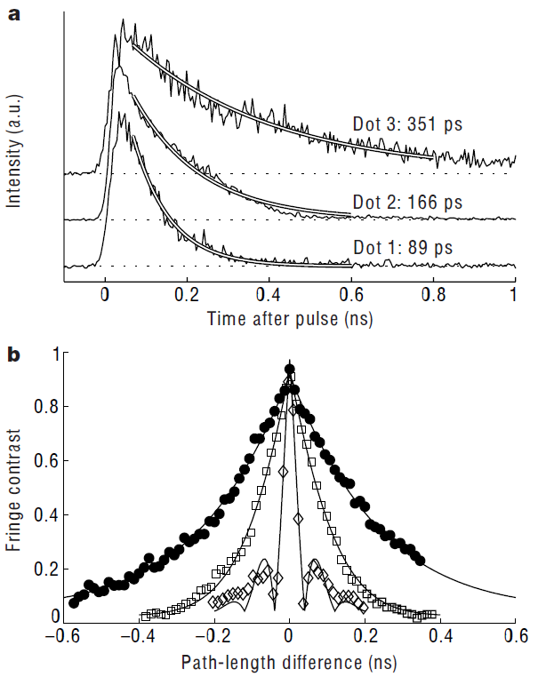
Single photon source measurements
QDs have 2 more properties that significantly effect the DOI
Spontaneous emission lifetime $τ_{s}$
Coherence length $τ_{c}$
$τ_{s}$ is measured for each QD by camera
$τ_{c}$ is measured using a Michelson Interferometer
Same properties as Mach-Zehnder
At each fraction of ns scale $Δt$ the path is fine tuned at $λ$ scale to scan visibility
An ideal source would have: ${2τ_{s}}/{τ_{c}}=1$

