Slide 1
Seeing a single photon without destroying it*
Tali Septon
Igor Khanonkin
*G. Nogues, A. Rauschenbeutel,
S. Osnaghi, M. Brune,
J. M. Raimond & S. Haroche
NATURE vol. 400 (1999)

Slide 2
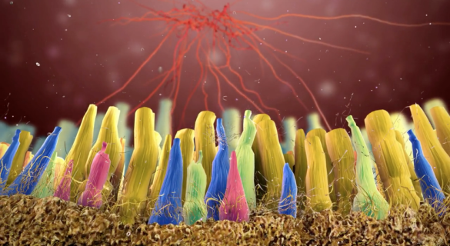
How do we see photons?
Opsins- light-sensitive proteins found in photoreceptor cells of the retina.
Photodiodes, photomultipliers, Pyroelectric photodetectors, Thermal detectors…
Seeing a photon = demolition of photon ?
Not a fundamental limitation !

Slide 3
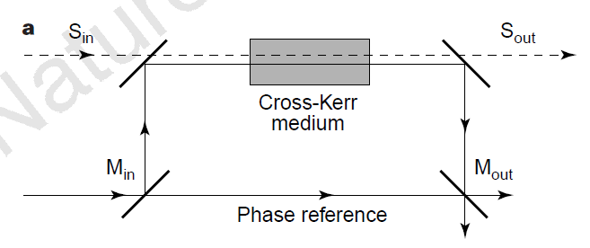
Quantum non-demolition strategies
“overcome the standard quantum limit in experimental detection of an observable”
Some degree of accuracy is required
Preservation of the physical integrity of the measured system
Repeated measurements should give the same result (no uncertainty back action)
Sensitive only to macroscopic photon fluxes, what about a single photon?

Slide 4
1 photon case:
e
Cavity
g
Atom
t=0
|1>
Rabi oscilations:
|g>, v
cos(Ω t/2)|g,1>+sin(Ω t/2)|e,0>
t= w/v
$$\sqrt{π}$$
time of interaction: t=2π/Ω (2π Rabi pulse):
|g,1>
exp(iπ)|g,1>
_______________________________________________________
0 photon case:
|g,0>
|g,0>
_______________________________________________________
e
0 photon case:
Cavity
Ci|i,0>+Cg|g,0>
Ci|i,0>+Cg|g,0>
g
1 photon case:
i
Ci|i,1>+Cg|g,1>
Ci|i,1>+Cg exp(iπ)|g,1>

Slide 5
SP-QND scheme
Cavity
e
g
(0.5exp(iπ)|g>+0.5|i>)
Field
Cavity
|1> or |0>
2π
i
(0.5|g>+0.5|i>)
Field (ν)
π/2
(0.5|g>+0.5|i>)
Field (ν)
π/2
no photon
Ramsey fringes
|g>
1 photon
“Meter” atom

Slide 6
Set-up details
To achieve strong matter radiation coupling we use:
Temperature ~1K:
Rydberg atoms – long natural life-time(~30ms)
High Q cavity- photon life-time (the same order of magnitude as atoms)
Control mechanisms of the system:
Stark shift - tune tinteraction
Eraser pulses – cleaning the cavity before meas.

Slide 7
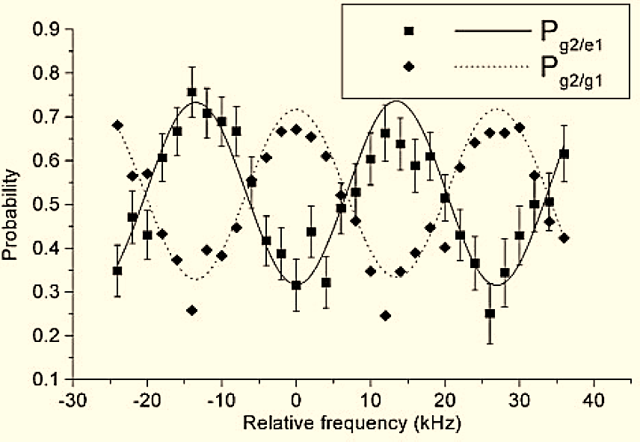
#1 Preparing and detecting one photon
Detecting Source atom:
|e> : no photons left in cavity
|g> : 1 photon left in cavity
π/2 Rabi pulse
.
.
.
2π Rabi pulse
(0.5exp(iπ)|g>+0.5|i>)
Field (ν)
π/2
Field (ν)
π/2
0.5|g,1> + 0.5|e,0>
(0.5|g>+0.5|i>)
P1=P0=50%
|e>
e
|g>
Cavity
“Source”
g
“Meter”
Field
i
The setup is characterized by well resolved
Pa/1 and Pa/0
In a practical measurement the photon number is initially unknown.
We are interested in the reverse probabilities
P1/a and P0/a

Slide 8
#2 Measuring a photon twice
P1,P0: probabilities to have a photon (or not) in C before measurement.
Describes how the information acquired by the meter changes the probability of having 1 photon

Slide 9
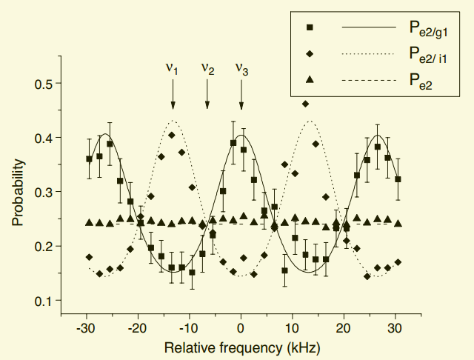
#2 Measuring a photon twice
Small thermal field P1=0.18; P0=0.77
Probability of finding
1 photon in C
= Pe2
2π Rabi pulse
π Rabi pulse
Field (ν)
π/2
Field (ν)
π/2
Short delay in
time
“Meter”
“Probe”
|g2>
The information acquired about the field by the first measurement modifies the probability of finding a photon in C
When the meter finds 1 photon, it does so without destroying it. SP-QND

Slide 10
#3 Repeated single photon measurements
Small thermal field P1=0.18
2π Rabi pulse
ν
ν
π/2
π/2
“Meter”
|g1>
Finding second meter in the same state as the first
is larger than the a priori probability
Short delay in time
At ν1:
“Meter”
Pi1=0.32
Pi2/i1=0.48
|g2>
Ideally: Pi1=0.18; Pi2/i1=1.
predicted by numerical model

Slide 11
Conclusion
Single photon QND measurements
satisfy the criteria of:
Eigen values are well resolved
Non-demolition
Repeatability: photon number probability increases after meter reading

Slide 12
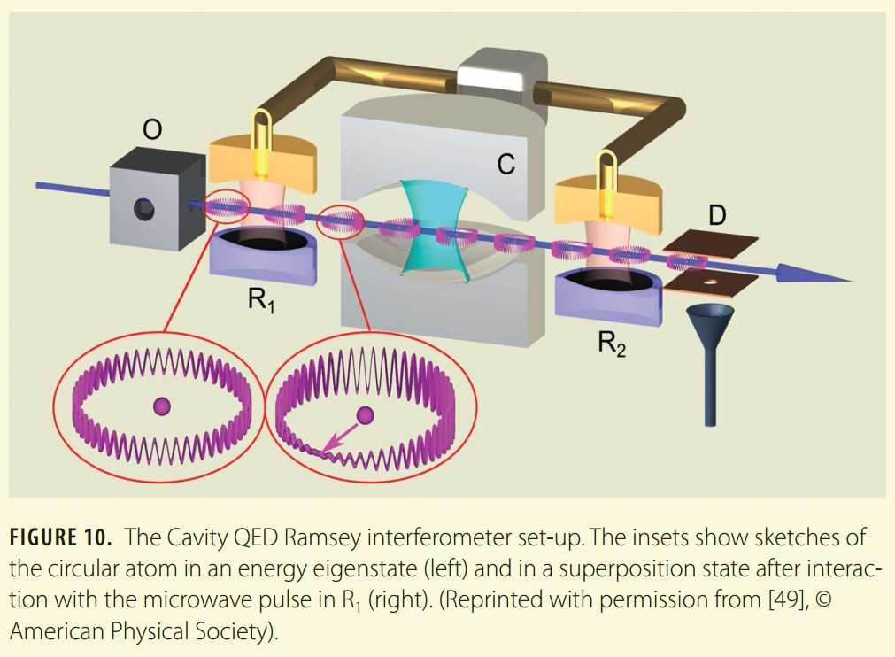
Thank you for your attention!

