Slide 1
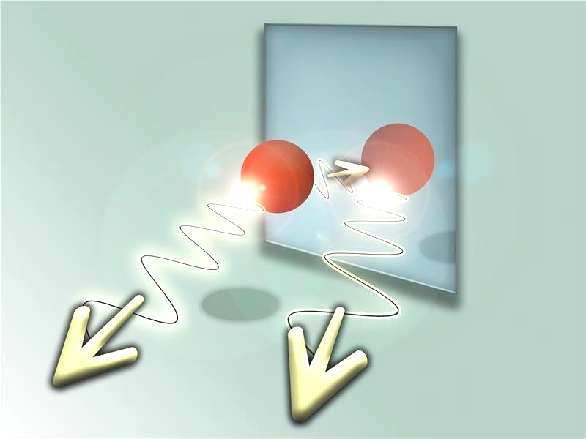
Light interference from single atoms and their mirror images
J. Eschner, Ch. Raab, F. Schmidt-Kaler & R. Blatt
Nature, 2001
Presented by: Yaniv Kurman & Shai Tsesses

Slide 2
Introduction and motivation
The semester taught us that spontaneous emission is not coherent, and therefore cannot create an interference pattern.
However, If we could have interference inside the emitter:
How can we tell?
How would that change the emission?
Can two emitters interact this way?

Slide 3
Experimental setup – Resonance fluorescence
Transmit 650nm
Mirror location is the only
tunable parameter

Slide 4
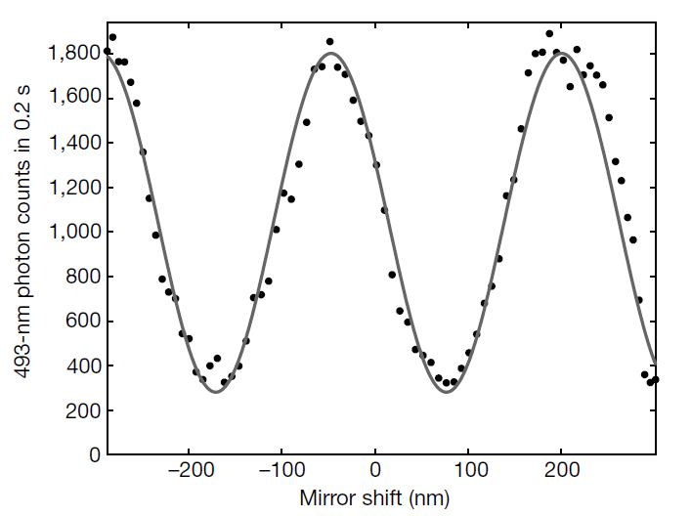
How does the spontaneous emission look like?
Classical interference – autocorrelation of a field
$$λ /2=246nm$$
$$I={\left|E\left(t\right)+E\left(t−τ\right)\right|}^{2}=2{\left|E\left(t\right)\right|}^{2}\left(1+Re\left[g_{1}\left(τ\right)\right]\right)$$
$$g_{1}\left(τ\right)=\frac{\left\langle E\left(t\right)\right.\left.E^{∗}\left(t−τ\right)\right\rangle }{{\left|E\left(t\right)\right|}^{2}}$$

Slide 5
Optical Bloch equations (OBE) - Reminder
Two level atom Description
$$ψ=c_{g}ψ_{g}+c_{e}ψ_{e} ; \hat{ρ}=\left(\begin{matrix}c_{e}c_{e}^{∗} & c_{e}c_{g}^{∗} \\ c_{g}c_{e}^{∗} & c_{g}c_{g}^{∗}\end{matrix}\right)=\left(\begin{matrix}ρ_{ee} & ρ_{eg} \\ ρ_{ge} & ρ_{gg}\end{matrix}\right)$$
Assuming dipole approximation:$\hat{\vec{d}}= \left\langle i\left|\vec{d}\left(\hat{σ}+\hat{σ}\text{†}\right)\right|f\right\rangle$
RWA - The emitted field corresponds to $\hat{σ}=\left|g\right\rangle \left\langle e\right|$=$\left(\begin{matrix}0 & 0 \\ 1 & 0\end{matrix}\right)$
Description of spontaneous decay (decay of population, not coherence):
$∂_{t}\hat{ρ}=−\frac{i}{ℏ}\left[{\hat{H}}_{At}+{\hat{H}}_{int},\hat{ρ}\right]+Γ_{0}$ D$\left[σ\right]\hat{ρ}$
Lindblad super operator : D$\left[σ\right]ρ$= $−\frac{1}{2}\left[σ^{†}σρ+ρσ^{†}σ−2σρσ^{†}\right]$

Slide 6
Describing interference using OBE
$$ϕ,C_{2}$$
Separate into angles:
$Γ_{0}$D$\left[σ\right]ρ={\left(\dot{ρ}\right)}_{diss}=−\frac{1}{2}\sum_{n}{C_{n}^{†}C_{n}ρ+ρC_{n}^{†}C_{n}−2C_{n}ρC_{n}^{†}}$
$$τc/2$$
Without the mirror :$C_{1}=C_{2}=\sqrt{ϕΓ_{0}}\hat{σ},C_{3}=\sqrt{\left(1−2ϕ\right)Γ_{0}}\hat{σ}$
Adding the mirror results in operator superposition (Interference):
$$C_{1},C_{2}→ C_{12}=C_{1}+e^{−iωτ}C_{2}\overset{indistinguishbable}{\overbrace{=}}\sqrt{ϕΓ_{0}}\left(1+e^{−iωτ}\right)\hat{σ}$$
$$ϕ,C_{1}$$
The measureable recombination rate:
$$C_{12}^{†}C_{12}=2C_{1}^{†}C_{1}+2Re\left[{\left(C_{1}e^{−iωτ}\right)}^{†}C_{1}\right]∝2\left\langle {\left|E\left(t\right)\right|}^{2}\right\rangle \left(1+Re\left[g^{\left(1\right)}\left(τ\right)\right]\right)$$

Slide 7
Cooperative effect - Superradiance
Image atom
$$ϕ,C_{2}$$
The tricky part of using the Dicke method is now known
$$S_{k}^{±}=\sum_{i=1}^{N}{S_{i}^{±}e^{±ik⋅r_{i}}}=S_{1}^{±}+S_{2}^{±}e^{±iωτ} ; S_{i}^{−}={\hat{σ}}_{i}$$
$$τc/2$$
$$Γ=Γ_{0}\left\langle s,m\left|S_{k}^{+}S_{k}^{−}\right|s,m\right\rangle =Γ_{0}\left\langle \left(S_{1}^{+}+S_{2}^{+}e^{iωτ}\right)\left(S_{1}^{−}+S_{2}^{−}e^{−iωτ}\right)\right\rangle$$
$$ϕ,C_{1}$$
Again, we claim the two processes are indistinguishable
$$Γ=2Γ_{0}⟨{{(S}_{1}^{−})}^{†}S_{1}^{−}+{{Re[(S}_{1}^{−}e^{−iωτ})}^{†}S_{1}^{−}]⟩$$
$$∝2\left\langle {\left|E\left(t\right)\right|}^{2}\right\rangle \left(1+Re\left[g^{\left(1\right)}\left(τ\right)\right]\right)$$

Slide 8
Interference inside the emitter
$P_{1/2}$ Unpopulated Populated
If spontaneous emission is inhibited – the atom must still be excited!
This can be seen from an increase in other transition rates
Simultaneous recordings

Slide 9
Alternative view – Purcell effect
The rate of spontaneous emission:$Γ=\frac{2π}{ℏ}d^{2}E^{2}ρ(ω)$
If we place the emitter at a node\antinode of the modes created by the mirror, spontaneous emission will be drastically altered!
Accounting for the measurement error, this allows locating an atom with better accuracy than the size of its ground state wavepacket!

Slide 10
Localization of atoms
The maximum slope of the interference in the experiment is
$$S=\frac{4πVi_{s}τ}{λ}$$
$V$ is the visibility; $i_{s}$ is the average count number per time τ and $λ$ is the wavelength.
Assuming mostly shot noise error, $Δ\left(i_{s}τ\right)≈\sqrt{i_{s}τ}$, and the localization error in determining the atom’s center is
$$Δx=\frac{Δ(i_{s}τ)}{S}=\frac{λ}{4πV\sqrt{i_{s}τ}}∝\frac{1}{\sqrt{N}}$$
Where $N$ is the number of photons.
This localization error is similar to that of the Photo-Activated Localization Microscopy method, invented 5 years after this article came out (though they are based on different prior information).

Slide 11
Interference between two emitters
Two emitters held and cooled separately, each of them interacts only with the reflected emission from the other
Usually, cooperative effects require the emitters to be really close.
Here, they are more than a million wavelengths away!
These effects are reminiscent of sub- and super-radiance, as the emitters interact through reabsorption of the electromagnetic field

Slide 12
Summary and conclusions
Interference of light can occur inside the emitter, and may allow us to accurately locate single atoms
Cooperative effects between atoms, which are similar in nature to sub- and super-radiance, can occur at a very large distance
There is no real difference between atom-atom interactions and the interaction of atoms and their mirror images
With a fairly similar configuration, using an engineered retro-reflector, it might be possible to engineer specific multiple atom interactions
Can CQED be described as interference of an emitter and its mirror images?

