Slide 1
Spin-Photon Entanglement
Quantum-dot spin-photon entanglement via fre- quency downconversion to telecom wavelength¹
Observation of entanglement between a quantum dot spin and a single photon²
¹ K. De Greve et al., Nature 491, pp. 421–425 (2012)
² W. B. Gau et al., Nature 491, pp. 426–430 (2012)
Yaroslav Don & Dan Cogan
09 August 2017

Slide 2
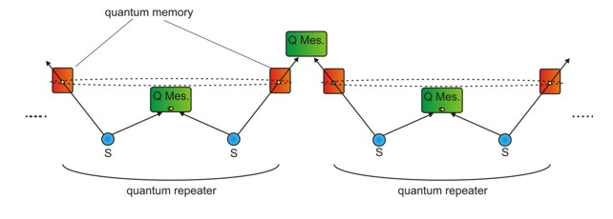
Motivation
Spin-photon entanglement in solid-state
Important for quantum information technology
E.g., a quantum repeater

Slide 3
Agenda
Motivation
Theoretical Background
Spin-photon qubits
Measuring qubits
Entanglement
Semiconductor quantum dots
Experimental Results
The physical systems
Measurement of $g_{2}$
Correlation measurement: computational basis
Correlation measurement: rotated basis (Ramsey)
Fidelity of Entanglement

Slide 4
Qubit: Basics
Superposition of 0 an 1 $$\left.\left|ψ\right.\right\rangle =α\left.\left|0\right.\right\rangle +β\left.\left|1\right.\right\rangle \\ {\left|α\right|}^{2}+{\left|β\right|}^{2}=1$$
Spin Qubit: Bloch Sphere*
Photon Polarization: Poincaré Sphere
$$\left.\left|↑\right.\right\rangle$$
$$H$$
$$i\left.\left|↑\right.\right\rangle −i\left.\left|↓\right.\right\rangle$$
$$B$$
$$\left.\left|↑\right.\right\rangle$$
$$\left.\left|↑\right.\right\rangle −i\left.\left|↓\right.\right\rangle$$
$$ΔE$$
$$\left.\left|↑\right.\right\rangle +i\left.\left|↓\right.\right\rangle$$
$$R$$
$$L$$
$$\left.\left|↓\right.\right\rangle$$
$$\left.\left|↑\right.\right\rangle +\left.\left|↓\right.\right\rangle$$
$$D$$
$$\left.\left|↓\right.\right\rangle$$
$$V$$
* Atom-Photon Interactions – Slava’s notes, Sec. 2.4.6.

Slide 5
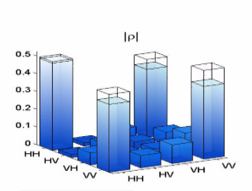
Measuring Qubits – Full Tomography
One Qubit
Two Qubits
Projection on $4$ different bases
Projection on $4×4=16$ bases
Correlation measurements
Extract density matrix $ρ$
$$H$$
$$B$$
$$R$$
$$V$$

Slide 6
Entanglement: Basic Principles
Define a product state $\left|ψ\right\rangle =\left|η\right\rangle ⊗\left|ξ\right\rangle$
A state that cannot be written this way is called “entangled” $\left|ψ\right\rangle =\sum_{i>1}{\left|η_{i}\right\rangle ⊗\left|ξ_{i}\right\rangle }$
In current case: entangle electron spin with photon polarization $\left|ψ\right\rangle =\left|↑\right\rangle ⊗\left|H\right\rangle +\left|↓\right\rangle ⊗\left|V\right\rangle$

Slide 7
Measuring Entanglement – Partial Tomography
$$\left.\left|↑\right.\right\rangle$$
Measure two different bases $\left|ψ\right\rangle = \left|↑\right\rangle \left|H\right\rangle +\left|↓\right\rangle \left|V\right\rangle$ $\left|ψ\right\rangle = \left|←\right\rangle \left|R\right\rangle +\left|→\right\rangle \left|L\right\rangle$
Calculate fidelity of entanglement* $F_{1}=\left(ρ_{H↑,H↑}+ρ_{V↓,V↓}−2\sqrt{ρ_{H↑,V↓}ρ_{V↓,H↑}}\right)/2$ $F_{2}=\left(ρ_{R←,R←}−ρ_{R←,L→}−ρ_{L→,R←}+ρ_{L→,L→}\right)/2$ $F≥F_{1}+F_{2}$
For $F>1/2$, the state is entangled
$$\left.\left|←\right.\right\rangle = \\ \left|↑\right\rangle −i\left|↓\right\rangle$$
$$\left.\left|→\right.\right\rangle = \\ \left|↑\right\rangle +i\left|↓\right\rangle$$
$$\left.\left|↓\right.\right\rangle$$
$$H$$
$$R$$
$$L$$
* B. Blinov et al., Nature 428, 153–157 (2004)
$$V$$

Slide 8
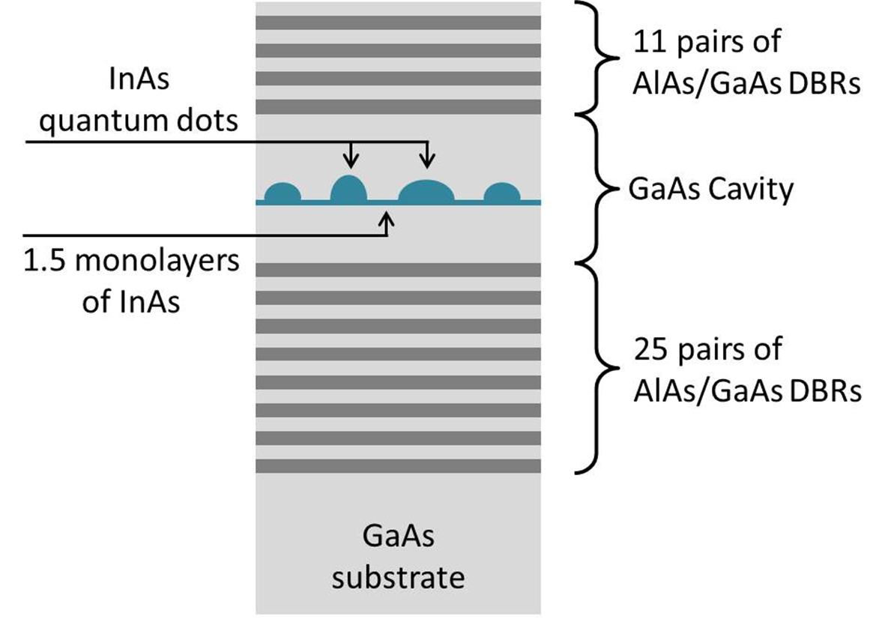
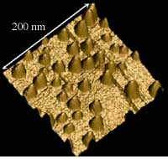
Semiconductor Quantum Dots: Artificial Atoms

Slide 9
Agenda
Motivation
Theoretical Background
Spin-photon qubits
Measuring qubits
Entanglement
Semiconductor quantum dots
Experimental Results
The physical systems
Measurement of $g_{2}$
Correlation measurement: computational basis
Correlation measurement: rotated basis (Ramsey)
Fidelity of Entanglement

Slide 10
Experimental Setup: $Λ$-system
Two degenerate spin states
Lifted by magnetic field (Zeeman)
One “excited” state
Decay paths are polarization dependent
Final state $\left|ψ\right\rangle =\left|↑\right\rangle \left|iH;ω+δω\right\rangle +\left|↓\right\rangle \left|V;ω\right\rangle$
Energy information must be destroyed

Slide 11
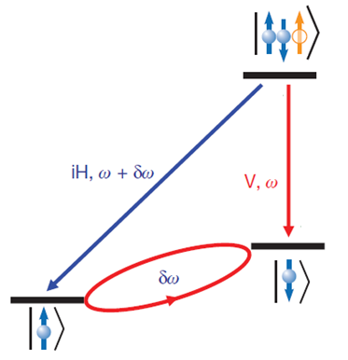
Energy Information Erasure
Article A
Article B
Post-selection by Down-conversion
To 1560 nm by difference frequency generation (2200 nm)
Synchronized with 8 ps pulses
Post-selection by SSPD
Using fast detectors (50 ps)
Recall: $δt δE≥ℏ$
Remove information on energy
Laser: 8 ps
D
8 ps single photon
QD: 600 ps
50 ps
^{A} K. De Greve et al., Nature 491, pp. 421–425 (2012) ^{B} W. B. Gau et al., Nature 491, pp. 426–430 (2012)

Slide 12
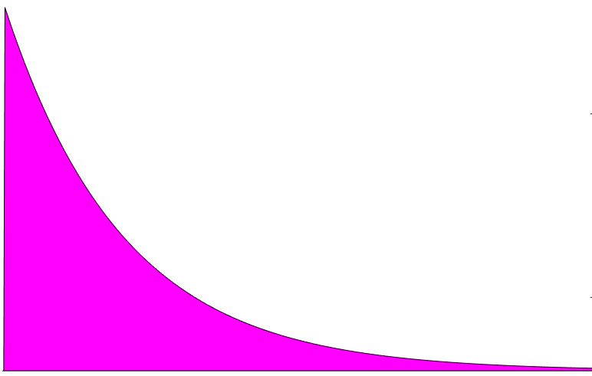
Experimental Scheme
(1)
(2)
(3)
(4)
Initialize spin
Measure photon
Entangle
Measure spin
down conversion
$$Ω_{eff} \left(0,\frac{π}{2},π\right)$$
$$Ω_{eff,π}$$
$$Δt$$
Correlate spin and photon

Slide 13
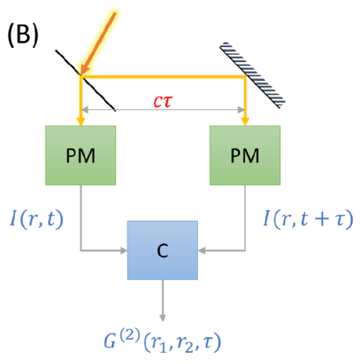
Measurement of $g_{2}$
Definition* $g_{2}\left(τ\right)=𝒢^{\left(2\right)}\left(r,r,τ\right)/{\left|𝒢^{\left(1\right)}\left(r,0\right)\right|}^{2}$
For quantum radiation (anti-bunching), $g_{2}\left(0\right)=0$
Black: raw correlation data
$g_{2}\left(0\right)=0.16$
Green: after background reduction
$g_{2}\left(0\right)=0.02$
* Atom-Photon Interactions – Slava’s notes, Sec. 5.7.

Slide 14
Correlation Measurement: Computational Basis
Classical measurement of a single spin
$\left|ψ\right\rangle =\left|↑\right\rangle \left|H\right\rangle +\left|↓\right\rangle \left|V\right\rangle$
With down conversion
Without down conversion

Slide 15
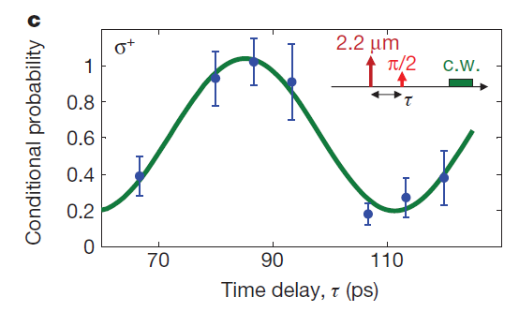
Rotated Basis – Ramsey Measurement
$$\left|ψ\left(0\right)\right\rangle =\left|↑− i↓\right\rangle \left|R\right\rangle +\left|↑+ i↓\right\rangle \left|L\right\rangle$$
$$\left.\left|↑\right.\right\rangle$$
$$i\left.\left|↑\right.\right\rangle −i\left.\left|↓\right.\right\rangle$$
$$\left|ψ\left(t\right)\right\rangle =\left|↑− ie^{iδωt}↓\right\rangle \left|R\right\rangle +\left|↑+ ie^{−iδωt}↓\right\rangle \left|L\right\rangle$$
$$\left.\left|↑\right.\right\rangle −i\left.\left|↓\right.\right\rangle \\ =\left|←\right\rangle$$
$$\left. \left|↑\right.\right\rangle +i\left.\left|↓\right.\right\rangle$$
$$=\left|→\right\rangle$$
$$R$$
$$\left.\left|↑\right.\right\rangle +\left.\left|↓\right.\right\rangle$$
$$\left.\left|↓\right.\right\rangle$$

Slide 16
Results – Fidelity of Entanglement
Article A
Article B
Post-selection by Down-conversion
$F=0.80±0.08$
Limited by the period of pulse
Post-selection by SSPD
$F=0.67±0.05$
Limited by the photodetector jitter
^{A} K. De Greve et al., Nature 491, pp. 421–425 (2012) ^{B} W. B. Gau et al., Nature 491, pp. 426–430 (2012)

Slide 17
Conclusions
Demonstration of spin-photon entanglement
With two different methods
Requires post-selection
Limits real-world applications (quantum repeaters, etc.)
“It might be true, even though it was published in Nature” – Anonymous

Slide 18
Thank you!

