Slide 1
Fits and Predictions of the HISH ( Holography Inspired
Stringy Hadron ) model
,
with: D. Weissman
Nazareth 2019
,

Slide 2
Old Regge theory
Skyrme model, chrial Lagrangian
Quark model
Hadron phyiscs
Purturbative
Large N
QCD
Light front
Supersymmetry
Lattice gauge
Gauge/gravity duality
Holography inspired stringy hadrons

Slide 3
String/field theory holography versus gravity/FT
The holographic duality is an equivalence between certain bulk string theories and boundary field theories.
Practically most of the applications of holography are based on relating bulk fields ( not strings) and operators on the dual boundary field theory.
This is based on the usual limit of α ‘ 0 with which we go, for instance, from a closed string theory to a gravity theory .

Slide 4
String/field theory holography versus gravity/FT
There is a wide range of hadronic physical observables which cannot be faithfully described by bulk fields but rather require dual stringy phenomena It is well known that this is the case for Wilson, ‘t Hooft and Polyakov lines
We argue here that in fact also the spectra, decays width and scattering amplitudes of
mesons, baryons, exotics and glueballs
can be recast only by holographic stringy hadrons

Slide 5
Introduction
The stringy description of hadrons has been thoroughly investigated during the sixties and seventies. What are the reasons to go back to “square one" and revisit this question?
(i) Up to date properties like the hadronic spectra, their decay width, scattering cross section are hard to get from QCD and easy from certain stringy pictures.
(ii) There is a wide range of heavy mesonic , baryonic and some exotic resonances that have been discovered in recent years
(iii) Holography, or gauge/string duality, provides a bridge between the underlying theory of QCD (in certain limits) and a bosonic string model of mesons and baryons.

Slide 6
IIntroduction
(iv) The passage from the holographic string regime to strings in reality is still a tremendous challenge
(v)Thus there is a challenge to develop a model describing mesons, baryons and glueballs in terms of strings in four dimensions that are inspired by the holographic strings
(vi) up to date we lack a full exact procedure of quantizing a rotating string with massive endpoints.
( We have already accomplished that task)

Slide 7
Outline:
I. A brief review of the HISH model
A. Hadrons in holographic backgrounds and in HISH
B. Mesons - open string between massive endpoints
C. Baryons- open strings between a quark and a di-quark
D. Glueballs –closed strings
E. Exotic hadrons
F. Width of hadronic decays
II. Fitting with PDG data and predictions
A. Spectra of Mesons
B. Spectra of Baryons
C. Glueballs
D. Exotic hadrons
E. Decay Width

Slide 8
Stringy holographic Hadrons

Slide 9
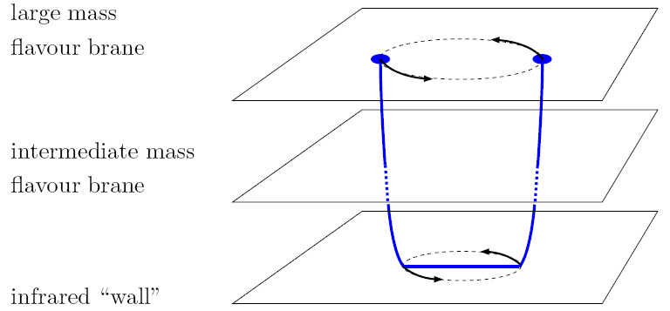
(1) The rotating holographic string meson
The structure of a holographic meson is a string connected to a flavor branes
The string is the classical solution of the Nambu-Goto action defined in confining holographic background

Slide 10
Example: The B meson

Slide 11
(2) Stringy Baryons
How do we identify a baryon in holography ?
Since a quark corresponds to an end of a string, the baryon has to be a structure with N_{c} strings connected to it.
The proposed baryonic vertex in holographic background is is a wrapped Dp brane over a p cycle
Because of the RR flux in the background the wrapped brane has to be connected to Nc strings

Slide 12
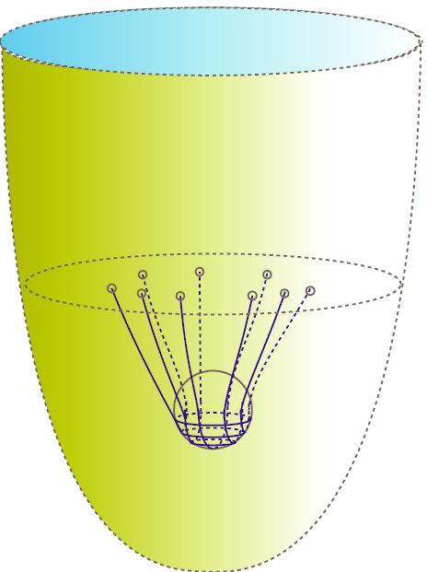
Dynamical baryon
Dynamical baryon – Nc strings connecting the baryonic vertex and flavor branes
boundary
Flavor brane dynami
Wrapped D
brane

Slide 13
A possible baryon layout
A possible dynamical baryon - Nc strings connected in a symmetric way to the flavor brane and to the baryonic vertex which is also on the flavor brane.
boundary
Flavor brane
Baryonic vertex

Slide 14
Nc-1 quarks around the Baryonic vertex
An asymmetric possible layout is that of one quark connected with a string to the baryonic vertex to which the rest of the Nc-1 quarks are attached.

Slide 15
(3) Glueballs as closed strings
Mesons are open strings connected to flavor branes.
Baryons are Nc open strings connected to a baryonic vertex on one side and to a flavor brane on the other one.
What are glue balls?
Since they do not incorporate quarks it is natural to assume that they are rotating closed strings
Angular momentum associates with rotation of folded closed strings

Slide 16
(4) Holographic exotic hadrons
A configuration of a bryonic vertex connected to a u c di-quark and connected to an anti-baryonic vertex which is connected to anti- u and anti- c
c
s
u

Slide 17
Hadrons of the (HISH) Holographic Inspired stringy model

Slide 18
HISH- Holography Inspired Stringy Hadron
The construction of the HISH model is based on the following steps.
(i) Analyzing classical string configurations in confining holographic string models that correspond to hadrons.
(ii) Performing a transition from the holographic regime (for fields) of large Nc and large λ to the real world that bypasses expansions in
(iii) Proposing a model of stringy hadrons in flat four dimensions with massive endpoint particles that is inspired by the corresponding holographic model
(iv)Dressing the endpoint particles with baryonic vertex, charge, spin etc
(v) Confronting the outcome of the models with experimental data .

Slide 19


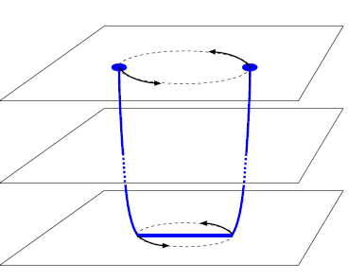
The HISH map of a stringy hadron
The basic idea is to approximate the classical holographic spinning string by a string in flat space time with massive endpoints. The masses are and

Slide 20

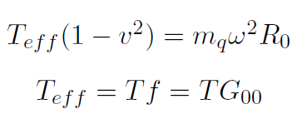

String end-point mass
We define the string end-point quark mass
The boundary equation of motion is
This simply means that the tension is balanced by the ( relativistic) centrifugal force.

Slide 21
HMRT- HISH Modified classical Regge trajectory
For strings with massive endpoints one determines the solution of the classical EOM that corresponds to a rotating string
The classical energy and angular momentum

Slide 22
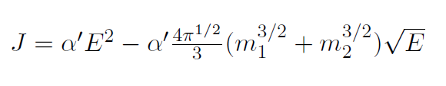
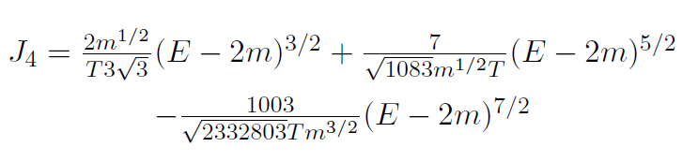
Small and large mass approximations
We can get a direct relation in the limits of
Small mass
Large mass

Slide 23
Holographic mesons and glueballs and their map

Slide 24
(ii) The HISH Baryons

Slide 25
On the quantization of the HISH
The passage from the classical to quantum bosonic string with no massive endpoints in D=26 is
For the excited states with excitation number n
a the intercept is given by the Casimir energy

Slide 26
Quantum modified Regge trajectory
With massive endpoints the intercept is modified
The modified intercept changes the trajectory
For the massless case that goes back to the usual liner Regge trajectory

Slide 27
The intercept for a string with massive endpoints
The eigenfrequencies for a static massive string
q=m/TL
We computed the intercept using a contour integral
We use a contour integral method to compute a

Slide 28
The negative intercept assumption
In nature the intercept associated with all the hadrons whether mesons or baryons is negative when it is defined in relation to the orbital and not the total angular momentum.
For instance ρ has a 0.5 and S=1 s so for L=J-S we get a= -0.5
The attempt to explain this universal feature is probably the most important problem of the hadronic spectra.
To account for it we study strings with different masses, electric charges and spins at their ends.
We can get negative intercept but not yet in a fully satisfactory manner
At present we take it as one of the HISH ingredients

Slide 29
Closed strings versus open strings
The spectrum of states of a closed string admits
The spectrum of an open string
The slope of the closed string is ½ of the open
The closed string ground states has
The intercept is 2 that of an open string

Slide 30
Decay width of Stringy holographic and HISH Hadrons

Slide 31
The decay of a long string
The decay of a hadron is in fact the breaking of a string into two strings
A type I open string can undergo such a split
A split of a string with massive
massive Endpoints

Slide 32
The decay of a long string in critical flat space-time
The total decay width is related by the optical theorem to the imaginary part of the self-energy diagram
A trick that Polchinski et al used is to compactify one space coordinate and consider incoming and outgoing strings that wrap this coordinate so one can avoid an annulus open string diagram and instead compute a disk diagram with simple vertex operator of a closed string

Slide 33
The string amplitude
closed
closed
Vertex operator

Slide 34
The decay of a long string in critical flat space-time
We would like to determine the dependence of the string amplitude on the string length L
open string
coupling
Gravitational
coupling
Vertex operator
Zero mode
Normalization
Of the vertex

Slide 35
The decay of a long string in flat space-time
After substituting into the integral the amplitude yields
The imaginary part
Using Stirling approximation
regulator
regulator

Slide 36
Check of the linear dependence on L
The final result for long strings is a linear dependence on the length L
For short strings with important role of the massive endpoints we add a phase space factor
The phase space factor

Slide 37
The suppression factor for stringy holographic hadrons
The horizontal segment of the stringy hadron fluctuates and can reach flavor branes
When this happens the string may break up , and the two new endpoints connect to a flavor brane

Slide 38
Determination of the suppression factor
Assuming first that the string stretches in flat space-time we found using both a string beads model and a continues one that
= Const
There are further corrections due to the curvature and due to the massive endpoints.
Γ=

Slide 39
Part 2:
Fits of the HISH model to the experimental data and predictions about yet undiscovered states.

Slide 40
Fits and predictions of the HISH model
Next we compare the predictions of the HISH model with the PDG data. We extract the optimal values of the tension ( or α’) , endpoints masses, and intercepts
We determine the chi square of the fits of the spectra
Mesons
Baryons
Glueballs
Exotic Hadrons
We fit the total decay width of hadrons including Zweig suppressed decays
We determine branching ratios

Slide 41
Fits of Mesonic Spectra and Predictions for higher excited states

Slide 42
The Fits of the meson trajectories

Slide 43
Fitted trajectories of mesons

Slide 44
Fitted trajectories of mesons

Slide 45
Fitted trajectories of mesons

Slide 46
Fitted trajectories of mesons

Slide 47
Fitted trajectories of mesons

Slide 48
Fitted trajectories of mesons

Slide 49
Fitted trajectories of mesons

Slide 50
Fitted trajectories of mesons

Slide 51
Fitted trajectories of mesons

Slide 52



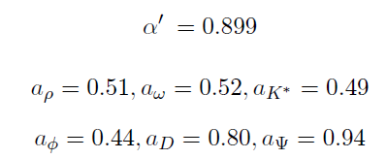
Toward a universal model
The fit results for several trajectories simultaneously. The trajectories of
We take the string endpoint masses in MeV
Only the intercept was allowed to change. We got

Slide 53
Optimization in the m α’ plane : s quark

Slide 54
Comments of light mesons
The trajectories of mesons containing u and d quarks are nearly linear.
For mesons with strange quarks there are significant deviations from linearity.
The strength of the HISH model - it describes well hadrons with light-light and light-heavy quarks.
The pion is notable as a meson that does not reside exactly on his trajectory probably since it is a goldstone boson but all his partners do.
Similar story occurs with the pseudo scalar Kaons
There is a puzzle with the K3 and K4 that should be according the model lighter than those discovered
The K* furnish nicely a HMRT

Slide 55
Light-Heavy mesons
For mesons with one heavy ( c or b) quark and one light ( u/d or s) the HMRT works well.
We have trajectories of including their decay width and also for .
We have predictions for higher excited states
We can assign quantum numbers for states that were discovered but not fully identified. For instance and should be states,

Slide 56
Charmonioum and Bottomonioum
The spectrum of quarkonia has be extensively studied
Here we see some deviations from the light quark trajectories. For still the slope is for aaaaa but for . For the slopes are .
For heavy quarkonia the HISH approximation of the holographic hadrons is not as good as for the light ones.
The reason for the disparity between the slopes of the trajectories of and is that for the latter the spectrum eigenvalues are wn and not n anymore
The Bc state with interpolates between the charmonioum and botomonium slopes.

Slide 57
Predictions on mesons with higher J

Slide 58
Predictions on excited mesons with higher n

Slide 59
(2) Fits of Baryonic Spectra and Predictions

Slide 60
Trajectories of N and

Slide 61
Trajectories of and

Slide 62
Trajectories of

Slide 63
Trajectories of and

Slide 64
Predictions on baryons with higher J

Slide 65
Predictions on excited baryons with higher n

Slide 66
On the Ω spectra
The spectrum of the excited Ω baryons sss could have helped us to determine the mass of the ss di-quark directly, but there is not much data on the excited states.
Our model predicts the first orbitaly excited state of the Ω to have a mass of around 2050 MeV, but there is no confirmed state there.
The states that are known - Ω(2250), Ω(2380), and Ω(2470) - could be higher excitations. The Ω(2380) is at the right mass for the
One possibility is that the Ω trajectories exhibit the same even-odd effect as the N and ∆. Then, one might claim that there is no missing state, and the Ω(2250) as the belongs to a separate trajectory

Slide 67
Charmed Baryons
The charmed baryons have trajectories with 3 and 2 states with the same slope as of the light baryons.
On the states are confirmed. The state found fits the first excited state of
Recently 5 narrow resonances of ( css ) were discovered. Their masses fit the HISH predictions for the first orbital excited states of gs.
The di-quark of the is ( cs) or (ss) . The fits prefer the (cs) option. We have predictions for both.

Slide 68
Doubly charmed baryons
For doubly charmed baryons only the gs of are listed in the PDG. The status of the former is uncertain so we use only the later,
The di-quark could be (cu)/(cd) or (cc). In the former case we have two mc masses on both sides of the string and in the later one light mass and one (cc) di-quark mass which depends on the location of the baryonic vertex.
We may estimate the decay width of the excited states from that of a single charm baryon states
The first excited state will decay to the gs plus pions.
The second excited state will be able to decay to a charmed meson and a charmed baryon we estimate the width to be around 20 Mev.

Slide 69
Bottom Baryons
The spectra of the excited states of bottom baryons is largely unexplored.
The only confirmed excited state is the of the gs
The corresponding slope is the universal one for baryons
We predict the excited states of
Recently has been discovered. Its mass is slightly higher than our prediction 6060. It can be identified as a 1P state.
LHCB has found recently a state of which can either be 1P or 2S.

Slide 70
(3) Fits and predictions of Glueball States

Slide 71
Fits of ( potential ) glueball spectra
A rotating and exciting folded closed string admits in flat space-time a linear Regge trajectory
=
The basic candidates of glueballs are flavorless hadrons f0 of 0++ and f2 of 2++. There are 9 (+3) f0 and 12 (+5) f2.
The question is whether one can fit all of them into meson and separately some glueball trajectories.
We found various different possibilities of fits.

Slide 72
Possible scalar glueball trajectories

Slide 73
Gluebal trajectory built on the 980 gs
Scalar glueball trajectory with the 980 gs
The 980 state can potentially be a bound state
So probably the more reliable glueball gs are the 1370 and the 1500.

Slide 74
Gluebal trajectory built on the 1370 gs
Assignment with f0(1380) as the glueball ground-state

Slide 75
Glueball 0++ fits of experimental data
The meson and glueball trajectories based on f0(1380) as a glueball lowest state.

Slide 76
Tensor glueballs f 2++
The meson and glueball trajectories of the f2++

Slide 77
On the identification of glueball trajectory
Unfortunately there exists no unambiguous way to assign the known flavorless hadrons into trajectories of mesons and glueballs,
But it is clear that one cannot sort all the known resonances into meson trajectories alone.
One of the main problems in identifying glueball trajectories is simply the lack of experimental data, particularly in the mass region between 2.4 GeV and the cc threshold, where we expect the first excited states of the glueballs to be found.
It is because of this that we cannot find a glueball trajectory in the angular momentum plane.

Slide 78
(4) Fits and predictions of “Tetra quarks” and other exotics

Slide 79
Exotic configurations.
We can have alternative ways to connect the baryonic vertex with strings to flavor branes and thus getting exotic hadrons.
Obviously one has to perform a stability check to such configuration.
One possibility is to connect the baryonic vertex to an anti-baryonic vertex thus forming a “ tetra quark”

Slide 80
Holographic tetra quark
A configuration of a bryonic vertex connected to a u c di-quark and connected to an anti-baryonic vertex which is connected to anti- u and anti- c
c
s
u

Slide 81
Decays of the tetra quarks
The tetra quark can naturally decay into a by baryon anti-baryon tearing apart the string that connects them and creating a quark anti quark pair
For instance a creation of a d anti-d pair at the endpoints of the torn apart string between a baryonic vertex that connects to a uc di-quark and a similar anti- baryonic vertex we get a pair of Λc and anti Λc
u
u
c
c
Λ
Λ
c
c

Slide 82
Predictions of charmed tetra quarks
Based on the Y(4630) that was observed to decay predominantly to . If we assume that it is on a Regge-like trajectory and we borrow the slop and the endpoint masses from the trajectory we get
The gs is 1-- thus easy to create in e+ e- collisions

Slide 83
Predictions for the trajectory of bottom tetra quarks
In a similar manner we predict a trajectory of Yb tetra quark that decays predominantly to

Slide 84
(5) Predictions about the decay width of strong hadronic decays

Slide 85
A test case: The K
We compare our model to the decays of K* trajectory

Slide 86
test case: The K*

Slide 87
Fit results: the meson trajectories
Fits of the decay width of other Mesons

Slide 88
Fit results: the meson trajectories

Slide 89
The decay width of baryons
For baryons the linearity with L is somewhat modified.

Slide 90
Exponential suppression of pair creation
The ratio of the decay width to a strange pair versus to a light quark pair is
In radiative decays

Slide 91
Decays of glueballs
Recall that the width of the decay of a meson into two mesons is
In a similar way the width for the decay of a glueball into two mesons is
Thus we get the following hierarchy for the decay of glueballs

Slide 92
Summary and Outlook

Slide 93
Ask HISH
If you encounter physics phenomena of Hadrons that has to be explained or quantitative calculation of certain properties.
Ask HISH
We may be able to provide an answer
HISH can hint where to look for new physics within the standard model: for instance glueballs and exotic hadrons

Slide 94
Summary and outlook
Hadron spectra fit much better strings in holographic backgrounds rather than the spectra of bulk fields like fluctuations of flavor branes.
Holographic Regge trajectories can be mapped into trajectories of strings with massive endpoints.
Heavy quark mesons are described in a much better way by the holographic trajectories ( or massive) than the original linear trajectories.
Even for the u and d quark there is a non vanishing string endpoint mass of ~60 Mev.

Slide 95
Summary and outlook
Baryons are also straight strings with tension which is the same as the one of mesons.
The baryonic vertex is still mysterious since data prefers it to be massless.
Glueballs can be described as rotating folded closed strings
Open questions:
Quantizing a string with massive endpoints
Accounting for the spin and for the intercept
Scattering amplitudes of mesons and baryons like (proton-proton scattering)
Nuclear interaction and nuclear matter
Incorporating leptons….

Slide 96
Decays of glueballs versus mesons

Slide 97
Zweig suppressed decays and the string length
The probability of a meson to decay via annihilation of the quark and antiquark
The decays of upsilon

Slide 98
Predictions for glueballs
Glueballs are closed strings. They form linear trajectories with the slope of
Unfortunately there are only few confirmed flavorless hadrons with higher J and higher n.
When we use the glueball slope we can fit at most 2 points. Higher points are already in a mass range where not much states have been confirmed.
We can predict the locations of the higher glueballs and their width based on

