Slide 1
Longitudinal coherence in astronomy
Erez N Ribak
with
S G Lipson and E Schwartz
Technion – Israel Institute of Technology
SPIE (2006) 6268-160
Astronomical Journal (2012) 144, 71
Submitted paper (2015)
Supported in parts by the Israel Science Foundation and Ministry of Science
Quantum Astronomy and Stellar Imaging, Sydney 2015

Slide 2
Astronomical temporal coherence
Some objects are more coherent than others (lasers vs. white light)
Lateral coherence is used to size out stars, atmospheres, etc.
Longitudinal coherence is never measured as such
Two main questions:
  Is it interesting to measure the temporal coherence? What kind of sources are we looking at? Looking for?
  How do we measure temporal coherence? Can we use existing instrumentation? Do we need to build new tools?

Slide 3
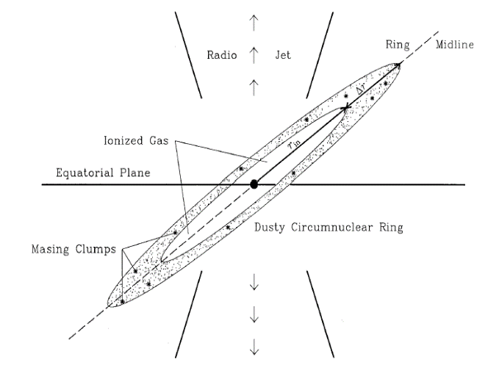
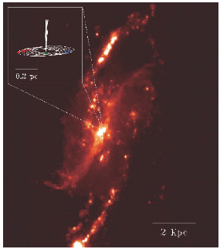
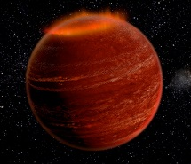
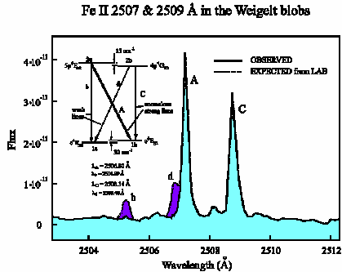
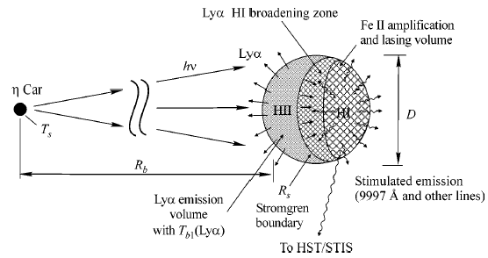
Possible sources of temporally coherent light
  Clouds, blobs, star forming regions
  Quasars, microquasars
  AGN disks
  Wolf-Rayet stars
  Protoplanetary nebulae
  Supernova remnants
  Comets in the solar system
  Planets’ aurorae
  Free electron masers in solar flares
  Masers, λ 12 μm
Jet in NGC 4258
Black hole in NGC 1068
Hallinan et al: brown dwarf corona
Klimov, Johansson, Letokhov:
2507Å Lyα pumping?
Johansson and Letokhov: 9997Å laser?

Slide 4
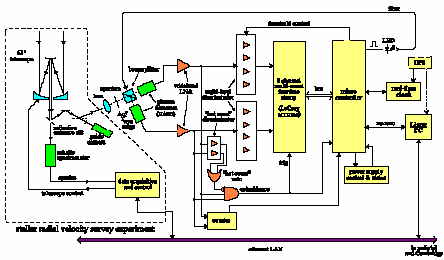
SETI and coherent radiation
Optical search for extraterrestrial intelligence (OSETI)
Looking for pulsed signals, having Poisson distribution
Harvard-Princeton OSETI search: no modulated sources
New design

Slide 5
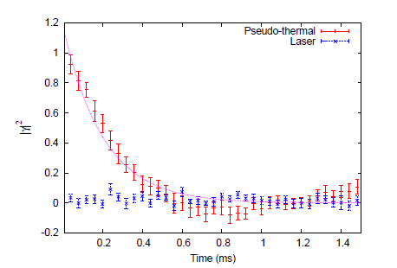
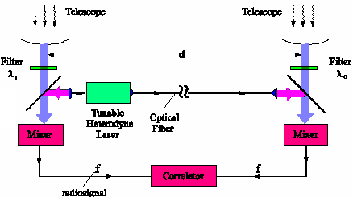
Search for temporal coherence / causality
The hard and safe way: intensity interferometry spectroscopy
Coherence time τ_{c}
Delay
Johansson and Letokhov: Brown-Twiss-Townes intensity-heterodyne
interferometry: similar to radio, but at 1μm
Nuñez: Photon bunching, in a single-aperture intensity interferometer

Slide 6
Search for temporal coherence
The easy way: Simple interferometry, long path difference
beam
splitter
mirror
etalon
2τ
beam
splitter
mirror
2τ
2τ  τ_{c}

Slide 7
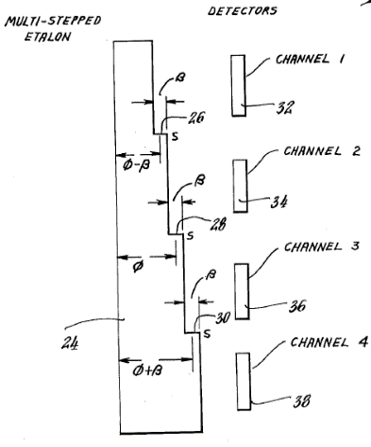
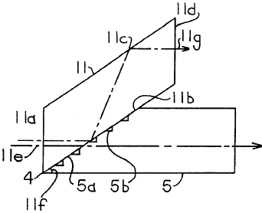
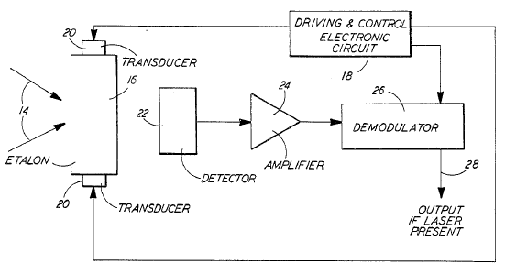
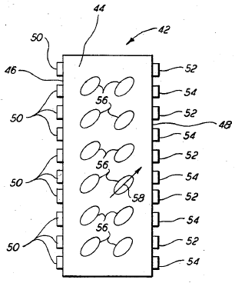
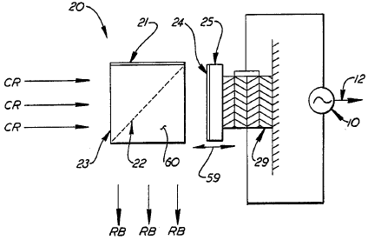
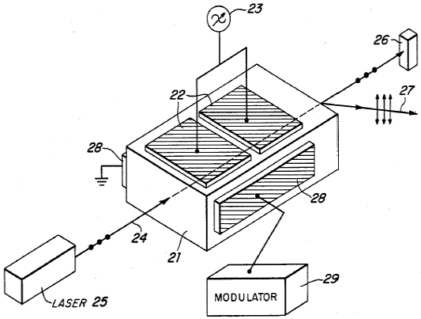
Military laser seekers
Looking for extended coherence in the battle field (unknown laser lines)
polarisation
stepped etalon
acousto-optic etalon
polarisation and acousto-optic
liquid crystal stepped etalon
Michelson and etalon

Slide 8
Coherence survey of the sky
  The whole field is imaged
  at different phase delays
  Coherent objects > 10⁻³ 
  background are detected
  First estimates:
  cover most sky within weeks
  Search for fringes with long path difference
  Spatial mode: slight tilt between beams to form fringes
  Temporal mode: fringe modulation
coherent object
incoherent object
band-pass filter
∗ =

Slide 9
Looking for coherence in specific objects
  Very narrow field around suspect objects
  Coherent objects > 10⁻⁶  background are detected
  With narrow known spectral filters, the limit can be down to 10⁻⁸
  Estimates are based on actual military experiments

Slide 10
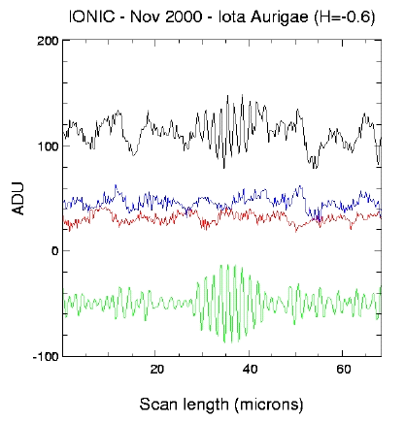
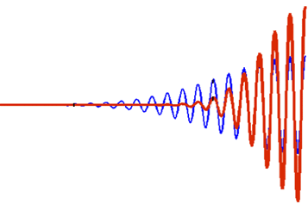
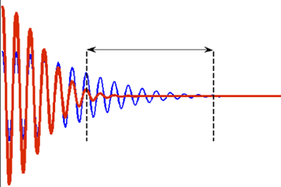
Extended coherence in astronomy
The idea can be used for improving measurements of narrow lines
Many spectral lines are background limited
  Strong background, contributing its noise
  Sloped background, distorting line shape and centre
But narrow lines correspond to higher longitudinal coherence
intensity
wave length
Spectrum
F. T.
measurement
range
intensity
0 path difference
Interferogram

Slide 11
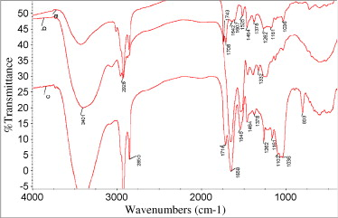
Application: narrow planet lines
To study planets, we wish to look at narrow spectral lines
Complex molecules have lines at ~10 μm – signs of life
Less complex molecules survive at ~1-2 μm
Strong background from
  Star
  Planet
  Atmosphere
  Telescope and optics
Background can be reduced by
  Long-pass filter (remove stellar BB radiation)
  Off-centre interferogram scan (remove wide lines)
FT-IR spectra of
chlorophyll rich fraction L₁
lignin fraction L₂
lignin fraction L₅
[Xu et al. 2007]

Slide 12
Removing the visible “donation”
IR bandpass filter
spectrum
S (λ)
F. T.
wave length λ
fringe
envelope
V (d)
measurement
range
visible and IR
IR only
path difference d
We filter out the shorter wave lengths, to get rid of their Fourier DC signal
This decreases the Poisson noise and reduces the required dynamic range

Slide 13
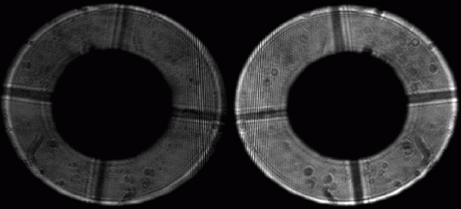
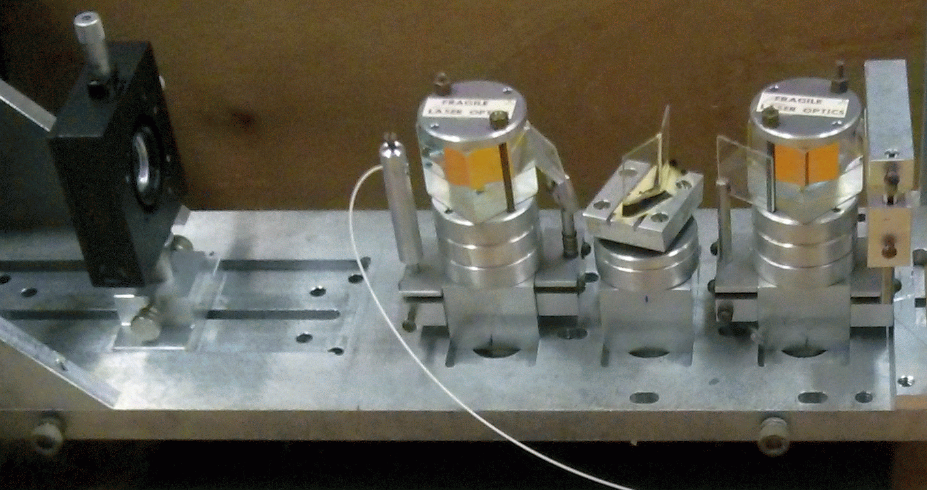
Observatory tests
Wise observatory 1m telescope (visible)
Zero-shear interferometer
(Ribak & Lipson)
set fringes shift
set fringes density
complimentary
aperture images
calibration source
telescope
collimating lens
beam splitter
delay glass
beam combiner
camera

Slide 14
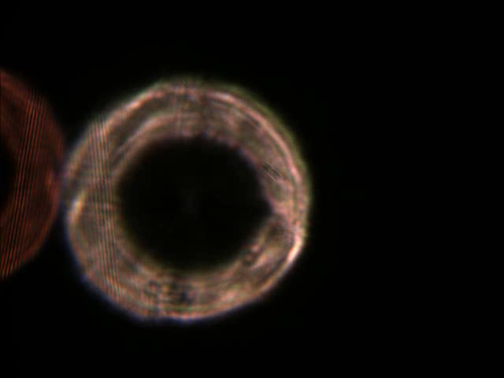
Camera instead of path scan
Star: Arcturus
(no known planet!)
Colour camera focused ~1km above telescope
At zero shear, the external atmospheric phase is immaterial
No slit needed
No scan required

Slide 15
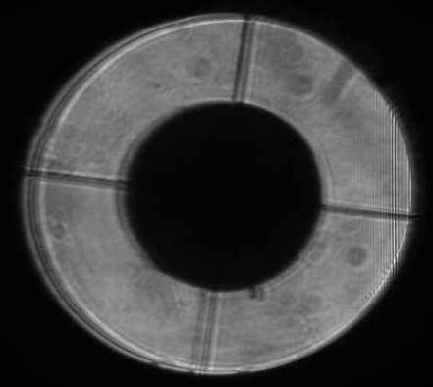
Narrow-line region
Camera focused at telescope aperture
Showing high-altitude turbulence
Stable fringes
Central (Fourier DC) fringes pushed out to measure only narrow lines

Slide 16
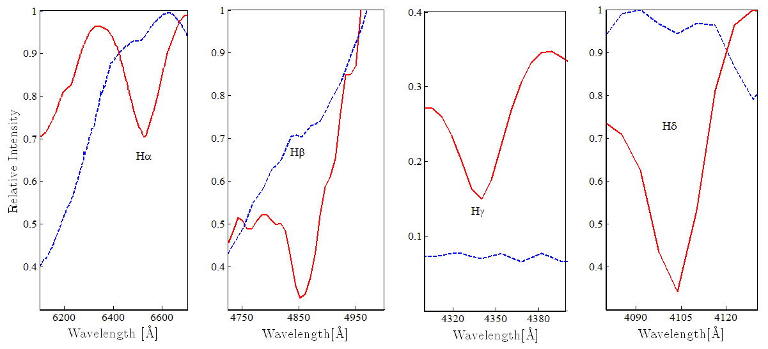
Narrow lines appear
Balmer lines on Deneb:
The broken blue lines signify the full spectrum with the zeroth fringe inside the telescope aperture.
The full red lines display the spectrum when using only the long-delay section of the interferogram.

Slide 17
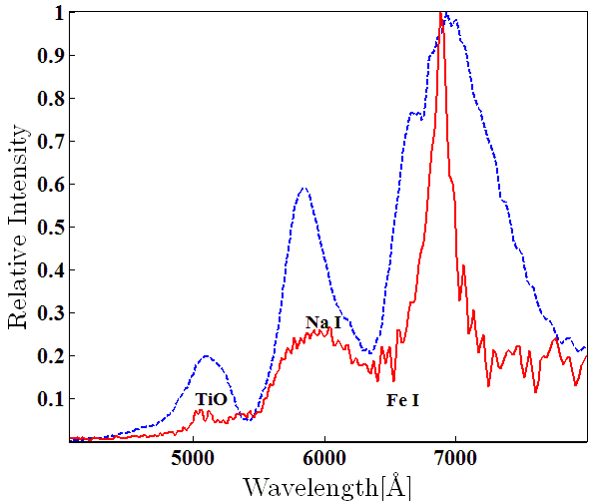
Betelgeuse spectrum: narrow lines revealed
Molecular and atmospheric lines not visible with central Fourier spectrum
Gain factors range between 2 and 20, even for a few micron delay
The off-centre spectrum serves as a high-pass filter
All narrow lines are enhanced, even unknown ones on exoplanets
full spectrum
partial spectrum

Slide 18


Search for exo-planet bio-lines
PROs | CONs
Star-planet spatial separation not necessary | Signal drops with star-planet distance
Scan-less, slit-less, stable spectrometer | Requires 2D detector (1D possible)
Stellar, planetary continua rejected | Background noise spreads all over
Detects directly life signals | Unknown levels of bio-signal, albedo
Molecular spectra not required | Most lines are in the infra-red, λ>4μm
Lower infra-red star/planet ratio | Telluric lines interfering
 | Annual variability; unknown period

Slide 19
The next step
It is difficult to observe at 8-12μm:
  Scarcity of telescopes and instrumentation
  Atmospheric and telescope noise
Before thinking about space, we wish to test the method at 0.9-1.7μm:
  Stellar atmospheric lines to be used as Doppler indicators (radial velocities)
  Accessible at most telescopes
Redesigned the interferometer
  Different optics
  New IR cameras (video rate, require summation)
  Possibility of additional cross-dispersion (channeled spectra) to increase R

Slide 20
Summary
Longitudinal (temporal) coherence was hardly used in astronomy
The method allows detection of coherent sources in large fields
Off-centre fringes serve as a high-pass filter, enhance narrow lines
Tests in the visible proved the method for a narrow field-of-view
The next step: infra-red

Slide 21
Thank you!

